Slide 1
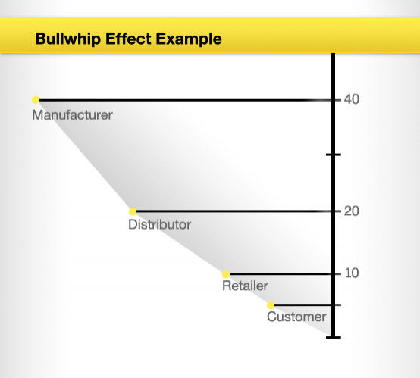

Slide 2
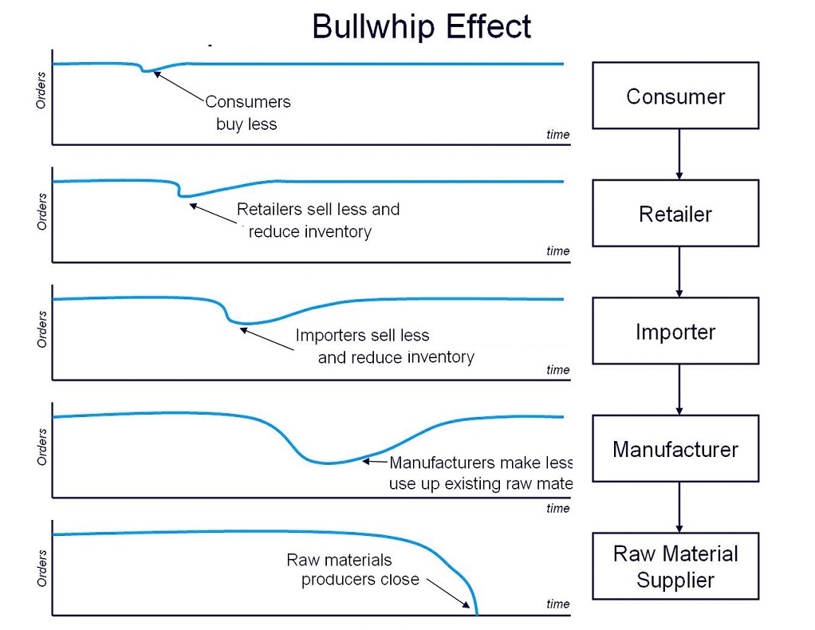

Slide 3
What contributes to the bullwhip effect?
Disorganization between each supply chain link; with ordering larger or smaller amounts of a product than is needed due to an over or under reaction to the supply chain beforehand.
Lack of communication between each link in the supply chain makes it difficult for processes to run smoothly. Managers can perceive a product demand quite differently within different links of the supply chain and therefore order different quantities.
Free return policies; customers may intentionally overstate demands due to shortages and then cancel when the supply becomes adequate again, without return forfeit retailers will continue to exaggerate their needs and cancel orders; resulting in excess material.
Order batching; companies may not immediately place an order with their supplier; often accumulating the demand first. Companies may order weekly or even monthly. This creates variability in the demand as there may for instance be a surge in demand at some stage followed by no demand after.
Price variations – special discounts and other cost changes can upset regular buying patterns; buyers want to take advantage on discounts offered during a short time period, this can cause uneven production and distorted demand information.
Demand information – relying on past demand information to estimate current demand information of a product does not take into account any fluctuations that may occur in demand over a period of time.

