Slide 1
Semester 7 Intercultural Communication
Lecturer
Department of International & European Studies
University of Piraeus

Slide 2
Part one: Culture
What is culture?

Slide 3
Culture
Myriads of definitions
A very powerful force in our lives.
Determines our experiences & meanings we give to them
Influences the way we communicate & and how we are perceived by audiences
The pragmatic: the way we do things around here
The academic: a shared system of assumptions, values and beliefs of people which result in characteristic behaviours

Slide 4
To the sociologist:
Culture is everything we are socialized to do, think, use and make.
(keyword: learning a primary culture)

Slide 5
Values:
Socially shared ideas about what we consider to be good, desirable, or important in life.
The values of a society form the basis of its rules, or norms.

Slide 6
Norms:
Define what is socially acceptable or unacceptable behaviour in particular social situations.

Slide 7
Types of Culture
Corporate culture
Professional culture
Gender culture
Age culture
Religious culture
Regional culture
Class culture

Slide 8
Multicultural vs Intercultural
Multicultural refers to nations that have diverse cultural groups (eg. As a result of immigration). Multiculturalism refers to the existence, acceptance and/or promotion of multiple cultures.
Intercultural refers to diversity among separate nations
Monoculturalism- melting pot
Multiculturalism- salad bowl

Slide 9
Key Terms
Enculturation
Acculturation vs Assimilation (https://study.com/academy/lesson/acculturation-vs-assimilation-definition-examples.html)

Slide 10
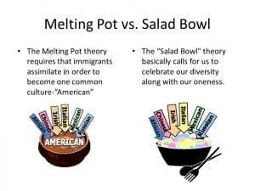
Identify acculturation and assimilation in this picture:

Slide 11
Questions to brainstorm upon
What are culture/values/norms?
What are the benefits of understanding a particular culture?
How does culture affect communication?

Slide 12
What are the benefits of understanding a particular culture?
Significant business advantage
Not understanding a culture could lead to disaster/misunderstanding/miscommunication/dispute/conflict
Unless you know how a culture works, you may easily become frustrated

Slide 13
How does culture affect communication? Layers of cultural behaviour/the culture iceberg analogy
Front stage cultural behaviour/surface elements
Back stage cultural behaviour/deep under the surface elements
https://www.youtube.com/watch?v=woP0v-2nJCU

Slide 14
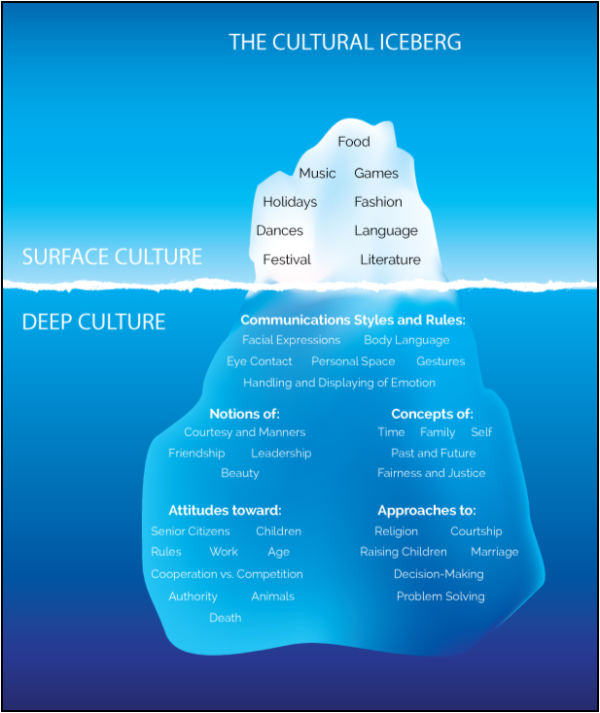

Slide 15
Intercultural Competence
Consists of two main elements:
Cultural knowledge
Cultural skills

Slide 16
ICC- Intercultural Communication Competence can
End dispute
Save lives
Radically transform the existence of millions of people
Lubricate the wheels of industry and business
Help teams win (e.g. sports teams, international aid teams)
Assure your overall success in communicating with individuals from diverse origins and ethnicities

Slide 17
Critical Incidents
Situations which create misunderstanding, problem or conflict resulting from cultural differences, interaction between parties or a program of cross-cultural adaptation and communication.

Slide 18
Cultural Briefing
The process of finding out about another country, especially in preparation for a period of residence, a business trip or a holiday (Utley, 2004)
What cultural elements do you think would be included in a cultural briefing?

Slide 19
High versus Low Context- The Hall Model
High context culture Speak indirectly Meaning is indirect, implied and derived from the context Information is either in the physical context or internalised in the person Show respect Maintain harmony/conflict is avoided Avoid saying “No” Rude to be too direct Save face Much is taken for granted Non-verbal communication Process-focused Relationship/trust builds over time Time polychronic | Low context culture Speak directly, to the point, without adding unnecessary details or formulae Verbal abilities are highly valued Logic and reasoning are expressed in verbal messages Suspicious who speak indirectly Very little is taken for granted Focus on verbal communication Results (tasks) focused Fast build relationships Individually oriented Time monochronic Literal meanings independent of context/setting What you hear is what you get Conflict is ok “No” is easily said

Slide 20
High versus Low Context- The Hall Model
High context cultures Japanese Arabs Most Latin American cultures American Indian Italians Chinese Korean Southern and Eastern Mediterranean cultures (Greece, Turkey and Arab states) African Afghans Brazilians French Hungarian Irish Thai (British) | Low context cultures Swiss Germans Scandinavians North Americans (Uniter States, Nordic States) Dutch Australian Finnish Israeli Switzerland
Hi High context culture
Speak indirectly
Meaning is indirect, implied and derived from the context
Show respect
Maintain harmony/conflict is avoided
Rude to be too direct
Much is taken for granted
Non-verbal communication
Process-focused
Relationship builds over time
Time polychronic
Low context culture
Speak directly, to the point, without adding unnecessary details or formulae
Suspicious who speak indirectly
gh context culture
Speak indirectly
Meaning is indirect, implied and derived from the context
Show respect
Maintain harmony/conflict is avoided
Rude to be too direct
Much is taken for granted
Non-verbal communication
Process-focused
Relationship builds over time
Time polychronic
Low context culture
Speak directly, to the point, without adding unnecessary details or formulae
Suspicious who speak indirectly

Slide 21
Monochronic vs Polychronic Cultures
Polychronic People prefer to do many things at the same time | Monochronic People like to do things one at a time and in sequence

Slide 22
Non-Verbal Communication
High vs Low Territoriality
Posture
Face and Eyes- Occulitistics
Voice
Clothing
Proxemics-Distance Zones-personal space
Chronemics –Time
The role of silence- Turn-taking

Slide 23
The Influence of Culture
Etiquette
Folkways
Norms (strong norms-taboos)
Mores & Laws

Slide 24
Paralanguage
It is the language spoken that consists of vocalisations other than words (Adler & Elmhorst 1993)
Vocal qualifiers (pitch, range, articulation, rhythm, volume, resonance, tempo)
Vocalisations (fillers inserted between sentences to help the speaker move on to the next thought)

Slide 25
Barriers to Intercultural Communication
As learning the norms of all cultures and subgroups would be an impossible task, LaRay M. Barna has come up with a list of six general barriers:
anxiety
assuming similarity instead of difference
ethnocentrism
stereotypes and prejudices
nonverbal misinterpretations
language

