Slide 1
Introduction to chartering
Lecture 1

Slide 2
Shipping & Chartering
Chartering refers to hiring a vessel or part of it for the purpose of transporting cargo by sea.
Chartering may take place for any type of ship: bulk carriers, general cargo, tankers and containers – Any type of cargo: bulk, general, specialized cargo.
It is made up of shipowners who wish to charter out transportation capacity and charterers who wish to charter in capacity to perform the transportation service.
The charter market also serves the needs of ship operators, who may not own cargo per se but who operate vessels to provide shipping services.

Slide 3
Shipping & Chartering
The chartering process is facilitated by the ship broker, who acts on behalf of its principals (owner and charterer).
The ship broker has knowledge and experience in the practice of chartering and has also developed a network of contacts and associates who are instrumental in efficiently fulfilling the chartering process.
The broker may convey relevant information or receive information about vessels and cargoes and analyze it. Apart of that, the latter will assist him/her in the negotiations between the principals.
Following negotiations and agreement, the broker may be responsible for drawing up the charter party contract that the principals agreed on.

Slide 4
The Baltic exchange
The only physical marketplace in the world specializing in the chartering of dry cargo ships and commodities.
The motto of the Exchange is “ Our Word, Our Bond” and symbolizes the importance of ethics in trading and the principle of treating others as you wish to be treated yourself.

Slide 5
Market practitioners - charterers
The term charterer’ applies to those who charter vessel to carry commodities.
There are many kinds of charterers, from individuals operating small corporations and concerned only with the carriage of a particular commodity, through to major international trading houses.
Some charterers are involved as traders in the worldwide purchase, sale and transportation of a range of goods, others perhaps manufacturers, mine owners, farmers etc for a single commodity may come from a particular geographical area.
Charterers may be state operations such as the President of India or government employees being given the task of securing suitable ships for the country’s needs.

Slide 6
Practitioners - shipowners
There is a wide variety of shipowners.
Some owners are of a single ship, others of larger fleets.
Some concentrate on a particular type of vessel e.g tweendeckers or size eg Handysize.
Others operate a varied collection of vessels.
Some are state-controlled or run their ships under the flag of the country in which they reside, while others operate offshore under open registries.

Slide 7
Open registries
Open registries offer registration facilities to any shipowner who meets their local requirements irrespective of the shipowner’s nationality or place of business.
An open registry may provide:
Anonymity for shipowners, who may operate their vessels from behind a faceless corporation registered in the same nation as the flag flown by the vessels.
Freedom for the vessel to be manned by a crew in whatever numbers or nationality the shipowner selects, at whatever wage scale the crew and owner negotiate.
Levies a very low tax against the vessel’s ownership and little or no taxation against earnings of the vessel. Some are concerned about the quality of the vessel management and condition than others, but fair to say that some of the best maintained ships in the world fly a flag of open registries, as well as some of the worst.

Slide 8
Flags of convenience - FOC
Open registries are subject to a great deal of criticism.
One of accusation is that FOC countries allow their ships to flout international regulations.
Without the support of Paname, Lyberia, Cyprus, Malta, Bahamas, Marshall Islands as well others, none of the IMO Conventions would even became law, due to the large percentage of the world fleet that is flagged out to them.
A number of traditional maritime countries have created second registries as a means of competing with the FOC countries (Norway, Isle of Man etc)

Slide 9
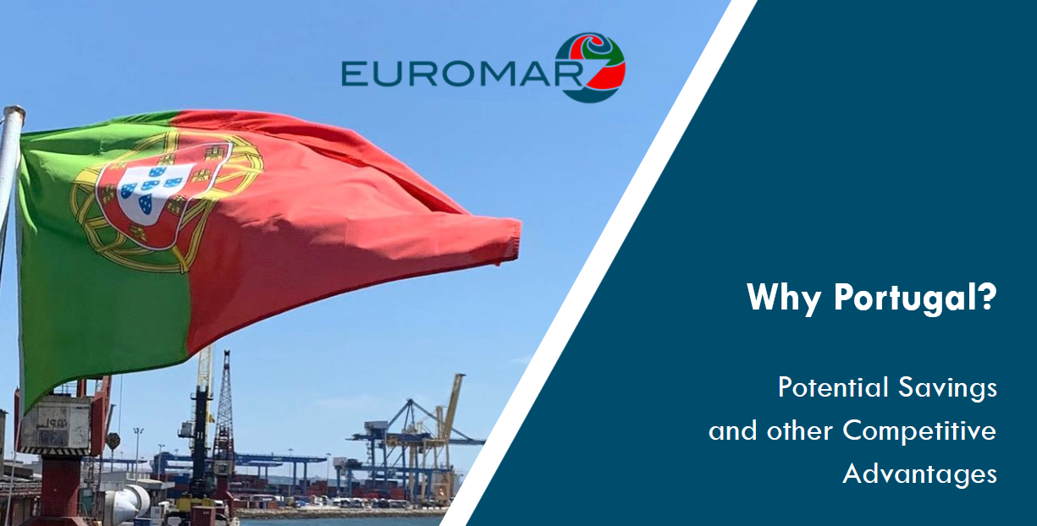

Slide 10
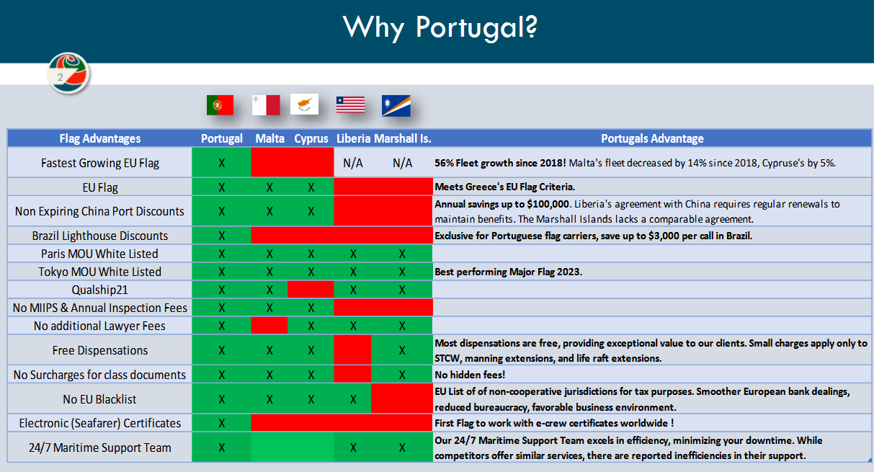

Slide 11
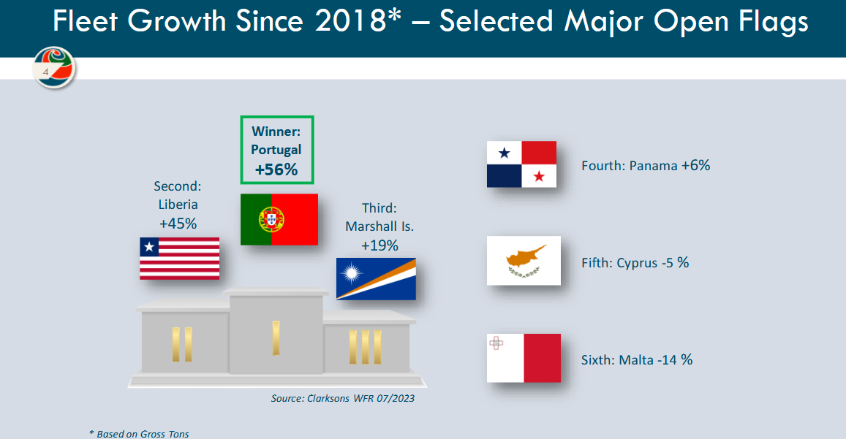

Slide 12
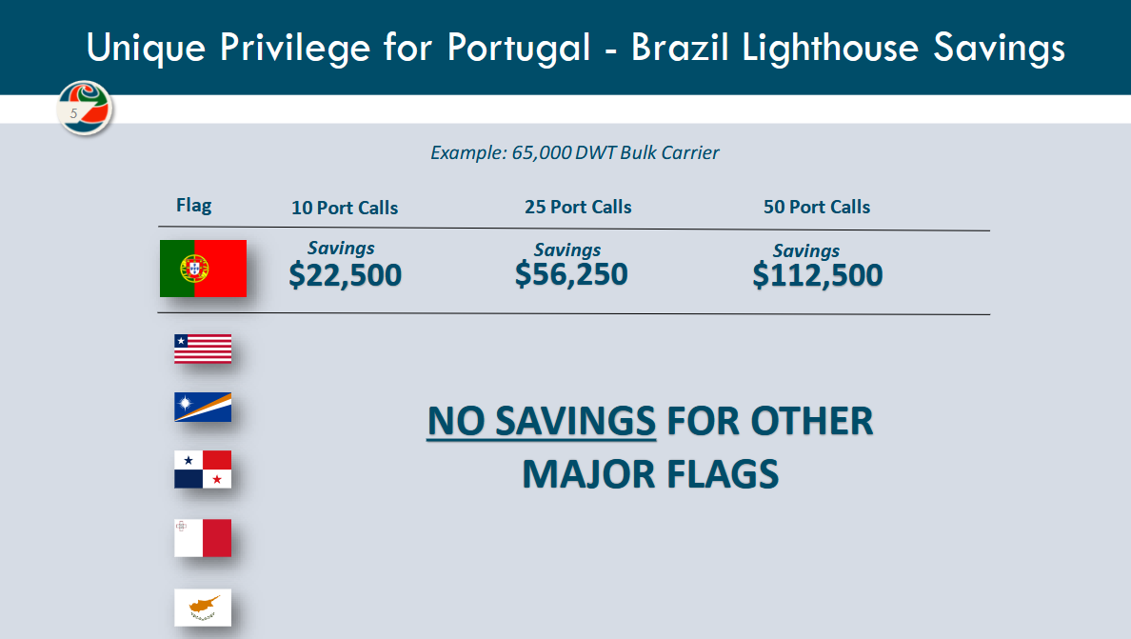

Slide 13
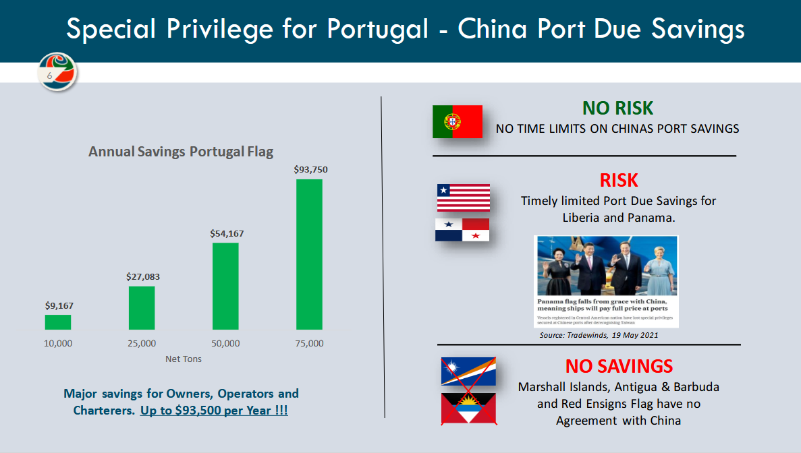

Slide 14
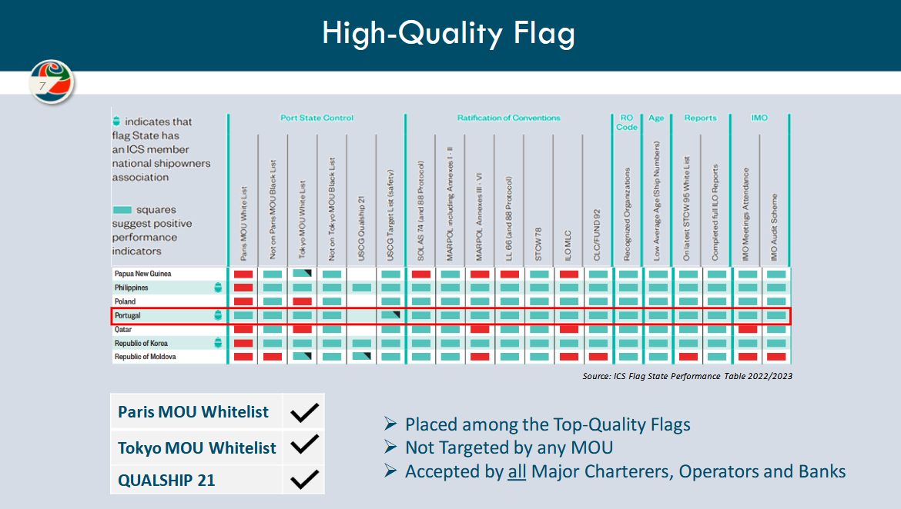

Slide 15
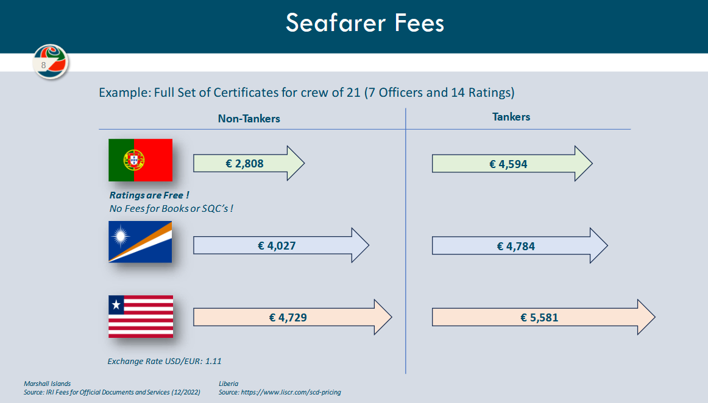

Slide 16
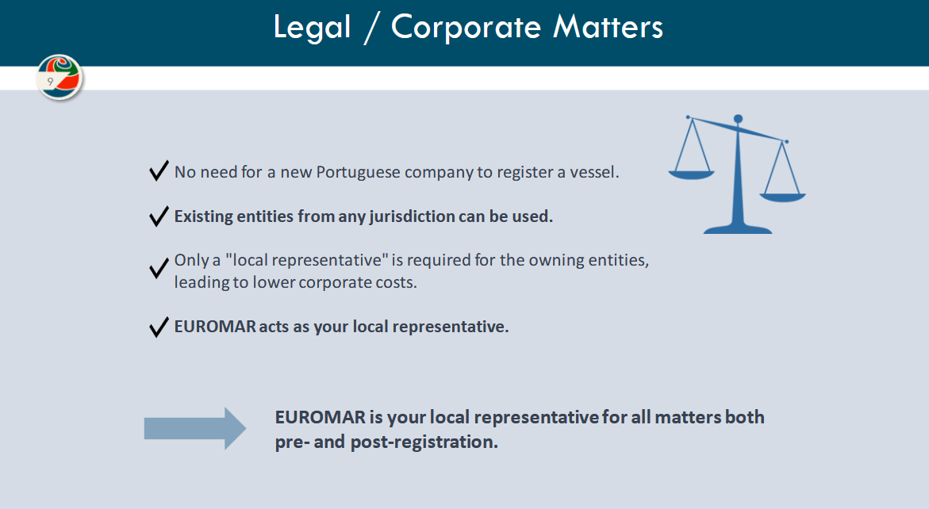

Slide 17
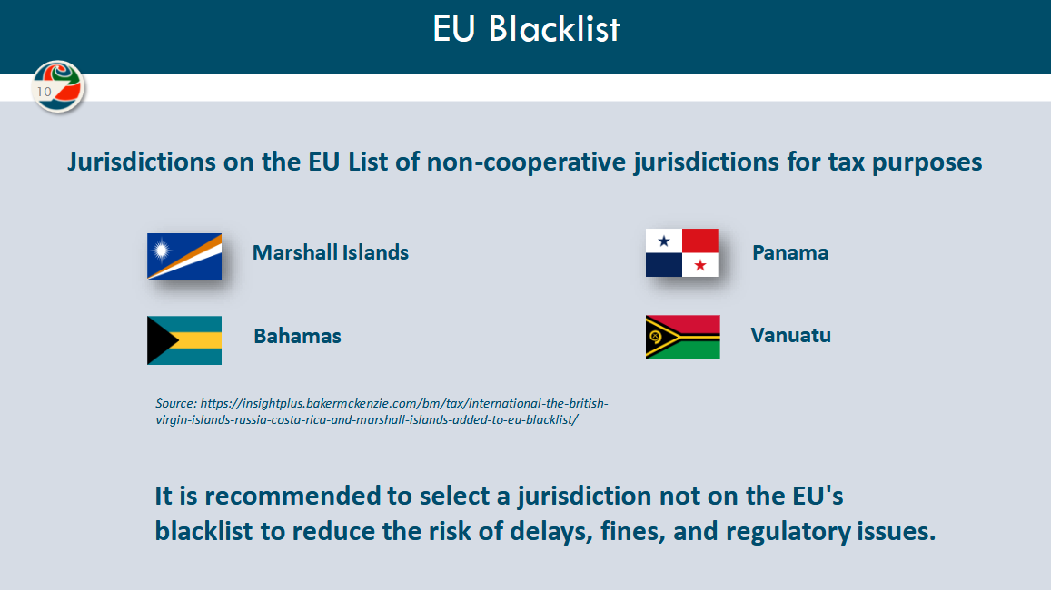

Slide 18
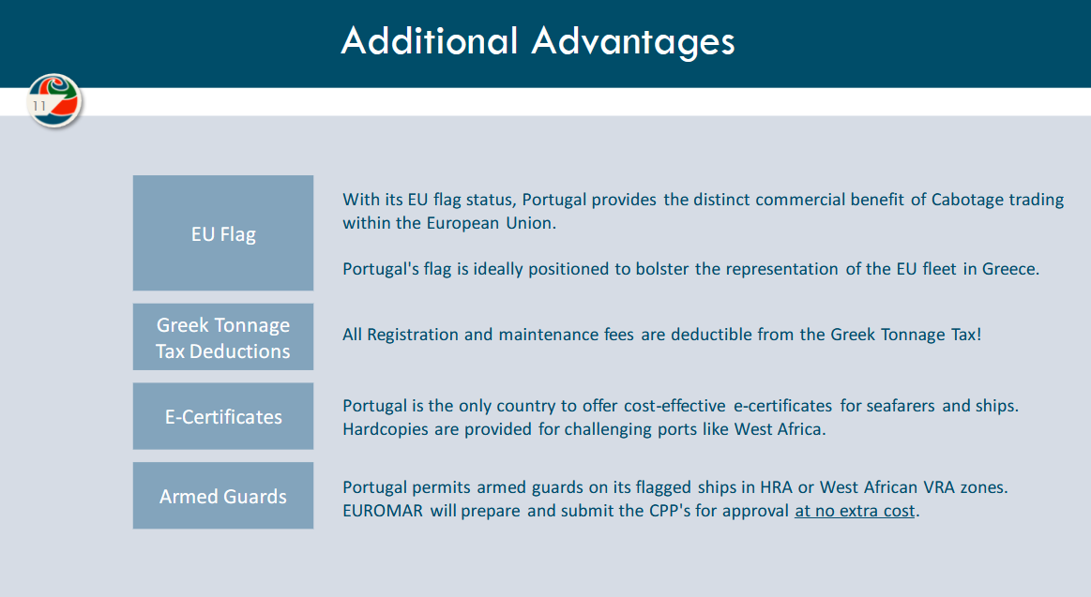

Slide 19
operators
The ‘operator’ is used to describe an organization or individual, setting out to create income from trading in ships and cargoes.
Some operators specialize in securing vessels on charter from shipowners, hoping to re-employ the ships to other charterers at a higher freight or hire rate and secure a profit.
Other operators concentrate on securing contracts for carriage of cargoes and by fixing in outside ships at lower freight rates, thereby covering their commitments to the charterers and at the same time making a profit.
Certain operator trade in both ships and cargoes.

Slide 20
Operators
Operator high risk business, consequently few operators will become bankrupt.
Some well known container liner companies are actually operators, as they run their liner services entirely with container tonnage chartered in for the service.
Operators who employ a vessel and then re-employ or relet that vessel are called ‘disponet’ or ‘time charter owners’.

Slide 21
Shipbrokers
The individuals or corporations acting as brokers in the middle of charterers, shipowners and operators.
A shipbrokers income is in the form of the reward of a commission, known as a brokerage fee, paid for a successful introduction and negotiation between ship-owner and charterer leading to a fixture (1,25% of Freight and Demurrage)
The term ‘shipbroker’ is wide-ranging: Dry cargo shipbroker, Port agency, Sale and Purchase, Tanker shipbroker, liner shipbroker.

Slide 22
Shipbroker-Exclusive Broker
He works in a shipping company where he deals exclusively with the chartering of a shipowner's ships.
He works with the people who work in the shipping company.
He/ she monitors the progress of each ship and is informed of any delays and difficulties when making each trip.
He/she is updated daily on everything that concerns the ships on the operational status of each ship.
e.g An accident can cause so much damage that it can immobilize a ship for several days.

Slide 23
Shipbrokers –direct shipbroker
He/she shares the ability to work with a ship-owner along with several others.
The direct broker has the advantage of communicating directly with the principal and informing him of ships and cargoes, but it does not have the exclusivity.
He/she has to compete with several other shipbrokers, who can pass cargoes at a lower commission and negotiate directly with charterers.

Slide 24
Shipbrokers- competitive shipbroker
They are brokers with special negotiation skills, who must understand in time how to match ships - cargoes in a highly competitive environment.
They are based in a major maritime charter center and cooperate with brokers in other charter centers or countries.
They have no commitments regarding their clients, as a result of which they also work with competitors of one of their principals.
Time is of the essence in this job.

Slide 25
Shipbrokers-Owner’s shipBroker
They are brokers appointed by shipowners in order to deal with securing employment for their ships, with the highest possible freight rates and well-known charterers.
Home –Broker beyond the responsibility he/she has, is in an advantageous position especially in times of crisis.
They work long hours a day and even into the evenings in order to contact brokers in other distant areas.

Slide 26
Shipbrokers-charter’s shipbroker
They are based in a charter center and aim to find ships to carry their charterers' cargoes.
A key objective is also to achieve the lowest possible fare on ships of the appropriate age and class.

Slide 27
Shipbroker’s responsibility
The shipbroker following negotiations leading to a fixture then has the task to:
Drawing up the C/P, faithfully recording all that has been agreed.
Dealing with any subsequent amendments or additions to the negotiations.
Handing negotiations between the parties
Dealing with financial exchanges, such as payments of freights, voyage balances and hires.
Mainly large Shipbroker houses also maintain a post-fixture department to handle efficiently the operations of a concluded fixture.

Slide 28
Methods of ship employment
Voyage chartering
Consecutive voyages
Time chartering
Bareboat chartering
Contracts of Affreightment
Joint Ventures
Shipping Pools
Parceling
Project Cargoes
Slot Charters

Slide 29
Voyage chartering
Chartering may take the form of short-term agreements o effect a single voyage for the carriage of an agreed-upon volume of cargo, fixed rate, measured as freight $/tons of cargo carried.
The shipowner undertakes to instruct the master of the ship to bring the vessel within a predetermined time period (laycan) to the agree port of loading, load the cargo and bring it to the discharging port as agreed in the C/P.
The charterer undertakes the responsibility and cost for cargo handling operations and the shipowner incurs the total operating and voyage expenses of the ship.

Slide 30
Voyage chartering
The shipowner gives the charterer a specific time, known as laytime, which is the period of time allowed for the loading and unloading the cargo.
If the charterer fails to load or discharge the cargo in the given period of the laytime, then the charterer must pay damages to the owner in the form of ‘demurrage’ at a negotiated sum per day.
If the charterer completes the cargo operations in a shorter time than allowed for the laytime, the shipowner may give a reward to the charterer in the form of ‘dispatch’ at an agreed upon sum.
NOT A GOLDEN RULE but: Full demurrage, half dispatch
The point in time when laytime commences is determined by a notice of readiness (NOR) issued by the master when vessel is at port and ready to commence cargo operations.

Slide 31
Consecutive voyages
Parties to a voyage charter are content to cooperate on pre-agreed repeat business.
They will sign an agreement which commits the vessel to performing a number of voyages within a fixed period of time.
All the voyages are covered by the same basic terms and conditions although it may be agreed that the freight rate fluctuates over the period of the contract.
Each of the voyages is treated as a separate contract for purposes of demurrage and despatch.
In total loss of vessel the contract comes to an end.

Slide 32
Time chartering
Is a longer term agreement between shipowner and charterer.
The payment of hire is $/d.
The charterer has the right to instruct the master of the ship as to the voyages to perform and is responsible for the payment of the voyage costs.
The shipowner remains responsible for the operation of the ship, as well as, the operating expenses.
The charterer pays daily, semi-monthly or monthly hire in advance.
Charterer incorporates all the commercial risks involved, while the shipowner only the operational.

Slide 33
Time chartering
shipowner
Time charterer
Crewing
Repairs
Maintenance and spares
Classification
Surveys
Lubricating oils
Fresh water
Insurance of vessel
Stores and Provisions
Heating and cooling
Employment
Bunkering
Port expenses
Canal tolls
Stevedoring
Insurance of cargo
Insurance of bunkers

Slide 34
Trip time / Voyage trip chartering
Refers to time chartering of a vessel for a single voyage.
Payments and terms are like those for time chartering.
Looking into the “Wehr Trave” (2016) case, the court held that there is no single definition of what constitutes a trip or one trip. According to the judge, the words “one time charter trip” did not restrict the charterers with regards to orders for loading and discharging if those orders were within the trading limits and the route was not inconsistent with what was agreed in the contract.

Slide 35
Bareboat chartering
Involves a long term arrangement in which the babeboat charterer becomes the disponent owner of the vessel.
In effect this is not a contract for the carriage of goods but a contract for the lease of the ship for an extended period of time.
The bareboat charterer takes over complete control and possession of the vessel for the duration of the charter, paying for all costs, althought the shipowner is still responsible for the payment of capital costs (e.g bank loan on the vessel)

Slide 36
cOntracts of affreightment
COA involves the carriage of a large volume of cargo over a longer period of time from a predetermined port (or ports) to another.
Terms are similar to those of a voyage charter
A shipowner is entitled to use any ship from the available fleet.

Slide 37
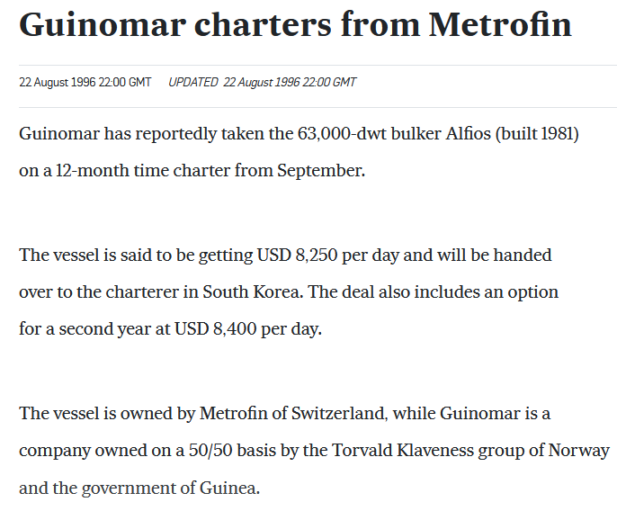
Joint ventures
These occurs when controlling cargoes negotiate and come to terms under a joint venture arrangement with those controlling ships.
Normally profits or losses will be shared not only perhaps on the freight element, but also on the production or purchase or sale costs of the goods involved.
E.g The joint venture between the Norwegian Klaveness group and the Guinean government in the bauxite production, transportationand marketing of the joint venture “Guinomar”.

Slide 38
Shipping pools
These occur when a group of shipowners band together to pool their tonnage and collectively market their combined fleet.
Pool income is collected together and once pool running costs have been deducted, remaining income is distributed amongst members my means of a weighted system by which each entered vessel’s individual characteristics are taken into account and measured against a pool model average, debits and credits being applied accordingly.

Slide 39
Parcelling
In dry cargo shipping, the smaller the quantity of a commodity, the more expensive it is to ship.
Operators specialize in transporting smaller parcels of a commodity by grouping them together in a vessel sailing from one or more ports in a particular region to one or more ports in another area.

Slide 40
Project cargoes
A specialized form of joint venture or COA is termed a project cargo.
E.g LNG vessels for Natural gas extraction projects
E.g movement of material and equipment necessary to construct a project in a developing country.

Slide 41
Slot charters
This is a prevalent form in liner trades and containerised trades in particular.
As liner vessels have increased in size, the owners have sometimes found themselves having difficulty in filling their ships.
Some freight forwarders and even former operators of small liner ships acquire space in vessels, then they sell this space on to their customers as they were in fact the line operators, known as non-vessel-operating common carriers (NVOCCs).

