Slide 1

Professor Konstantina E. Botsiou
Department of International and European Studies
Geopolitics
Geopolitical Theories

Slide 2
Why geopolitics?
Unfreezing of global politics after the Cold War (a period of “Cold Peace” when antagonism took place only in terms of ideology) >>> emphasis on economy (capitalism as vehicle of the domination of liberal democracy . S. Huntington, The Lonely Superpower, 2001)
End of ideologies (Fr. Fukuyama: The End of History and the Last Man, 1992) >>> only Western liberalism = capitalism will prevail
Economistic attitude after the Cold War - Bill Clinton: “It’s the economy, stupid” based on the assumption that economic won the Cold war
Rise of mistrust on the dividing line of revisionism vs. anti-revisionism (= lively in the interwar years)
Wars on the geopolitical fault lines of
WWI (e.g. Yugoslavia, Ukraine) – revisionism vs. antirevisionism-
naval vs. land powers- stability vs. crisis-stricken regions
Helen Ahrweiler, 1990
“Let’ see if you can also win World War I”

Slide 3
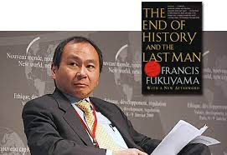
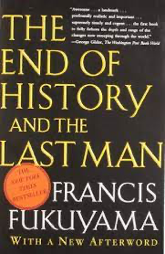
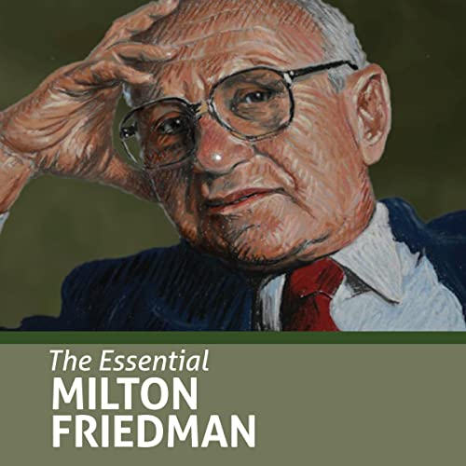
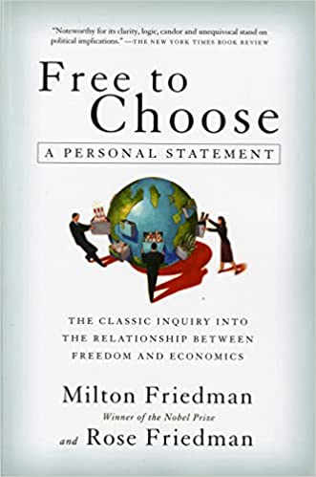
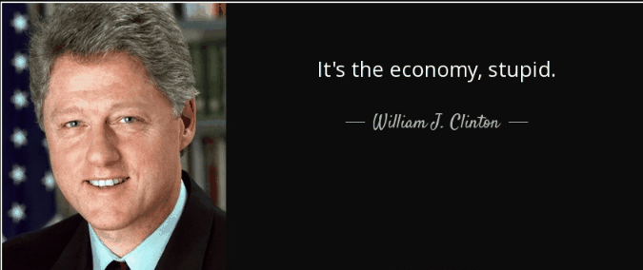

Slide 4
The new old term “geopolitics”
Geography = the drawing of nature and history (e.g. canals)
Geopolitics = the linkage of politics with geography
Derivative terms : geopolitics, geostrategy, geoeconomy
History and geography = twin powers
-------
Napoleon the Great
“The politics of a state is in its geography”
Robert Kaplan
“Everything is geography, until it becomes Shakespeare”

Slide 5
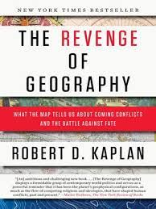
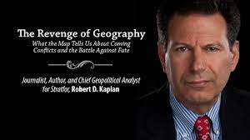

Slide 6
Why are we interested in geopolitics ?
Understand the deeper and long-term dynamics of events
Comprehend the role of geography
Grasp the relationship between geopolitics and ideology (“where you stand depends on where you sit”)
Understand the "other" (identity): climate, environment, euphoria, threats, survival strategies (long-term struggle with the elements of nature than with the conveniences of technology)
See and predict trends
Understand the turning points
Make better decisions
Consider the consequences of decisions
Prepare for each other's strategy

Slide 7
Historical changes in geo-politics by external developments changing the impact of geography
  Discoveries – Imperialism – Colonization
  Wars
    National revolutions: from frontiers to borders
    General wars (Napoleonic wars, Crimean War, WW)
    Regional wars: Balkan wars, French-German wars, Arab-Israeli wars,
    Civil wars
  Human intervention through technical works, esp. in geopolitical “chokepoints” (Canals in Suez and Panama, Great Wall of China, Wall between US and Mexico, China-Taiwan relation etc.)
  Rise of new powers, e.g. Germany, China
  Human intervention through the installation of bases (e.g. Souda, Alexandroupolis)
  Technological evolution, e.g. airplane strategic bombardment, cyberspace, e.v. ICBMs, Starlink by Elon Musk
  Climate change: e.g. shipping in the Arctic circle, refugee waves caused by water deficit
  Migration: due to hunger, war, or search for better life opportunities

Slide 8
Rise of geopolitical theories
(late 19th, early 20th century)
-Causes
New (types of) states: Dissolution of large empires through nationalism/revolutions (Lutheran, American, French, Greek, Russian etc.) >>> new international system
New ideologies: imperialism vs nationalism vs communism
Trust in new scientific discoveries: e.g. Darwin: “the survival of the fittest” - states as organisms
Communism >>> promise of a new world order based on reengineering of people
Creation of new strong states and buffer zones, e.g. Germany
Emergence of rising powers, e.g. Japan
Change of the nature of wars (ideology - technology): from the archaic Napoleonic wars to industrial WWI
Industrial revolution>>> change of the concept of “time” and geography
Antagonism between established sea powers and upcoming land and/or sea powers, e.g. Germany, Italy, Japan

Slide 9
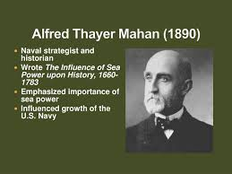
Alfred Mahan (1840-1914)

Slide 10
Geopolitical theories
Alfred Thayer Mahan (US, 1840-1914) > mahanists
The problem of Asia and Its effect upon international policies, (1900)
The Influence of Sea power upon History (1890)
He influenced US Presidents McKinley, Th. Roosevelt = supporters of sea power as a basis for democracy and peace since it limits itself to naval bases vs.
The despotism and greed of land powers that want to control other nations
Pivotal states: China, Afghanistan, Iran, Turkey

Slide 11
Geopolitical theories
Impact on rising Germany
Friedrich Ratzel (Univ. Leipzig, 1844-1904), “Lebensraum”
Influenced by Darwin: “human geography” = geography, anthropology, politics
The world would be dominated by super-states that would secure autarky
Rudolph Kjelen (Swe, 1864-1922), όρος “Geopolitik” (student of Ratzel): believed in Greater Germany as a bulwark against
Russian expansionism
British imperialism

Slide 12
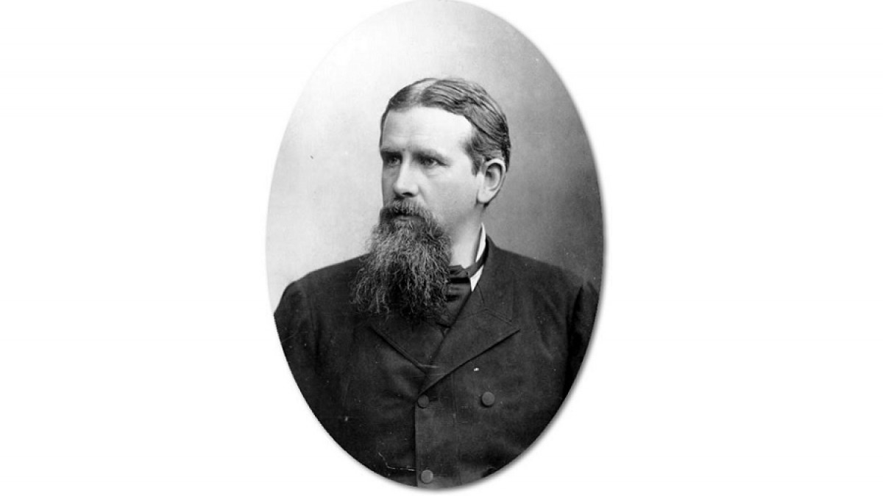
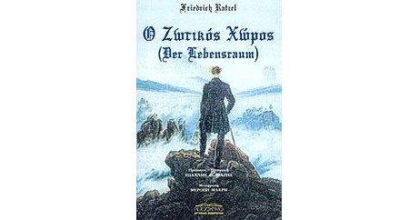
Friedrich Ratzel (1844-1904)

Slide 13
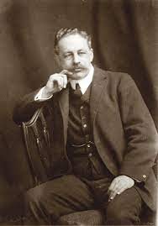
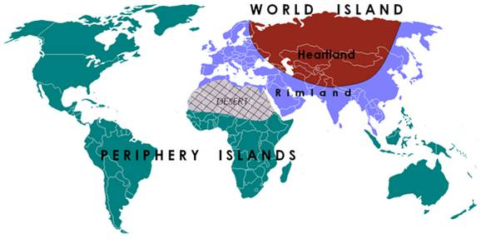
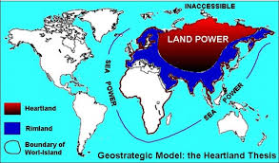
Lord Halford Mackinder (1861-1947)
Heartland

Slide 14
Geopolitical theories: Heartland
-Lord Halford Mackinder (1861-1947) :
“Whoever controls the heartland (Eurasia) controls the world”
Concept of “Heartland”
“The geographical pivot of history”, The Geographical Journal (1904)
-European history = a struggle between European civilization vs. the Asiatic threat: e.g. Greeks-Persians, Romans-Francs vs. Huns-Mongols etc.
-Turning point = the invasion of the Golden Horde in Russia >>> permanent fear of invasion for Russia (13th-16th century)
-Europe = designed to be in love-hate relation with Russia (= “divided land”, according to Samuel Huntington)
-The frontier of Europe = in Russia
-Even faith = a result of geography >>> Orthodox faith = at the borders of Europe

Slide 15
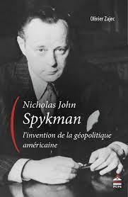
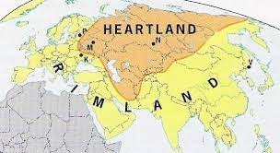
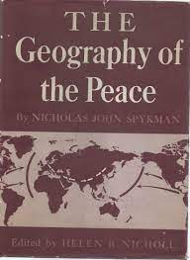
Nicholas Spykman (1893-1943)
“Rimland”

Slide 16
Geopolitical theories: Rimland
(US strategy in the Cold War)
-Nicholas J. Spykman (US, 1893-1943, Yale University):
Rimland (Στεφάνη ή Δακτύλιος) :
“Whoever controls the Rimland controls the world”
Books:
-America’s strategy in world politics (1942)
-The geography of peace (1944)
US = the most blessed country in the world regarding geography
“2 walls”: Atlantic and Pacific oceans
Located in the temperate zone of the northern hemisphere where civilization is written (between 20 and 60 degrees latitude)
The geography of the USA protected its freedom and hegemony in the Western Hemisphere and the American political system
The US controls the "American Mediterranean" (Caribbean) >>> to the Panama Canal is considered B. America
Dominant in the Western hemisphere since Monroe Doctrine (1823> Latin America - distanced from Europe

Slide 17
Common question for Mackinder και Spykman
Who controls the Heartland, or the World Island?
They both saw one continent and one ocean
Heartland = Europe Asia, Africa
Ευρώπη, Ασία, Αφρική
“Pivotal states” in both theories:
Hungary, Kazakhstan, Greece
The Balkans =
balance between the Great powers/Superpowers
miniature of the global political divisions
Key strategy = not leave one power control all three zones
(heartland, rimland, pivotal states)
Solution = balance of powers
-Hans Morgenthau (1904-1980),
considers geopolitics pseudoscience and criticizes Mackinder as an imperialist and determinist that gave arguments to the Nazis

Slide 18
Geopolitical theories
Marshall Hodgson (US 1922-1968, University of Chicago)
The Venture of Islam:
Conscience and History in a World Civilization
(1947)
Revival of the world of Herodotus
«Globe»: N. Africa to China = the key to world history
Islam = uniting element of villagers-traders on a new moral basis
Arabia = Iraq-Syria-Yemen (ancient Mesopotamia)

Slide 19
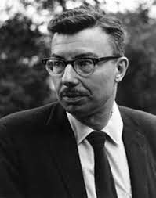
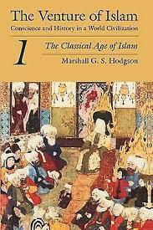
Marshall Hodgson (1922-1968)
University of Chicago

Slide 20
Geopolitical theories
Fernand Braudel (1902-1985), The Mediterranean World (1949)
Low quality of soil in the Mediterranean vs. big land estates >>> pressure for authoritarianism
Northern Europe: rich natural resources: forests, mines, raw materials >>> luxury for liberalism
William H. McNeill (Canada, 1917-2016, University of Chicago), The Rise of the West. A history of the human community (1963)
Middle East = the centre of developments
Regional civilizations = Greece, China, India,
Harsh environment lead to harsh economic conditions >>> political authoritarianism and economic underdevelopment

Slide 21
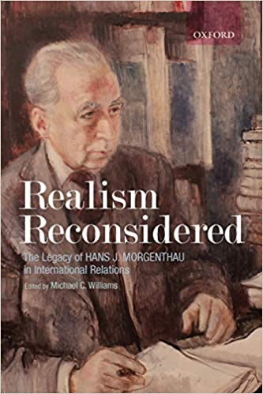
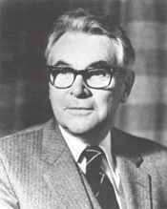
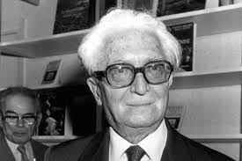
Geopolitical theorists
William H. McNeill
Fernand Braudel Hans Morgenthau

Slide 22
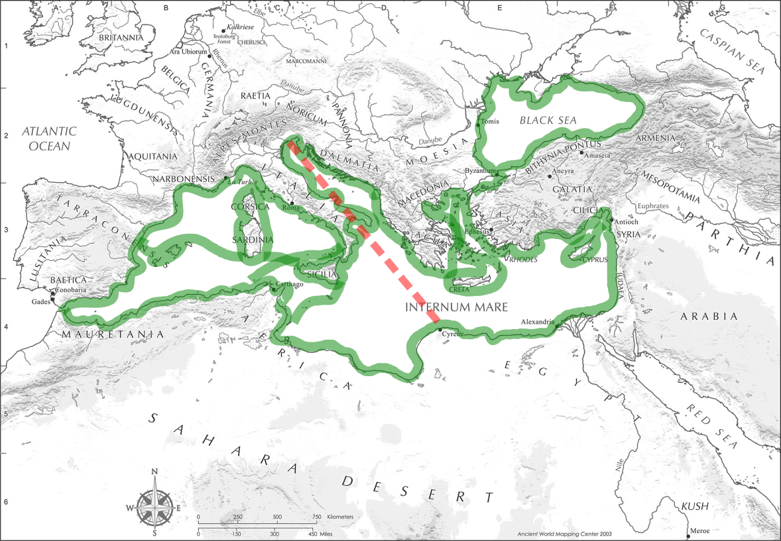
Fernard Braudel, Mediterranean

Slide 23
Geopolitics or ideology dominate world affairs?
Geopolitics
is based on power and realism (Hans Morgenthau: “only power can limit power”)
prefer order to freedom
ideology a tool
Are fixed on international power politics, not in systems of governance
International organizations = reflection of the balance of powers or guarantors of the balance of powers?
Examples to discuss: ideological or geopolitical causes?
-Alliance of US/Britain with the USSR in WWII
-Beginning of the Cold War
-UNO

Slide 24
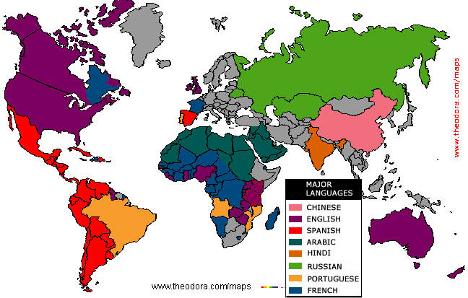
Language map

Slide 25
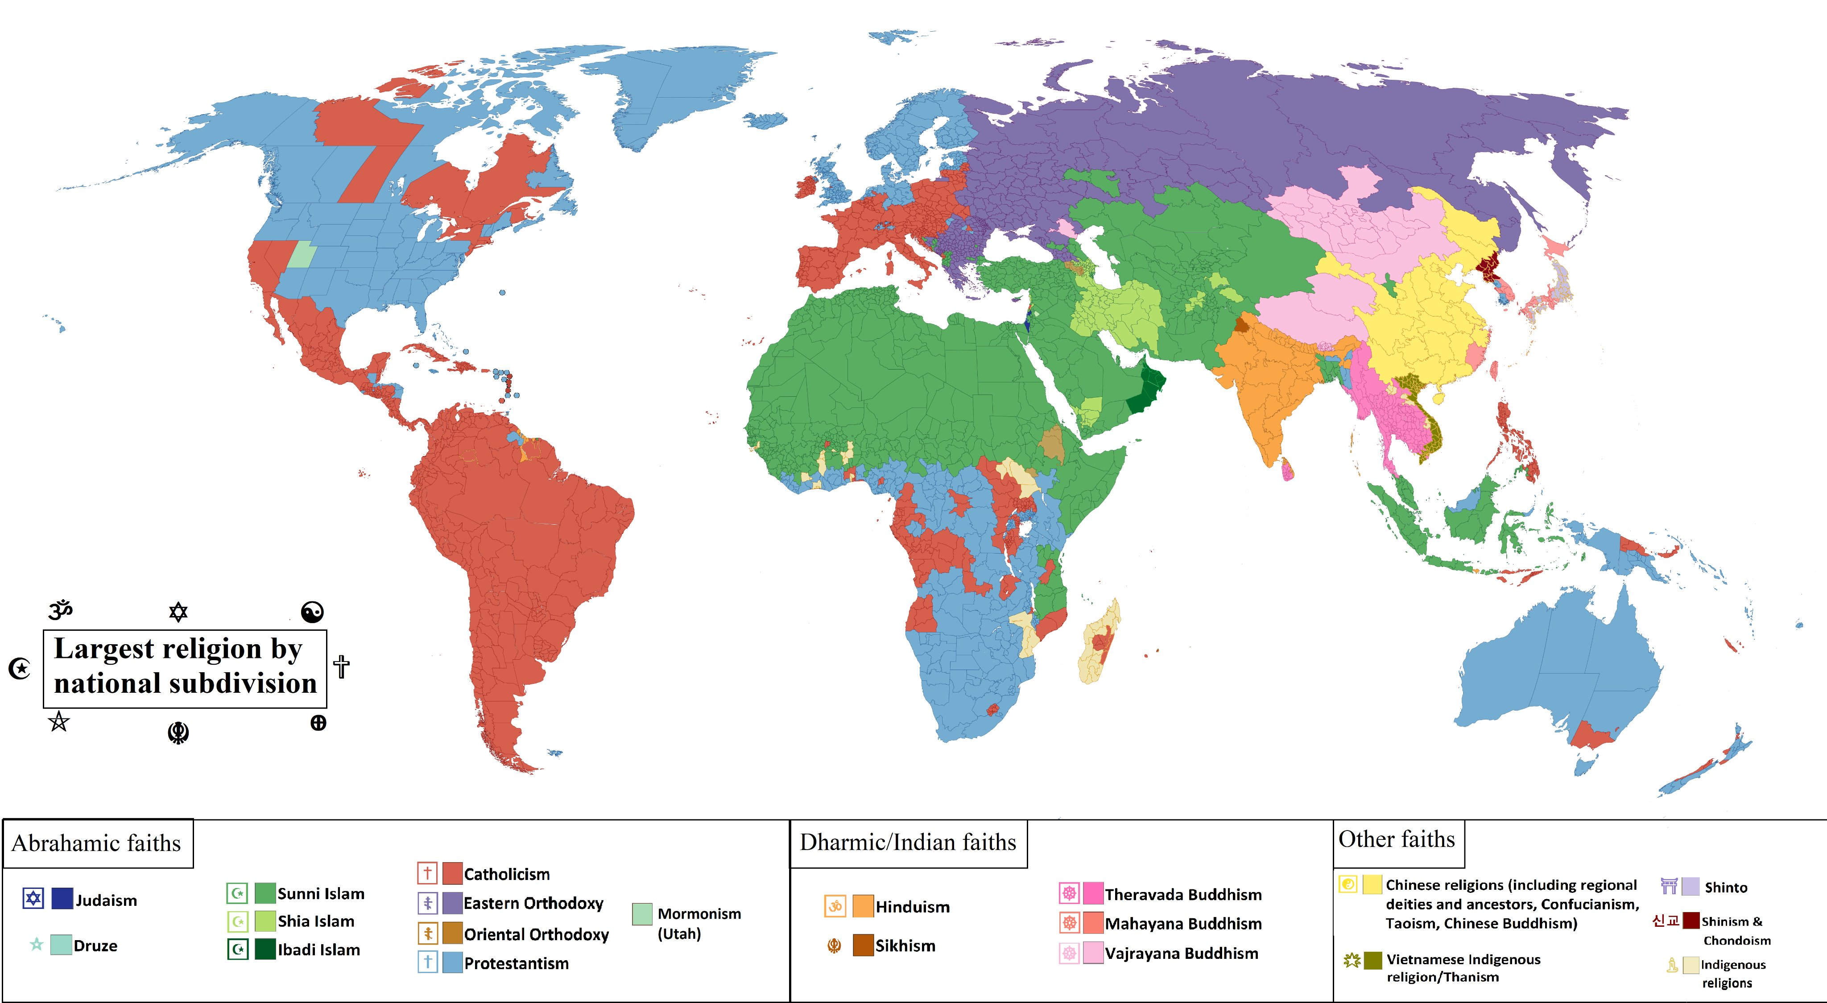
Religions map

Slide 26
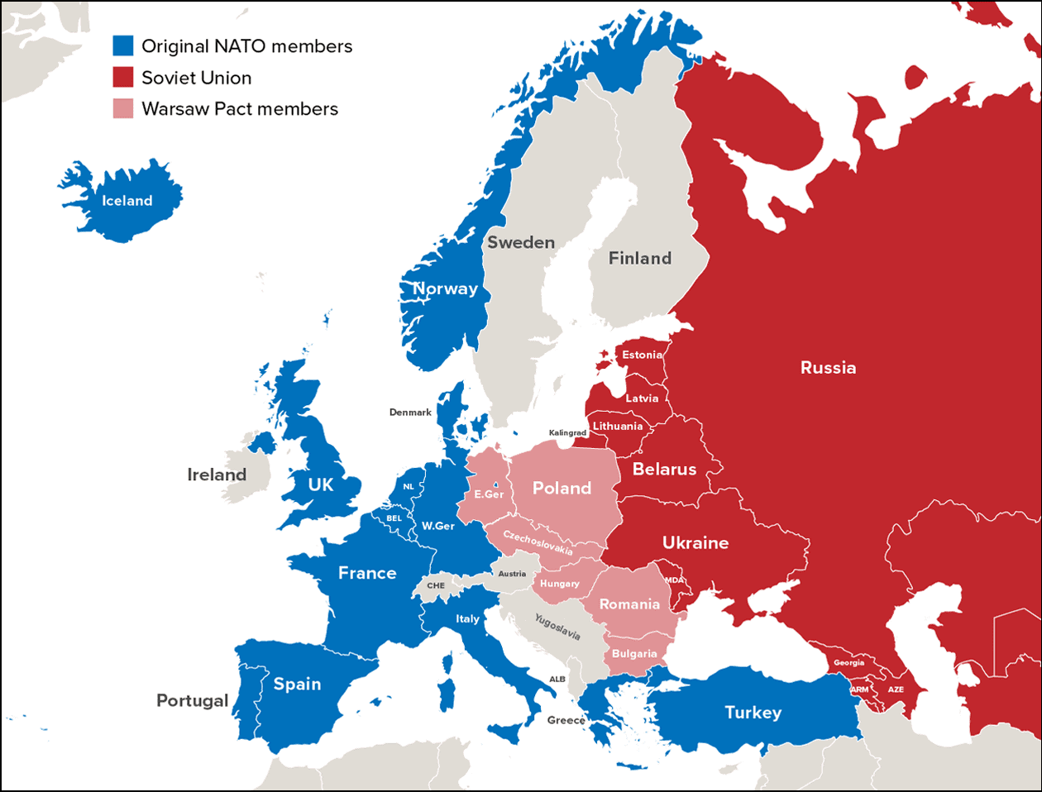

Slide 27
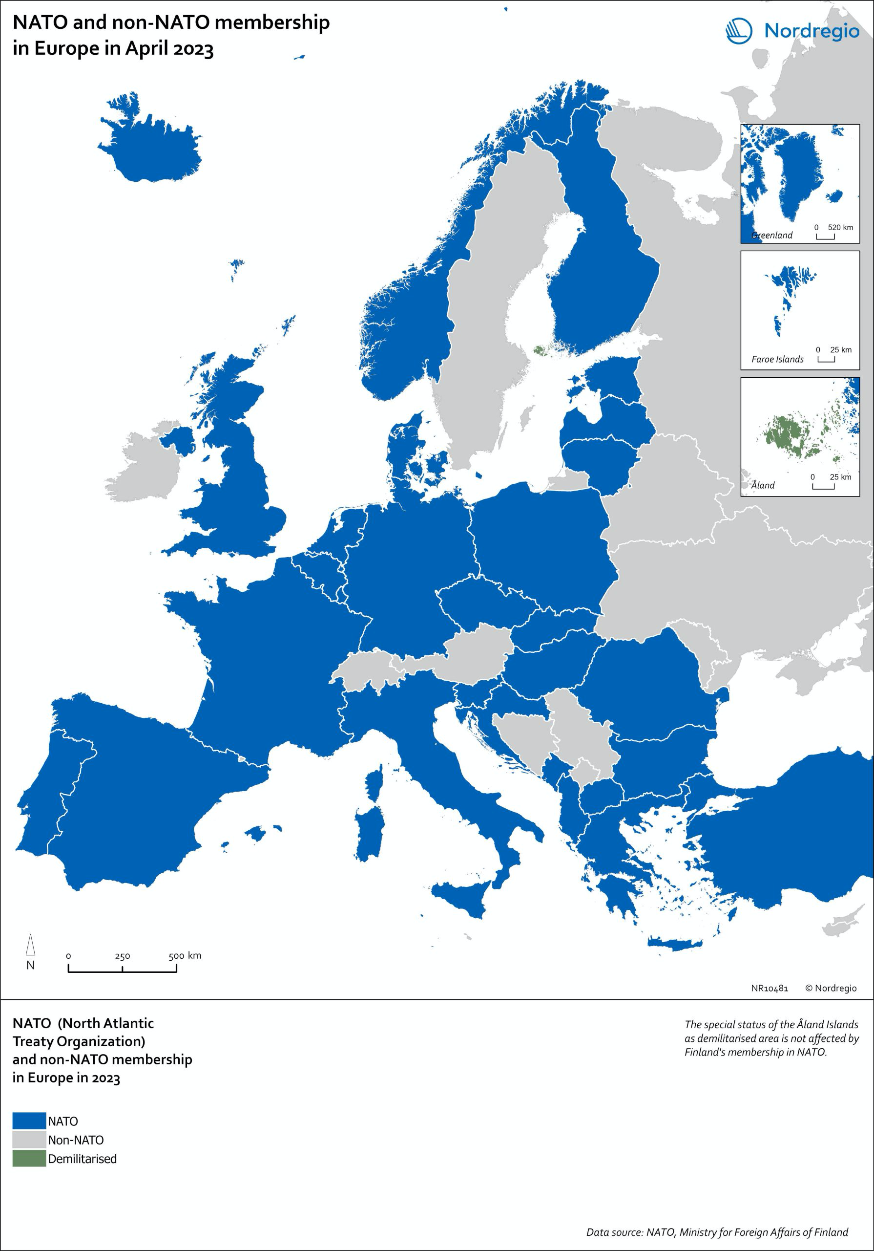
ΝΑΤΟ

Slide 28
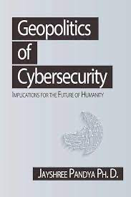
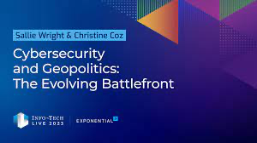
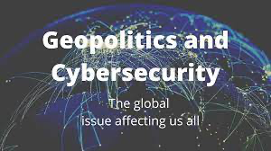

New geopolitics

Slide 29
New geopolitical theories
Pivot to Asia (Barack Obama)
One Belt, One Road (China, Xi)
Strategic Depth (Davutoglou)

Slide 30
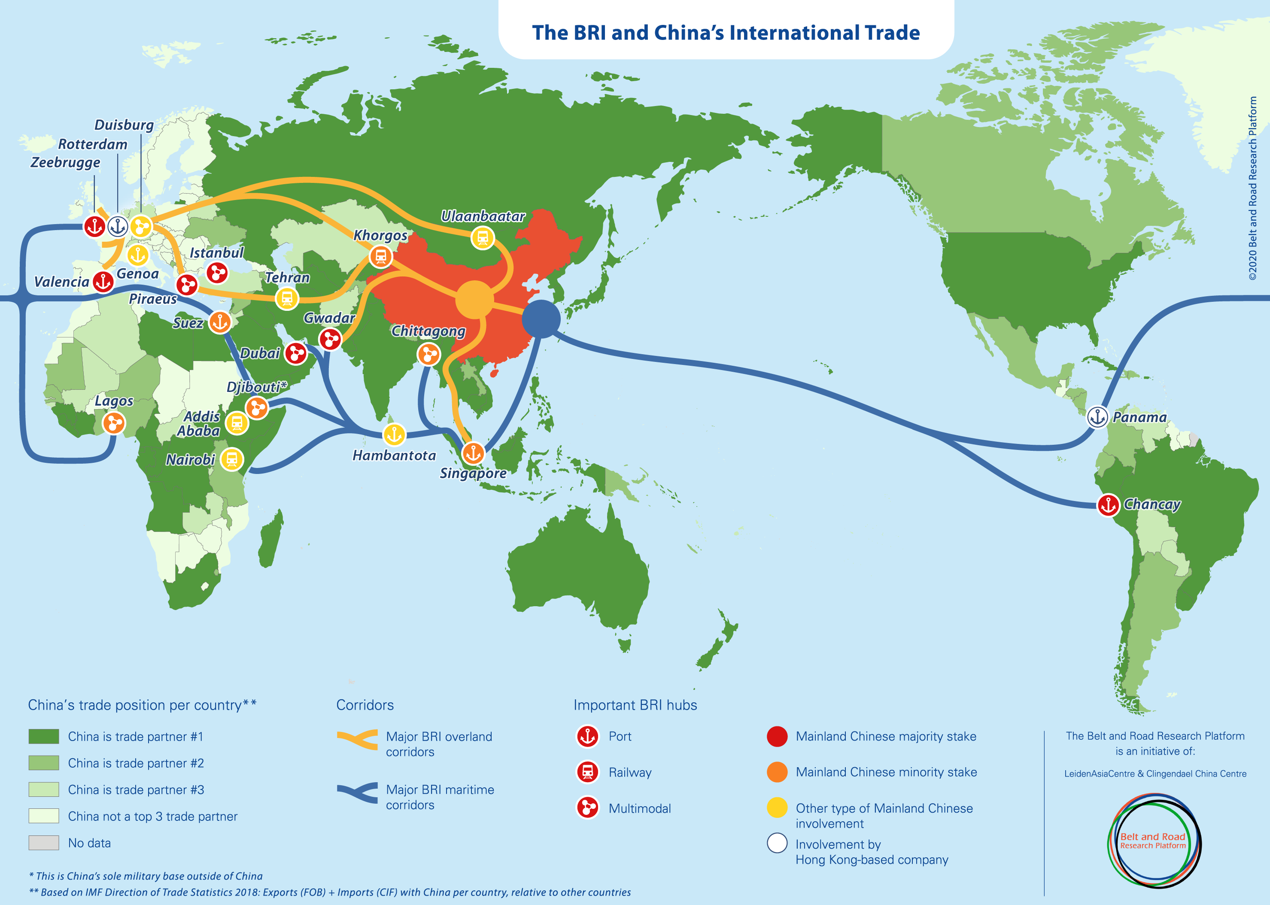
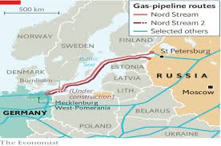
Belt and Road Initiative

Slide 31
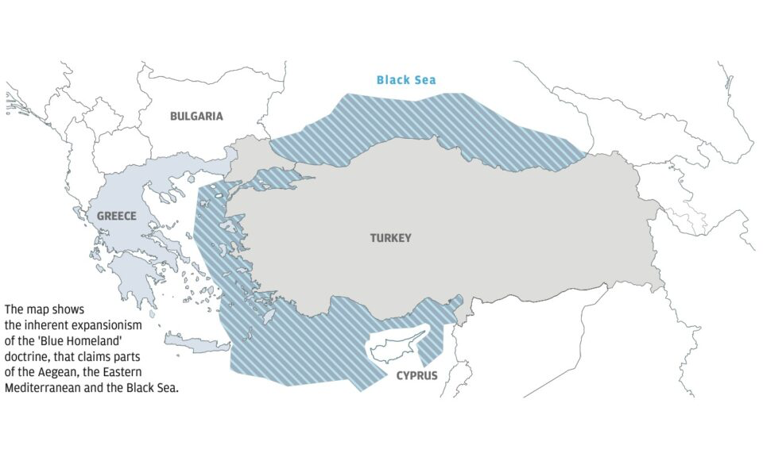
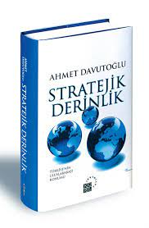
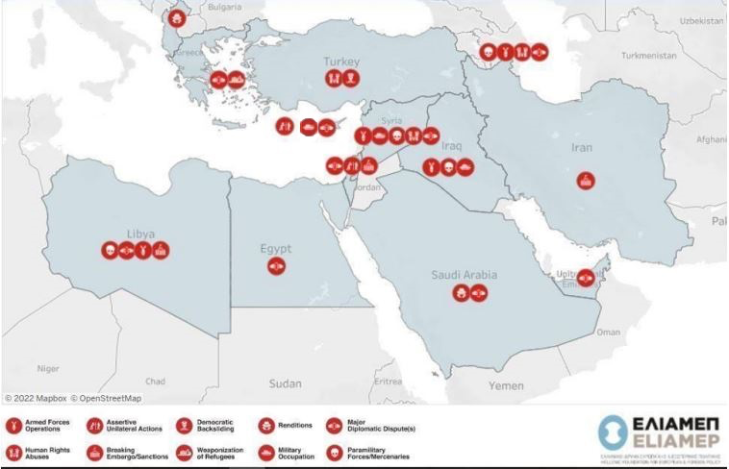

Slide 32
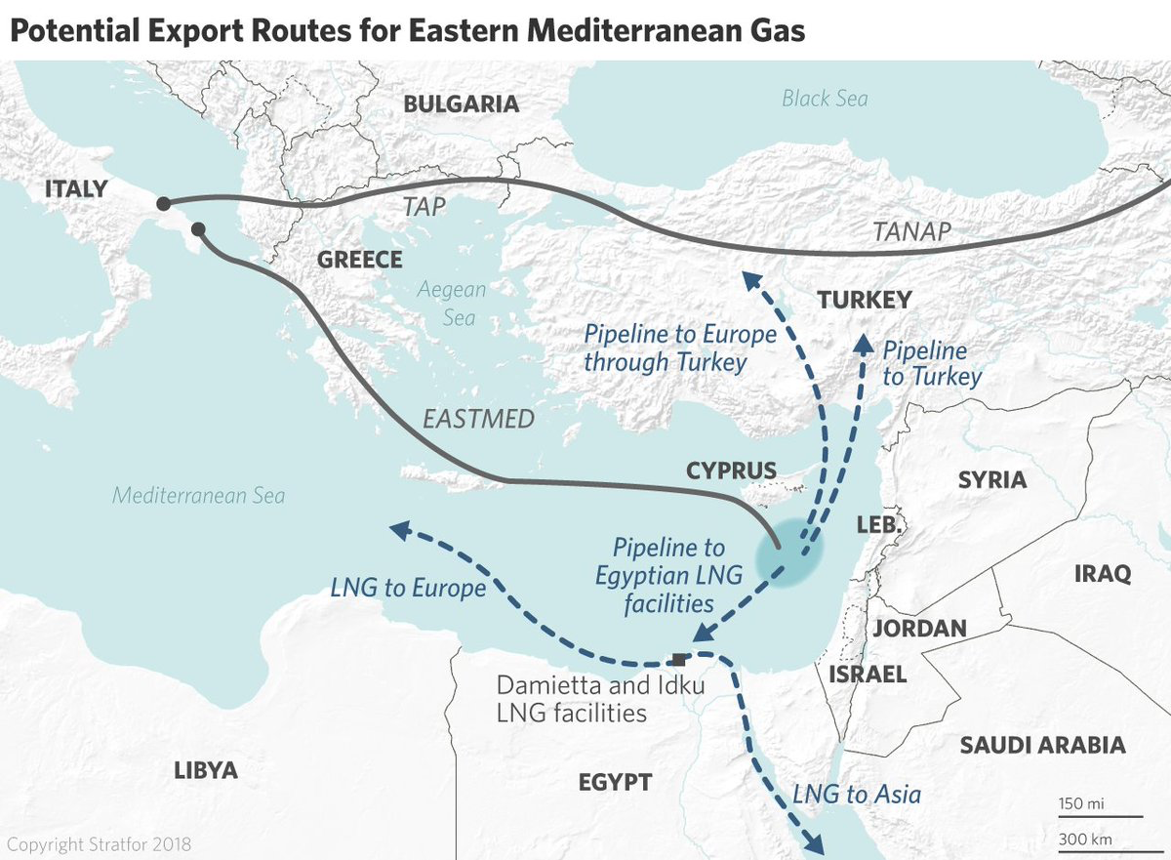
Energy geopolitics

Slide 33
Current geopolitical competition
West – the Rest
USA-China
NATO-Russia
Democracy vs Autocracy zones Global north – Global South
Reasons for Competition
Political control
Raw materials
Energy
Minorities (e.g. Kurds)
Chokepoints
Alliances

Slide 34
New theories
Democracy vs. Autocracy
Global North - Global South
…

Slide 35
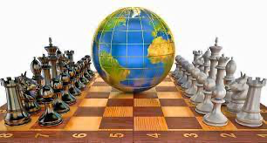
Play chess?

