Slide 1

Professor Konstantina E. Botsiou Department of International and European Studies Geopolitics Geopolitics and Alliances

Slide 2
What is an alliance?
Treaties or Agreements between two or more nations aiming at their defense with mutual sacrifice:
written or oral (gentlemen’s agreement)
#
Cooperation (trade, dialogue, trust-building-measures)
Types:
Offensive (to wage war)
Defensive (to prevent war)
3. Collective defense (“all for one, one for all”)
4. Guarantee of Great Powers (WWII)
5. Neutrality - Non-aggression (Ribbentrop-Molotov Pact, 1939)
6. Friendship and Cooperation (Greece-Turkey, 1930 - Greece-Italy, 1928 genuine or appeasement of the enemy)

Slide 3
Reasons for forging alliances
-Quest for security, justice, prosperity, freedom of action
-Change of the realities of geopolitics (e.g. Greece-Russia-Britain)
Recognition of the existence of enemies (non-pacifist ideal)
Balance against threatening states (impossible to have a unipolar system for long): [Morgenthau, Stephen Walt ]
Bandwagon with threatening states (appeasement)
Multiplication of force
Aggrandizement of influence
Avoidance of isolation
Expansion through persuasion of prospective members (positive influence)
Support deprivation of the enemy (negative influence)
Establishment of common interest
Labour division
Transfer of Knowhow (esp. in technology and strategy)

Slide 4
Criteria for alliances
Common enemies (Balkan Pact, 1953-54)
Geographical proximity (Balkan Entente, 1911-12)
Similarity of political systems (NATO)
Similarity of cultures (AUKUS, 2021)
Similarity of geography (naval powers with naval powers)
Complementarity of economies (Warsaw Pact, 1955-1991)
Few or non-existent fights/wars against each other (Greek-Serbian pact of 1913)
Smaller states with greater degree of insecurity but with comparative advantages for greater states (SEATO, 1954)
Democracies (EU)
Revanchism for past wars (Tripartite Pact, or Pact of Steel, or Berlin Pact, 1940)
Attraction to strength

Slide 5
How are alliances being created?
Military might ( admiration of strength)
Μilitary coercion
Political penetration
Economic aid
Economic interdependence
Propaganda
Confidence-building measures (e.g. ping-pong diplomacy)

Slide 6
Costs and benefits
Costs
Loss of autonomy
Dependence
Time loss in decision-making
Commitment
Exposure to the threats of others
Reprisals from other alliances
Benefits
Protection-Deterrence >> > Security
Power increase, esp. for smaller nations
Inside information
Transfer of knowhow
Access to materials for growth
Prosperity because of security
Increase of trade partners

Slide 7
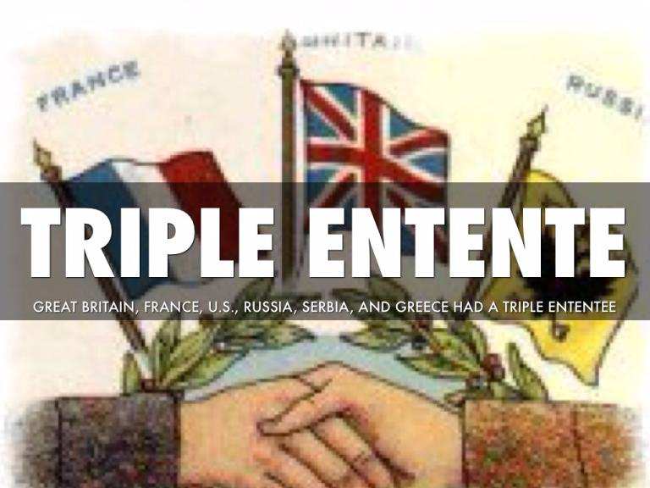
Triple Entente Cordiale, WWI

Slide 8
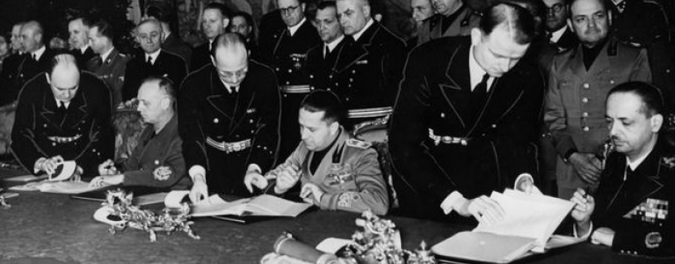
Tripartite (Axis) Pact, 1940

Slide 9
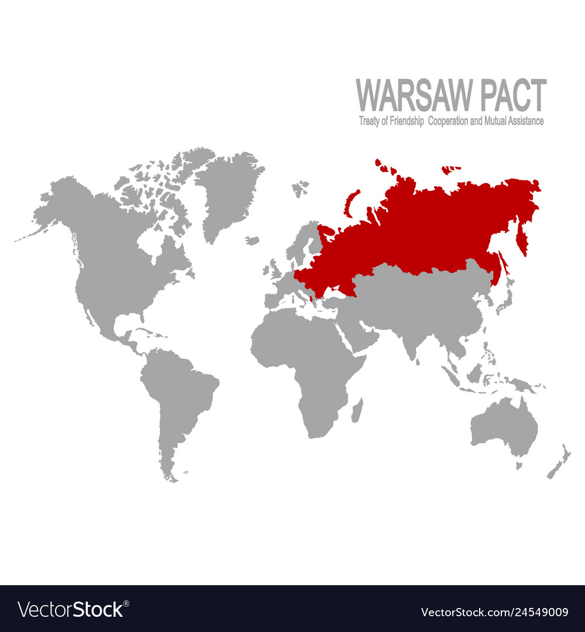
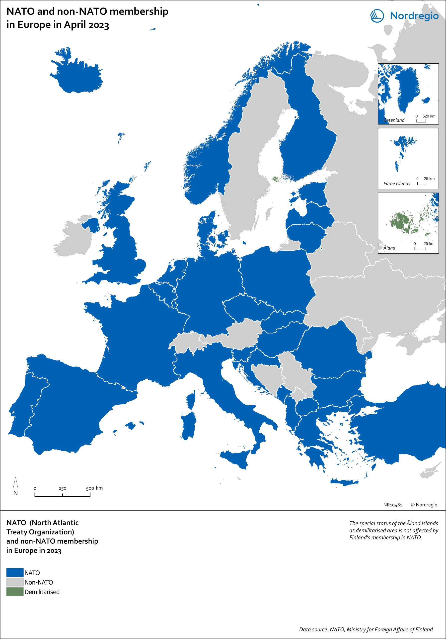
Cold war alliances

Slide 10
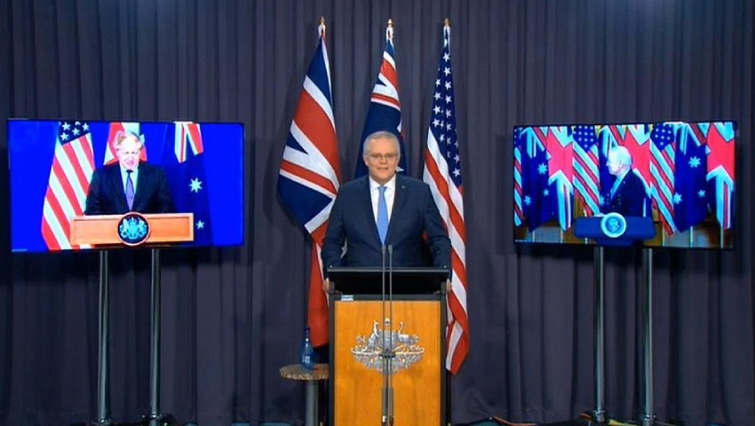
AUKUS, 2021

Slide 11
Do superpowers need alliances, e.g. the US?
Ronald Rumsfeld, 18 October 2001
Pentagon News Conference
Charles Krauthammer (Washington Post), after Bosnia-Herzegovina
“The worst thing you can do is to allow the coalition determine what your mission is.
It’s the mission that determines the coalition”
“The grand alliances are dead. With a few trusted friends, America must carry on alone”

Slide 12
Do Superpowers need alliances?
On the positive side:
They grant them legitimacy for their “way of life”
They get input from different ankles (recognition of multiculturalism)
They secure coherence: “leadership needs followship” (Richard Haas, Council on Foreign Relations)
They provide labour sharing
Robert Kagan: “US from Mars, Europe from Venus…”
They deprive allies from the other side (Kissinger: China policy= aligning with the weaker – non-unification of Eurasia between China and USSR)
On the negative side:
Alliances are expensive >>>
one needs to have a robust economic basis (autocracies) and/or far- sighted policies of social cohesion (taxation for democracies)
Alliances can create enemies
Alliances can distort priorities

Slide 13
Does Greece need alliances?
-What kind?
Offensive
Defensive
Military
Political
Economic
With which states?
-With neighbors –or distant in geography
-With naval or land forces
-With many nations or with a few nations (multilateral or bilateral?)
-With at least one Great power/superpower or more?
-Western or non-Western?
-With democracies or autocracies or is according to an ideologically neutral geopolitical approach?

Slide 14
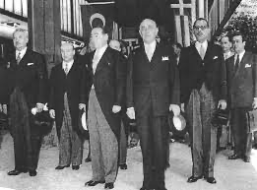
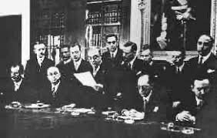
Balkan pacts (the distrust among neighbors)
Balkan act, 1954
Balkan Entente 1934

Slide 15
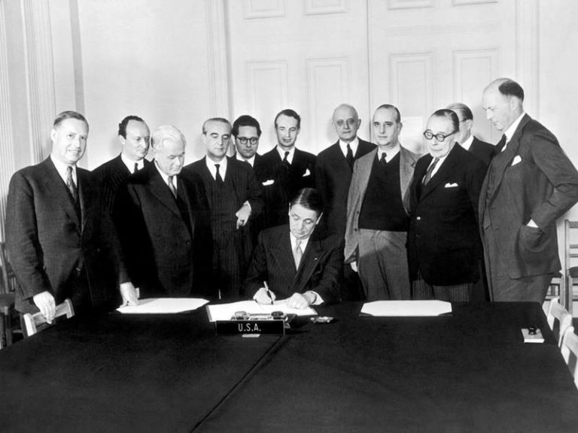
Accession of Greece to NATO, 1952 (alliance with the US)

Slide 16
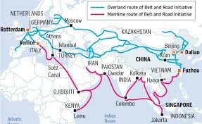
Belt and Road Initiative One Belt, One Road

Slide 17
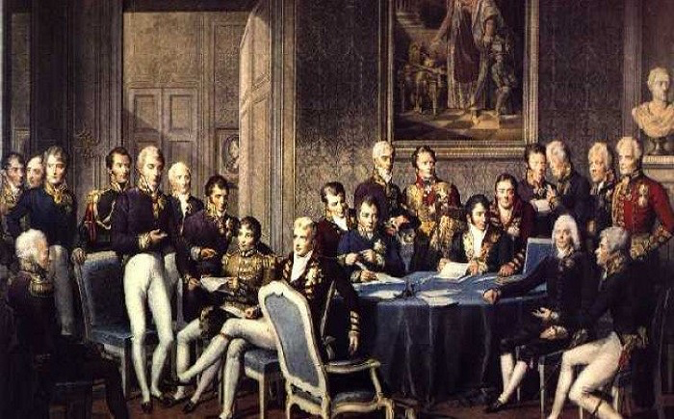
Holy alliance, 1815

Slide 18
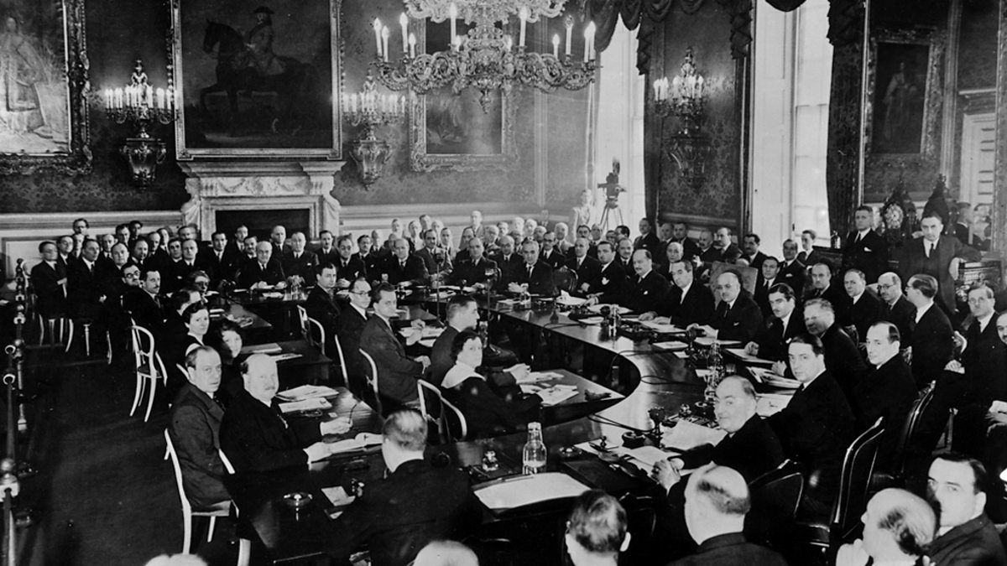
League of Nations, 1919

Slide 19
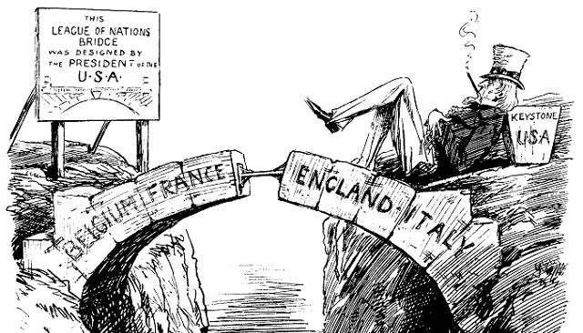
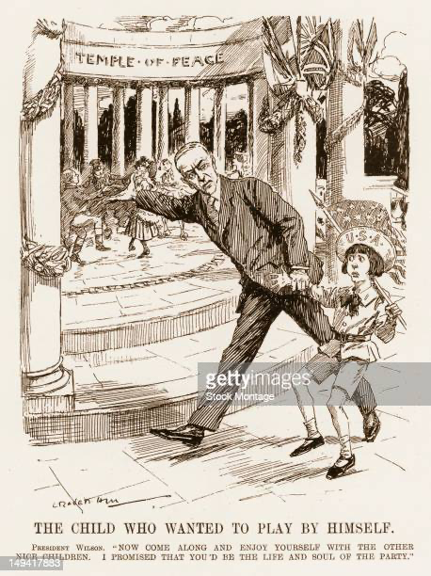
League of Nations vs. isolationism

Slide 20
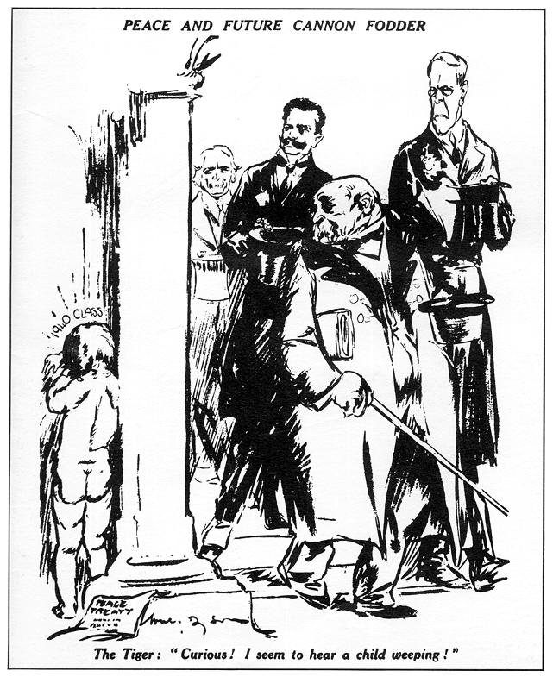
Versailles system revisionism-anti-revisionism (“fragile peace”)

Slide 21
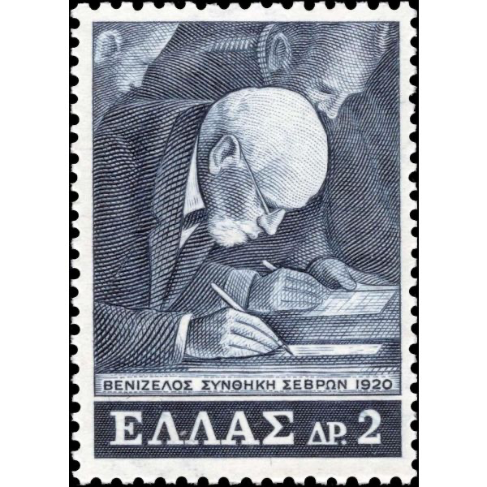
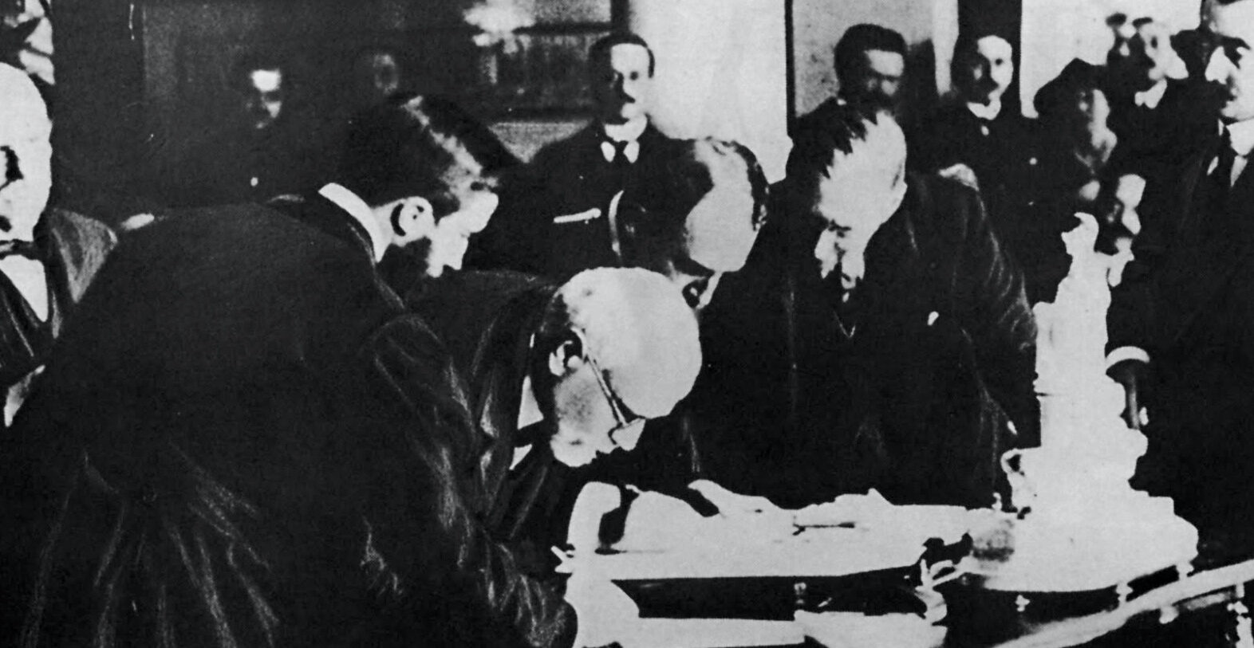
Treaty of Sevres, 1920
Ink is more lasting than blood:
every war ends when a peace treaty is signed and ratified

Slide 22
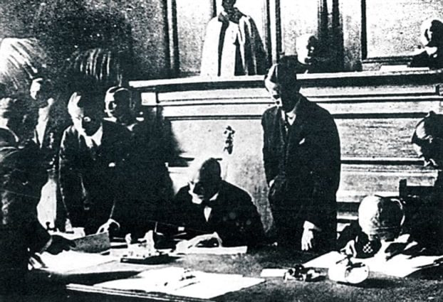
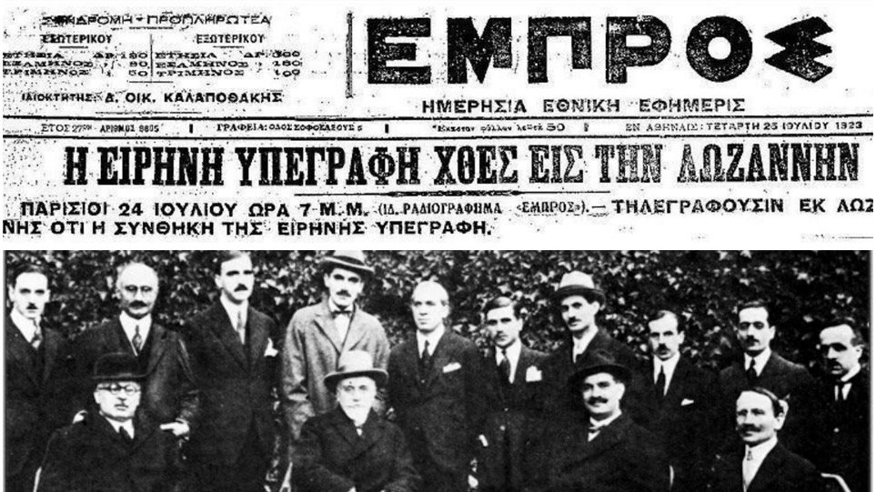
Treaty of Lausanne (1923)

