Slide 1

Professor Konstantina E. Botsiou Department of International and European Studies Geopolitics Geopolitics and Leadership

Slide 2
Kinds of leadership
Individual
Political leaders
Elites
Kings
Religious leaders
VIPs
Activists
Influencers (scientists, actors,
Collective
Multinationals
International organizations
Foundations
Business CEOs

Slide 3
Types and characteristics of leaders
Charismatic (Max Weber definition)
Meritocratic
Types:
Visionaries – Transactionals
Bureaucratic - Transformational
Democratic - Autocratic
Paternalistic - Laisse-faire
Doers - Communicative
Characteristics:
Sense of mission and responsibility (Beruf - calling)
Stamina
Love of solitude (De Gaulle) – no fear of isolation (Churchill)
Definite decision making
Moral strength - courage
Patriotism
Alternative views of reality >>> change of geopolitics (e.g. Luther, Napoleon, Hitler)

Slide 4
Leadership tools
War - Violence
Peace (e.g. Gandhi, Martin Luther king)
Power
Alliances – networks (invisible might)
Propaganda/Communication (e.g. Churchill, Reagan)
Achievements (miracles, technology, athletes etc.
Trust
Coercion
Economic aid
Knowledge of people (Humanities)
Discussion with others
Realism
Controversy

Slide 5
Leadership and geopolitics
Systems are more long-lasting than leaders, but fail if they do not create leaders
Leaders can effect abrupt changes to systems and geopolitics creating new ones (e.g. Napoleon)
Leaders are important because they can read differently the same geopolitical strategy
Leadership is more important where there is concentration of power
Developed nations tend to reformist leaders >>> long-term influence
#
Underdeveloped countries tend to messianic leadership >>> short-term influence

Slide 6
What do leaders show us?
The future: see the world through different lenses
The present: read between the lines
The past: interpret it for today’s questions (good knowledge of history)
Speed-up decision-making
Make safe predictions
Henry Kissinger, Leadership, Six Studies in World Strategy (2022)

Slide 7
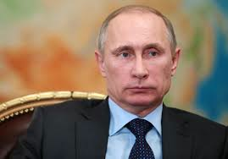
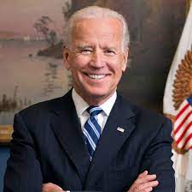
Governments

Slide 8
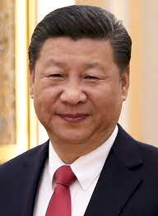
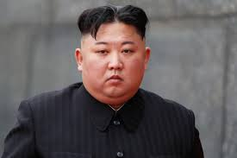
Governments

Slide 9
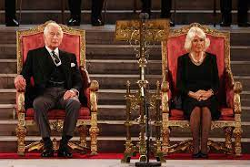
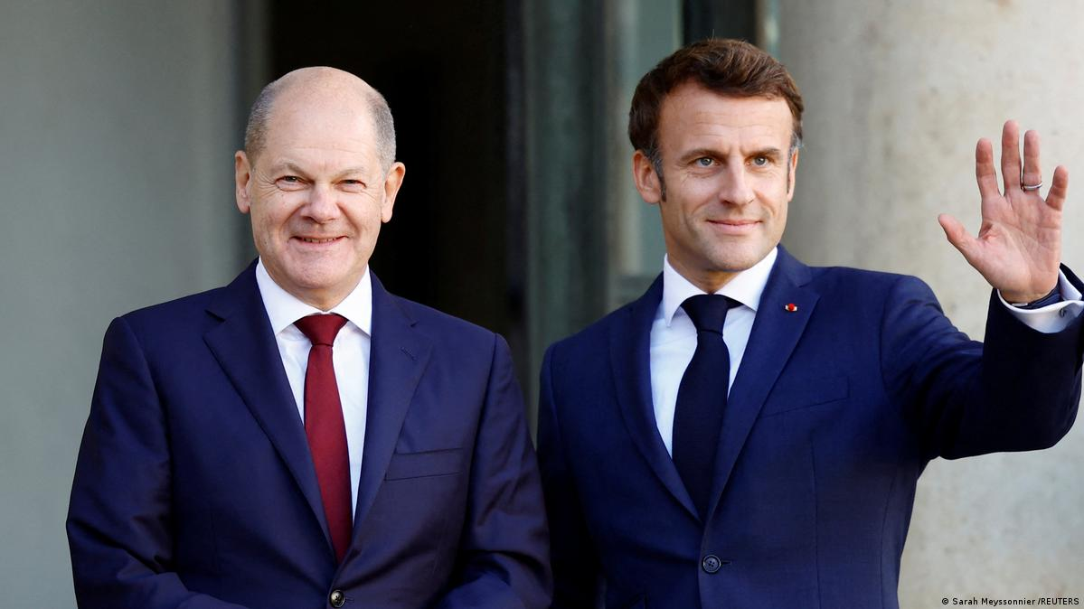
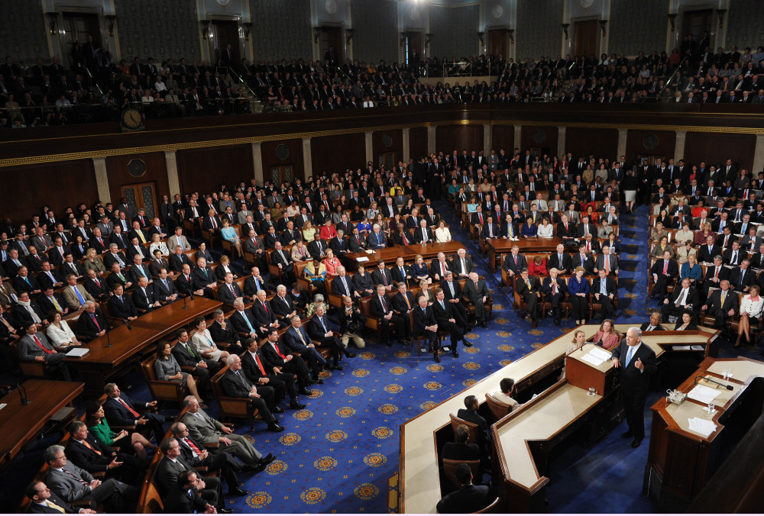
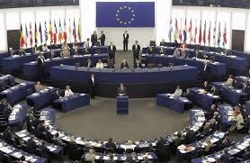
Leaders

Slide 10

International organizations

Slide 11

International Organizations OECD

Slide 12
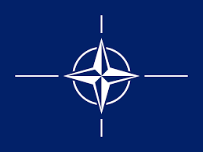
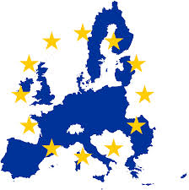
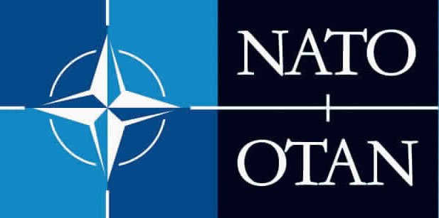
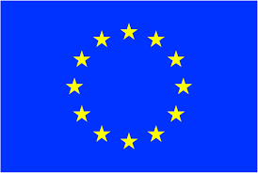
NATO EU

Slide 13


Multinationals

Slide 14


Multinationals

Slide 15
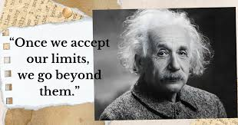

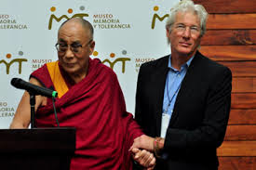
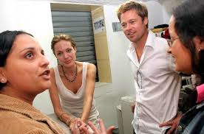
VIPs

Slide 16


International activist organizations

Slide 17


International organizations

Slide 18
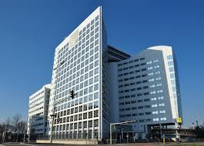
International Court at the Hague

Slide 19
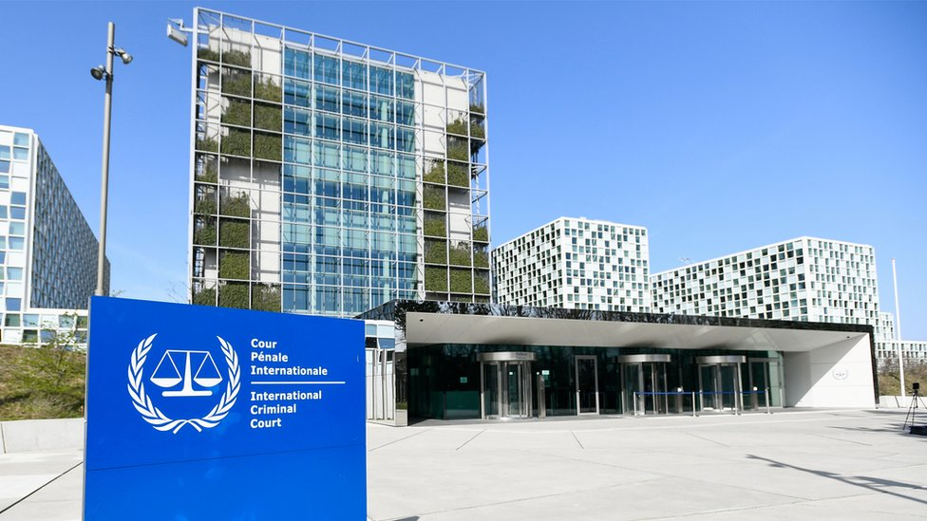
International Criminal Court

Slide 20
Current geopolitical conflicts: states, states, states
-Wars:
Russia-NATO, Ukraine
Israel-Hamas-Lebanon/Hezbollah
-Trade wars
-USA vs. China vs. Latin America vs. EU (MAGA)
-EU vs. China
-North vs. South Europe
-NATO vs. Houthis

Slide 21
Other types of geopolitical competition except wars
Demographics
New technologies: e.g. AI
Brain drain
Energy
Raw materials

