Slide 1
THE ROLE OF A FLAG STATE IN TODAY’S SHIPPING ENVIRONMENT
Presented by:
Konstantinos Levitikos
Technical and Safety, Manager
(International Registries, Inc., Piraeus)
University Of Piraeus, Greece
26 March, 2026

Slide 2
WHO WE ARE
International Registries, Inc. and its affiliates (IRI) provide administrative and technical support to the Republic of the Marshall Islands (RMI) Maritime and Corporate Registries.
IRI provides a broad spectrum of services for the shipping and financial services industries.

Slide 3
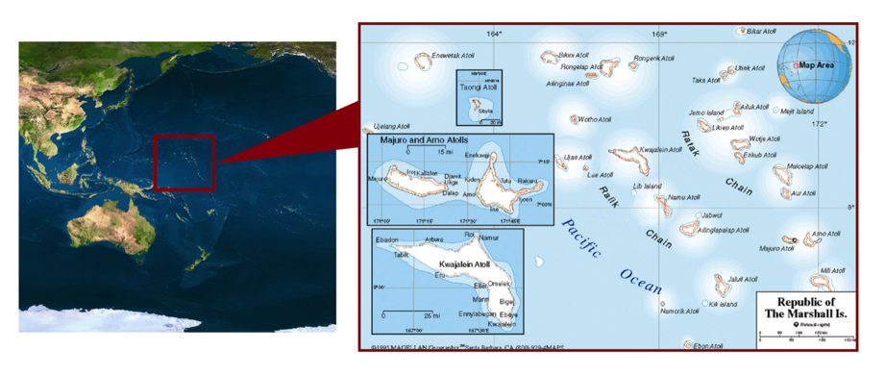
RMI

Slide 4
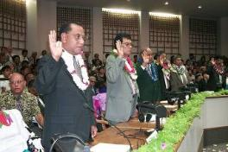
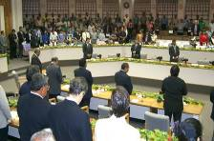
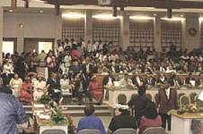
POLITICAL STABILITY
Population
83,037
(2025 est.)
Capital
Majuro
Government Type
Sovereign nation; blend of United
Kingdom (UK) parliamentary and US style of government
Total Area
Land area: 70 square miles
Islands and islets: 1,225
Sea area: 750,000 square miles*
*Source: https://www.state.gov/countries-areas/marshall-islands/

Slide 5
ROLE OF THE FLAG STATE
The shipping industry has an international character, which has been extensively strengthened in this modern globalized economy. More than 95% of all international trade is worldwide. As a result, ships, like human beings, require a name, nationality, and transportation documents.
The ascription of nationality to a ship is one of the most important means by which public order is maintained at sea.

Slide 6
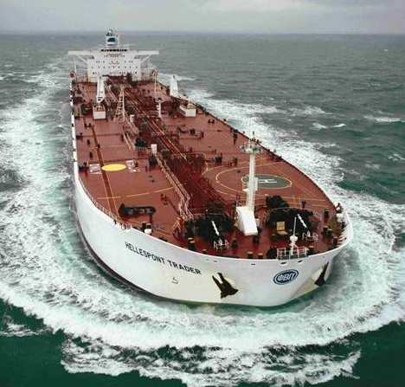
UN CONVENTION ON THE LAW OF THE SEA (UNCLOS) ARTICLE 91 – NATIONALITY OF SHIPS
The flag State confers nationality to ships and implies:
  what rights the ship enjoys;
  obligations the ship may be subject to; and
  the law of the State that governs the ship.

Slide 7
UNCLOS ARTICLE 94 –
DUTIES OF THE FLAG STATE
General Jurisdiction and Control
“In particular every State shall:”
Exercise Jurisdiction: “Effectively exercise its jurisdiction and control in administrative, technical, and social matters…”
Maintain Register: “Maintain a register of ships containing names and particulars of ships flying its flag...”
Assume Domestic Jurisdiction: “Assume jurisdiction under internal law over each ship flying its flag and its master, officers, and crew...”

Slide 8
UNCLOS ARTICLE 94 –
DUTIES OF THE FLAG STATE (continued)
Safety at Sea Measures Taken Include:
Ensuring Seaworthiness: Regarding the construction, equipment,
and seaworthiness of ships.
Regulating Manning: Regarding the manning of ships and
labour conditions.
Mandating Training: Regarding the training of crews, taking into
account international instruments.
Safety of Navigation: Regulate the use of signals, maintenance of communications, and prevention of collisions.

Slide 9
UNCLOS ARTICLE 94 –
DUTIES OF THE FLAG STATE (continued)
Inspection and Certification
Initial and Periodic Surveys: Ensure each ship is surveyed by a qualified surveyor before registration and at appropriate intervals thereafter.
Mandate Onboard Equipment: Ensure ships carry appropriate charts, publications, and navigational equipment.
Verify Qualifications: Ensure the master and officers possess appropriate qualifications in seamanship, navigation, and engineering.
Verify Crew Competence: Ensure the crew is appropriate in qualification and numbers for the ship type.
Ensure Regulatory Observance: Ensure master and crew are conversant with and required to observe international regulations such as the International:
  Convention for the Safety of Life at Sea (SOLAS)
  Regulations for Preventing Collisions at Sea (COLREGs), and
  Convention for the Prevention of Pollution from Ships (MARPOL).

Slide 10
UNCLOS ARTICLE 94 – DUTIES OF THE FLAG STATE
Conform to International Standards: Conform to generally accepted international regulations, procedures, and practices.
Investigate Reports of Non-compliance: Investigate matters when another State reports clear grounds that proper jurisdiction has not
been exercised.
Conduct Casualty Inquiries and Cooperate on Inquiries: Cause an inquiry into every marine casualty or incident on the high seas involving loss of life, serious injury, or serious damage. Cooperate with other States in the conduct of any inquiry held by that other State into
such casualties.

Slide 11
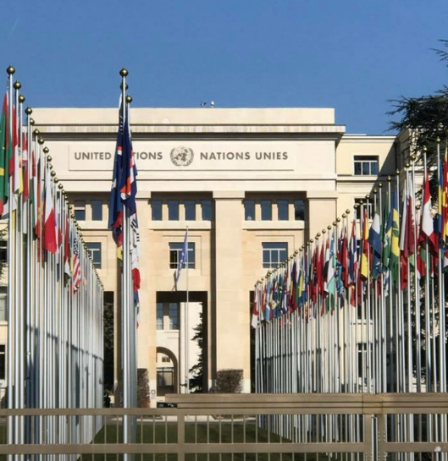

INTERNATIONAL REPRESENTATION
IMO and ILO participation
FLAG STATES MUST:
enforce applicable international laws;
participate in the work of international organizations; and
disseminate pertinent information.

Slide 12
IMO AUDIT SCHEME AND INTERNATIONAL ORGANIZATION FOR STANDARDIZATION
(ISO) CERTIFICATION
Evaluate the results
Identify possible problems
Work on the committees to overcome possible difficulties
Requires:
  Strong presence
  Active participation
  Proactive systems

Slide 13

REGULATORY AFFAIRS
International Representation
Active representation and delegation to committee and subcommittee meetings at the IMO
Participates at the ILO meetings
The RMI is a signatory to and enforces major conventions and
their related codes such as:
SOLAS
MARPOL
International Convention on Standards of Training, Certification and Watchkeeping for Seafarers, 1978
The International Convention on Load Lines (LL)
MLC, 2006
Issuance of Marine Notices (MNs), Guidelines, and Safety Advisories

Slide 14
DECENTRALIZATION

Slide 15
REGIONAL SUPPORT

Slide 16
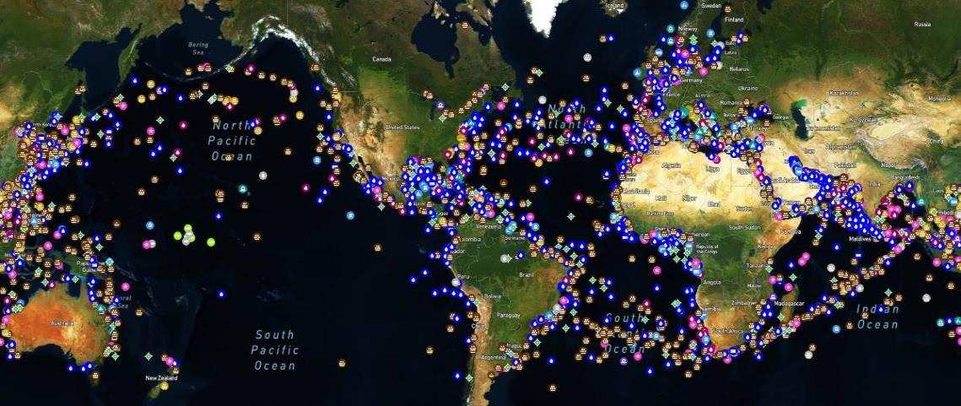
LONG-RANGE IDENTIFICATION AND
TRACKING (LRIT) VIEW OF THE RMI FLEET

Slide 17
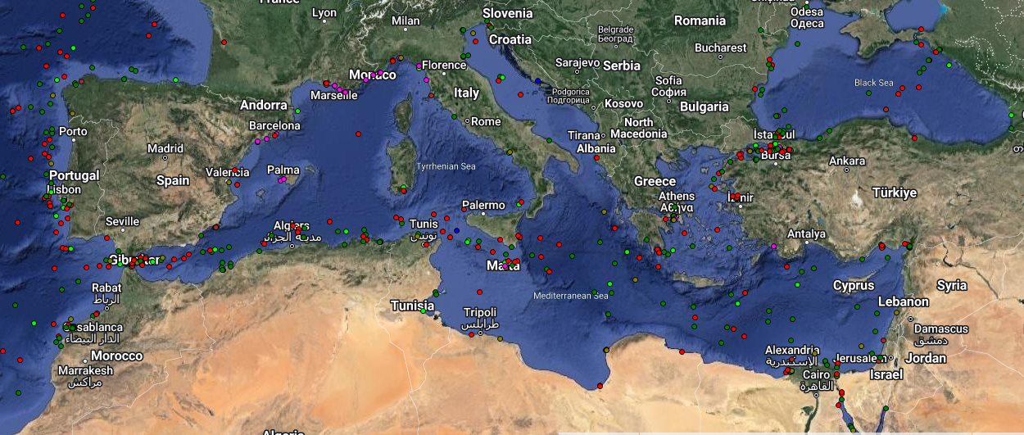
LRIT VIEW OF THE RMI FLEET MEDITERRANEAN SEA

Slide 18
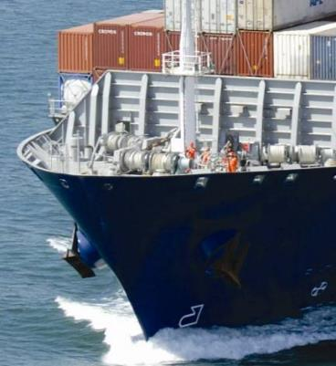
DECENTRALIZED REGISTRY SERVICES
Vessel Registration
Marine Safety and Security
Regulatory
Technical
Seafarers’ Identification
Radio Station Licensing
“KEEP THE SHIPS MOVING”

Slide 19
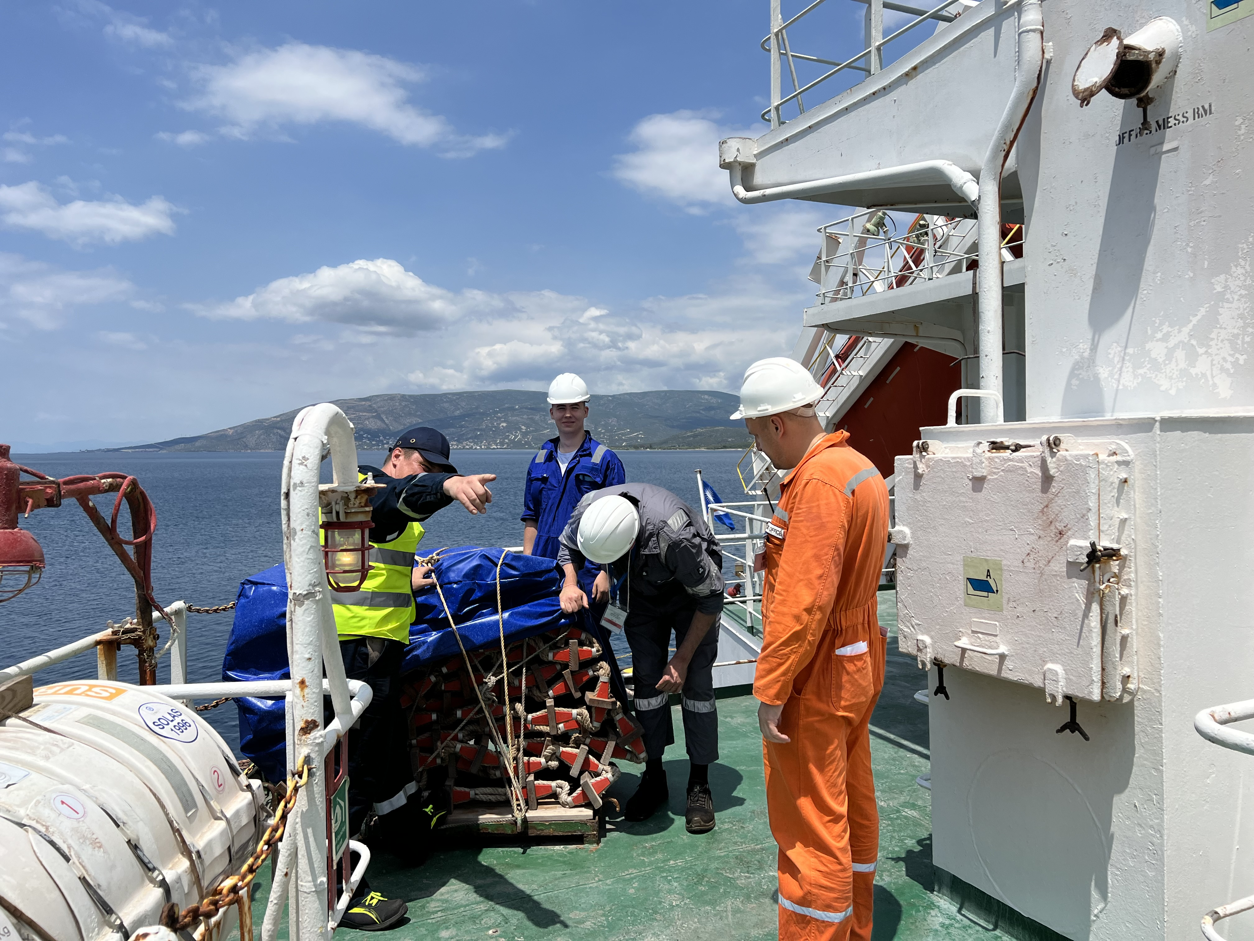
OPERATING FEATURES
Pre-registration screening
Annual safety inspections
Vessel watch list

Slide 20
MARINE SAFETY AND TECHNICAL
Vessel and operator
risk assessments
Marine Safety and Technical
experts worldwide
Oversight of Recognized Organizations (ROs) acting on behalf of the RMI Maritime Administrator
(the “Administrator”) for issuance of statutory certificates
Annual, Semi Annual, and Special Safety Inspections including quality control boardings
Interpretation of IMO requirements
Close contact with the local
port State control (PSC) officials

Slide 21
TECHNICAL POLICY
24/7 availability – timely coverage – prompt response.
Proper evaluation of each case (criticality / severity) and/or proper follow-up.
Uniformity on email response / handling at the regional and worldwide level (according to statutory procedures / rules and requirements).
Ongoing and continuous educational training – updated with the latest requirements and marine technology.

Slide 22
TECHNICAL
Dispensations
Service Extensions
Trade Compliance
Casualties
Letters of Acknowledgements
Investigations (partly)
Recognized Organization (RO) Authorizations / Classification Society (Class) Involvement
Daily Technical Issues /
Operator’s General Queries
Verbal Clarifications / Physical Presence

Slide 23
OTHER DUTIES
Participating / presenting at technical conferences
Technical seminars
Meeting with operators (upon request)
Meeting with vendors / suppliers / service providers (upon request)
Participating in technical committees
Classification Society Consultative Committee meetings
Regional technical meetings (internal / external)
Onboard attendance (upon request)
Investigations (upon request)
Radio cases (upon request)

Slide 24
VETTING
Development of an efficient and effective vetting system for new ships and managers
Vetting includes examination of the previous record of the ship and International Safety Management (ISM) Code managers

Slide 25
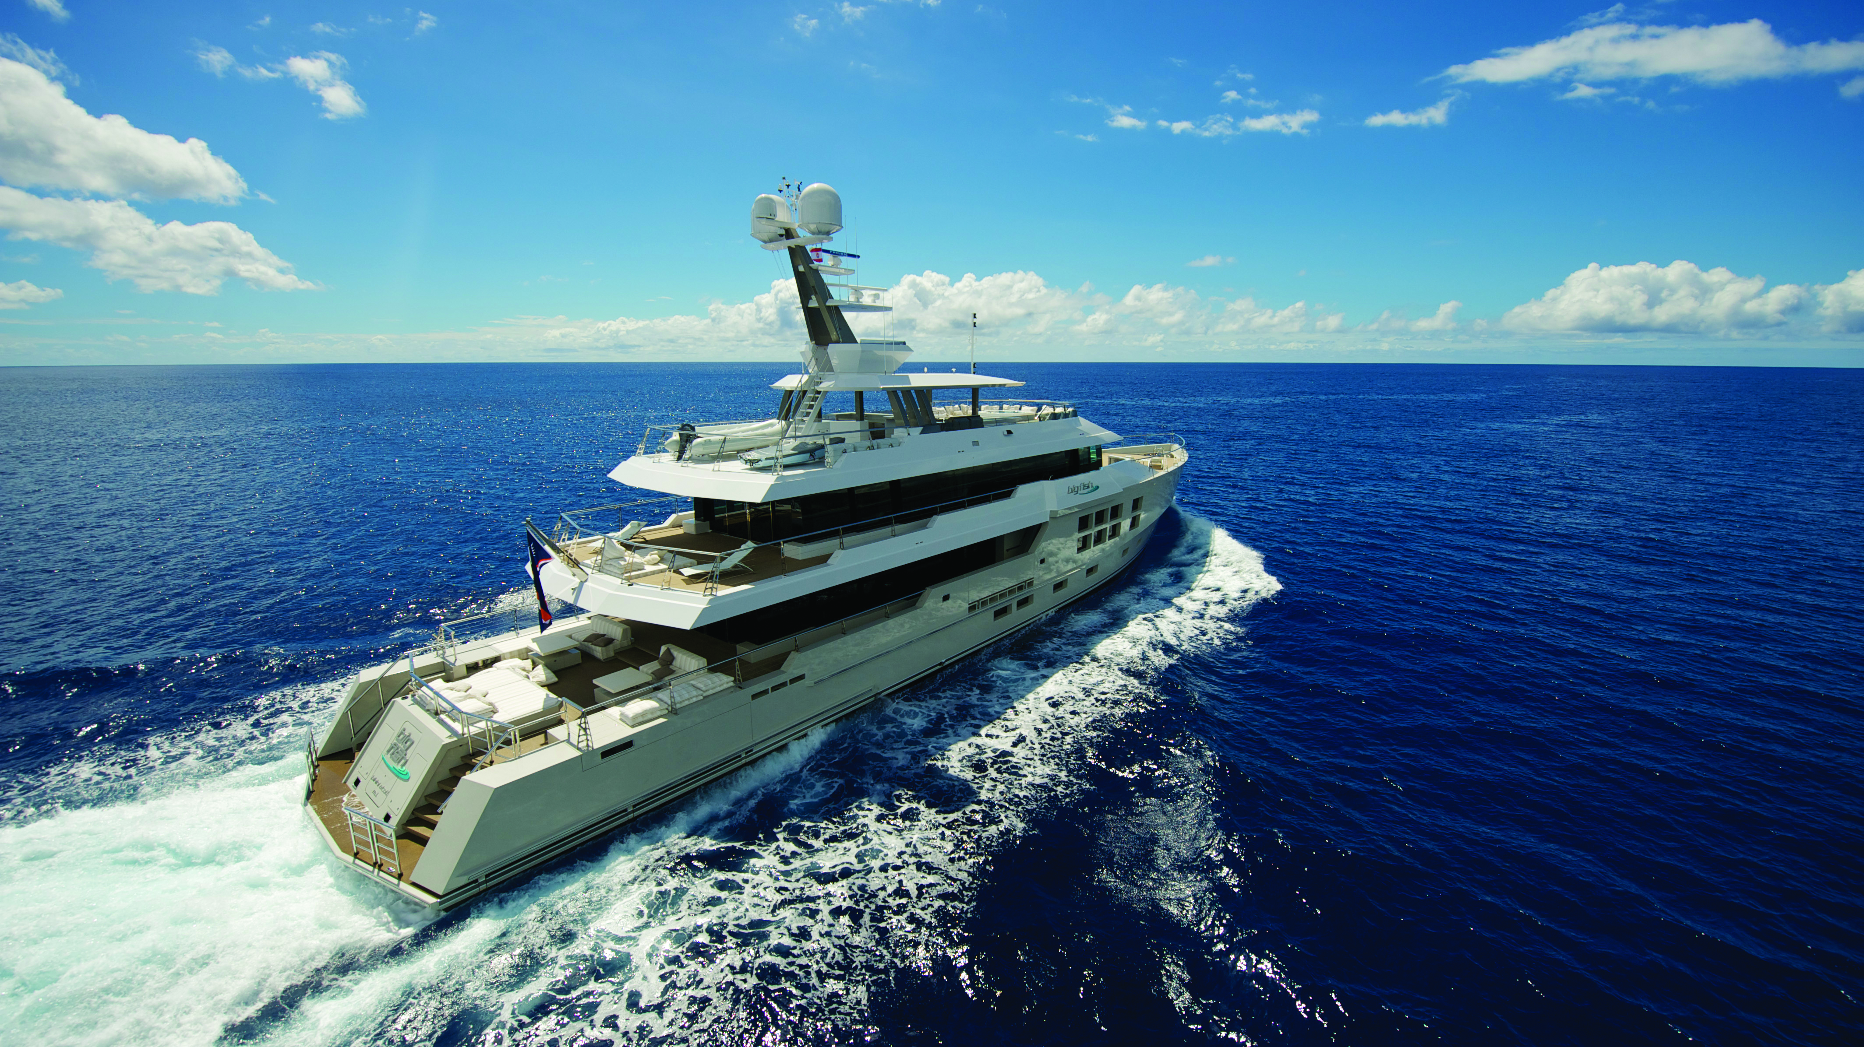
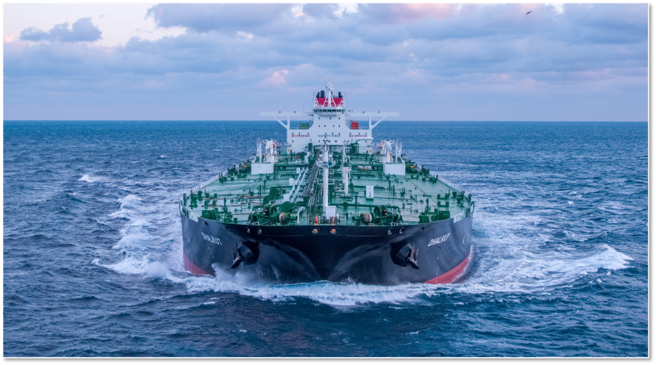
VESSEL REGISTRATION
Home Port: Bikini
Home Port: Majuro

Slide 26
VESSEL REGISTRATION (continued)
REQUIREMENTS:
Legal documentation
International Association of Classification Societies (IACS) documentation and survey report
Cancellation from the previous flag, if applicable
PROVIDES:
Ownership recordation
Mortgage security
Governing law
Protection afforded to that nationality

Slide 27
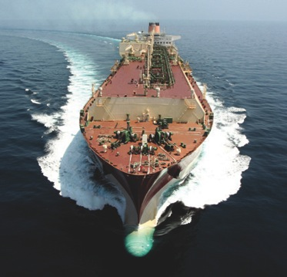
VESSEL REGISTRATION (continued)
Must be held by an RMI business entity or
a qualified foreign maritime entity (FME)
Vessels should be under 20 years of age
Clear and simple procedure
All applications / mortgages in English
Competitive fees
Professional and efficient service
The Provisional Certificate of Registry
is issued at the time of closing and is
valid for 12 months

Slide 28
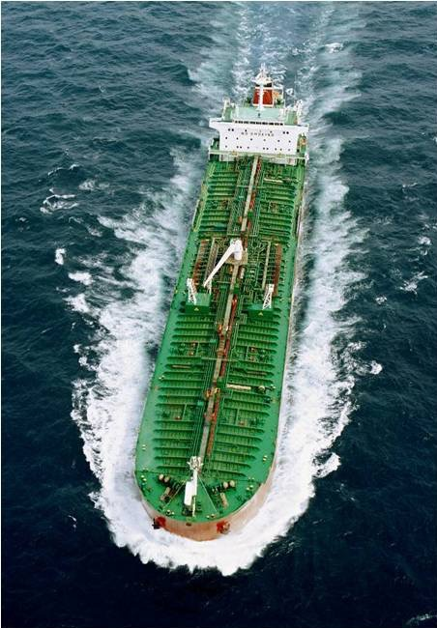
REGISTRATION OF SHIPS AND MORTGAGES
Properly recorded in a public mortgage registry
Insulated from political instability or other incidents
Recorded in English
Includes satisfactory statutory provisions covering the ranking of liens
Permits speedy deletion of a vessel

Slide 29
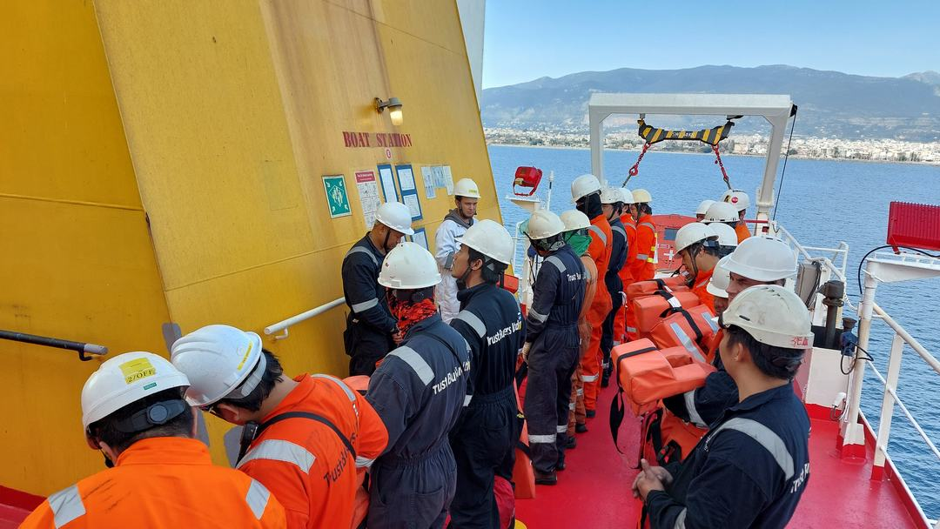
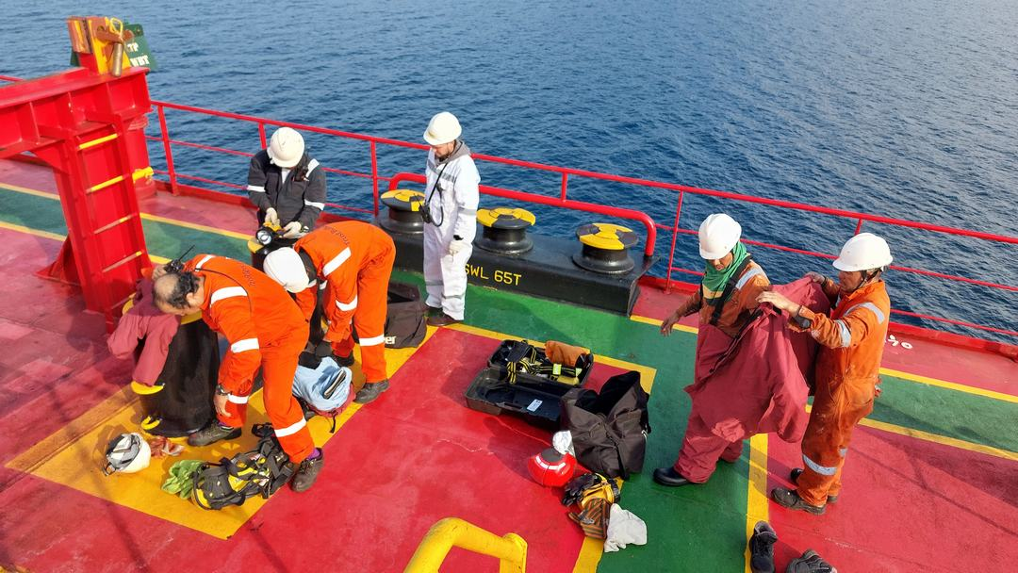
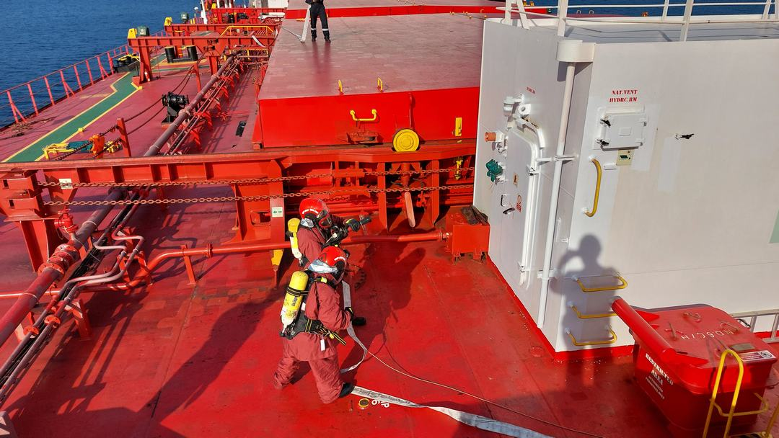
FLEET OPERATIONS:
MARINE SAFETY
Good mustering
Conducting flag State safety inspections
on the vessels
Proactively informing operators on ship inspection-related information trends
Analyzing and evaluating flag State and
PSC inspections data
Providing training to crew / office personnel on flag state inspection-related matters
Monitoring and handling of PSC activities
in every region
Fire squad preparation
Fire squad in action

Slide 30
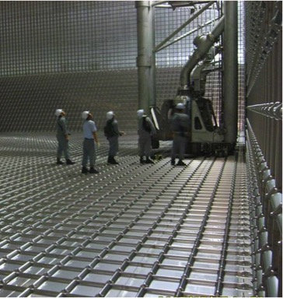
TECHNICAL:
RMI INVOLVEMENT – CONSTRUCTION
Assignment of Official Number and Call Sign in order to program the equipment
Vessel is built in accordance with Class rules and international standards
SOLAS, MARPOL, and other international conventions apply during construction
RO / Recognized Security Organization (RSO) oversight:
    ISPS / ISM Code audits
    Close contact with local Class offices
    Regular meetings with all ROs / RSOs
Vessel and operator risk assessments on a monthly basis

Slide 31
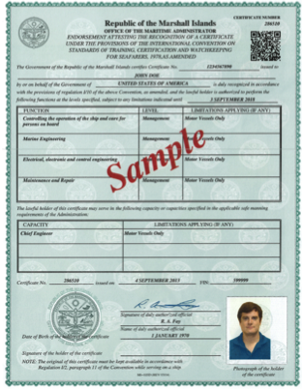
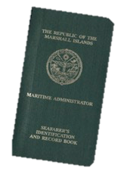
MANNING AND LICENSING
Each crewmember must hold an
RMI Seafarer's Identification and Record Book
Officers must apply for
RMI endorsements
Decentralization of issuance of original documentation
Electronic / online application system

Slide 32
INVESTIGATIONS
Serious marine accidents or casualties must be reported
to the Administrator
Review and make determination as to required attendance
Obligation to report to the IMO

Slide 33
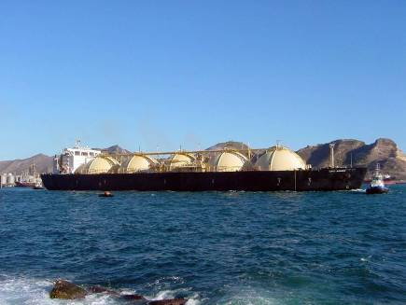
REGISTRY GROWTH
The RMI Maritime Registry has experienced significant growth since January 2000 surpassing 207 million quality gross tons (GT) with 6,152 vessels.

Slide 34
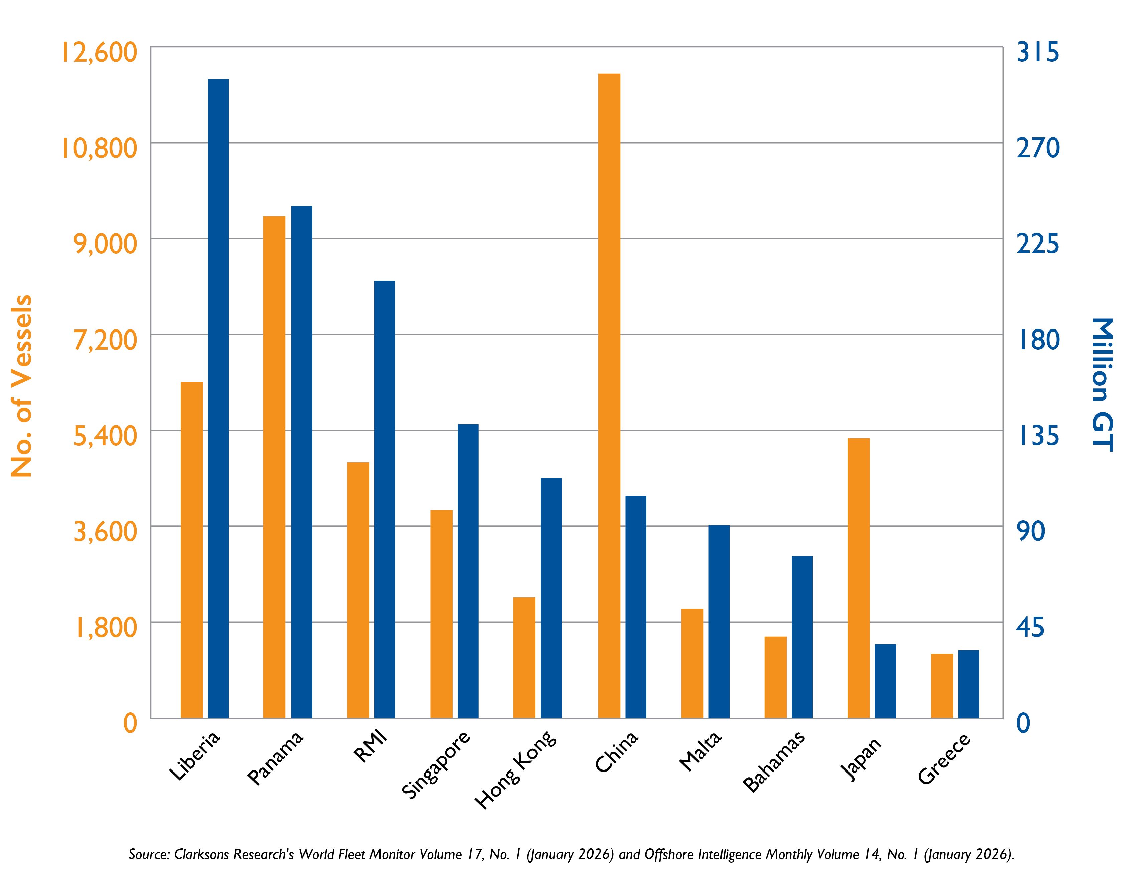
TOP 10 FLAG STATES

Slide 35
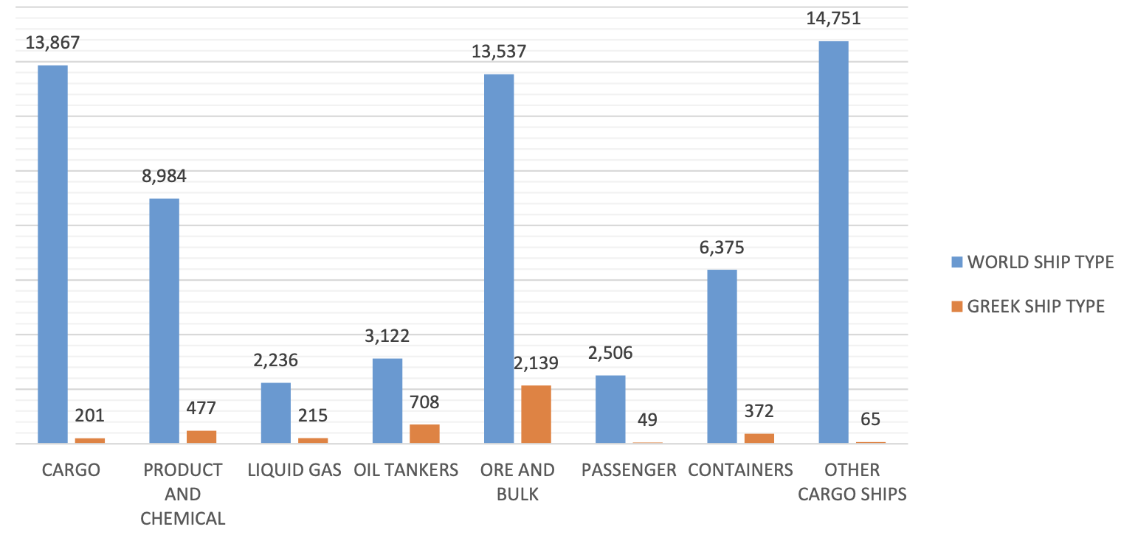
WORLD AND GREEK-CONTROLLED FLEETS
BY SHIP TYPE AND SHIP NUMBERS
Source: Greek Shipping Co-operation Committee Report, March 2025

Slide 36
GREEK SHIPPING’S SHARE
IN THE EUROPEAN UNION
Greek shipping is the fundamental pillar of European shipping as it accounts for more than 61% of the European Union (EU)-controlled fleet.
In particular, Greek shipowners control 81% of the EU-controlled bulk carriers, 77% of the EU-controlled oil tankers, 79% of the EU-controlled LNG carriers, and 84% of the EU-controlled containerships. The Greek-owned fleet is registered under 29 flags, and more than one-third of the fleet flies the flag of an EU member state, thereby further supporting the sector’s added value to the EU economy.
Source: European Commission, EU Transport in Figures, Statistical Pocketbook 2024, and Clarksons Research (January 2025).

Slide 37
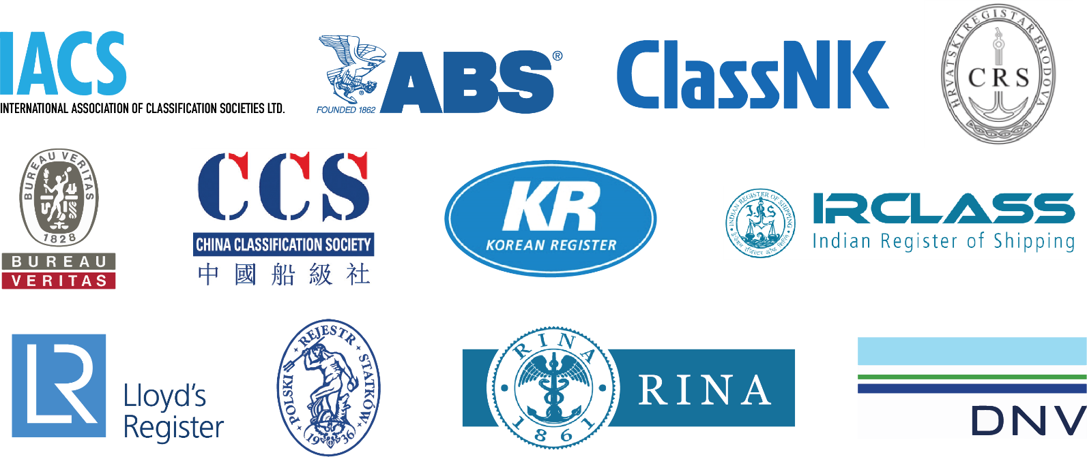
CLASS INTERACTION

Slide 38

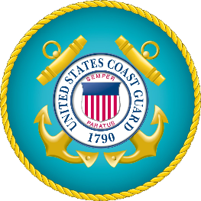
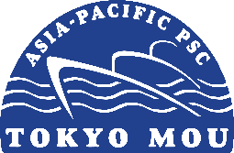
PSC
Paris Memorandum of Understanding (MoU): Belgium, Bulgaria, Canada, Croatia, Cyprus, Denmark, Estonia, Finland, France, Germany, Greece, Iceland, Ireland, Italy, Latvia, Lithuania, Malta, the Netherlands, Norway, Poland, Portugal, Romania, Slovenia, Spain, Sweden, UK
US Coast Guard (USCG): US
Tokyo MoU: Australia, Canada, Chile, China, Fiji, Hong Kong,
Indonesia, Japan, Malaysia, New Zealand, Panama, Papua New Guinea, Peru, Philippines, Republic of Korea, RMI, Singapore, Thailand, Vanuatu, Vietnam

Slide 39
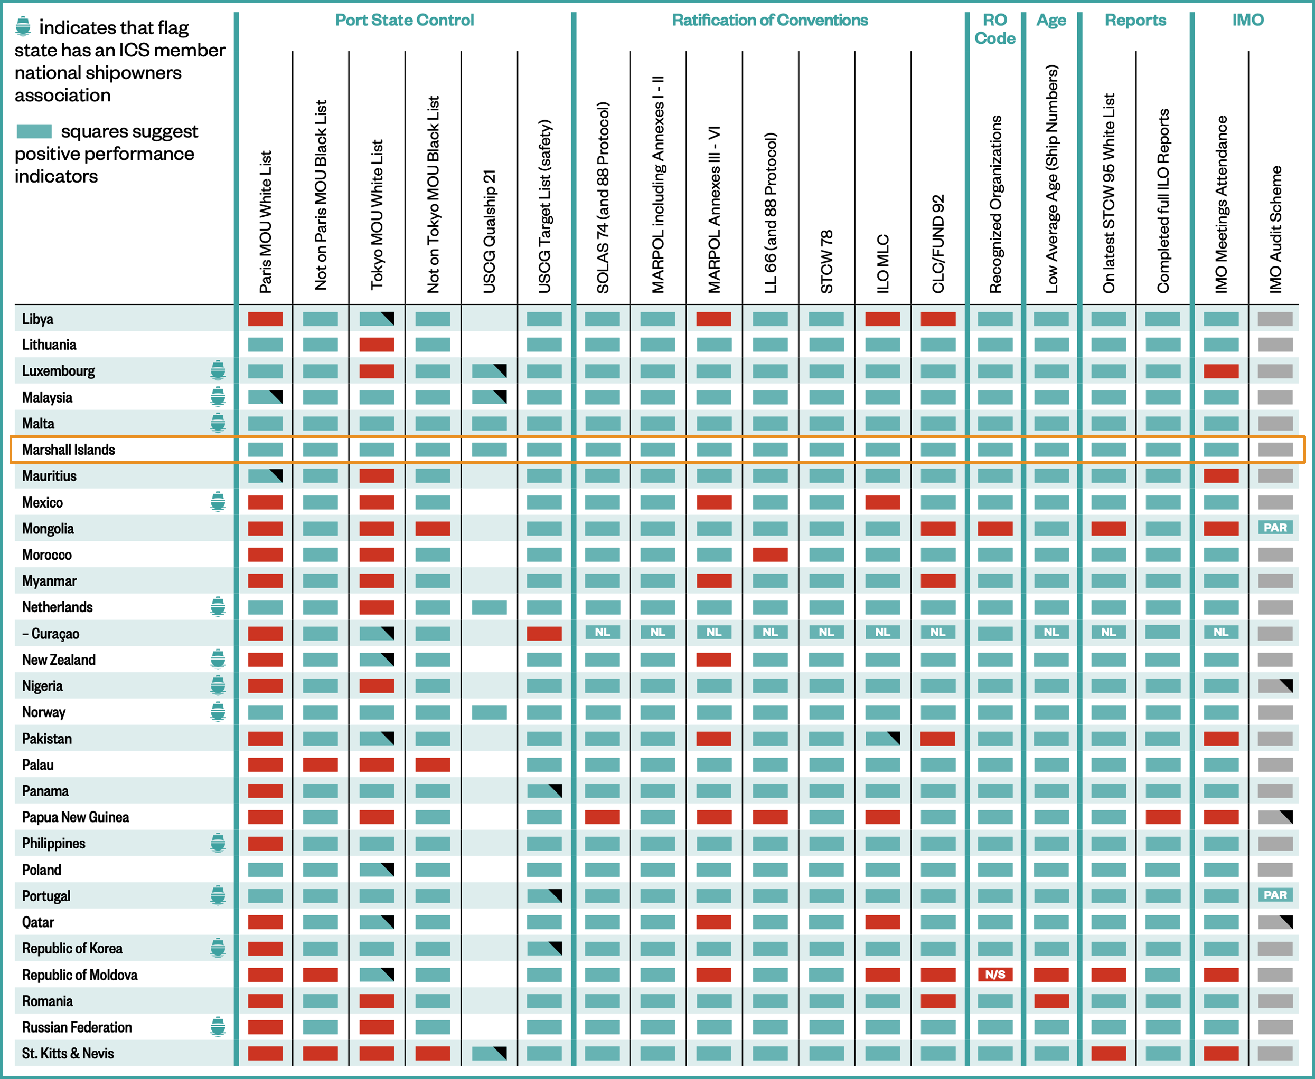
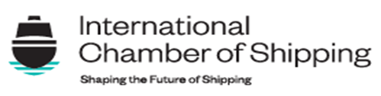
2025 / 2026 FLAG STATE PERFORMANCE TABLE

Slide 40
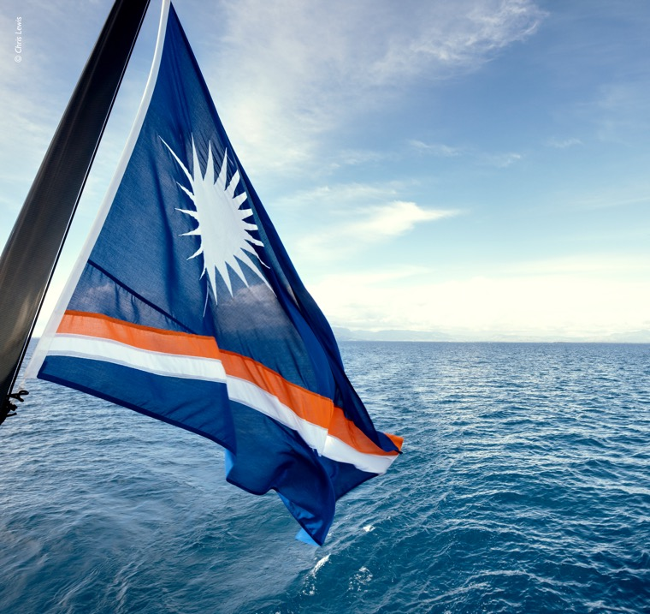
CONCLUSION
Quality flag
Measurable “high-standard”
operations
Experienced personnel
Worldwide infrastructure
Exceptional service to our clients
“KEEP THE SHIPS MOVING SAFE”

Slide 41
THANK YOU

