Slide 1

ΕΡΓΑΛΕΙΑ ΚΑΙ ΣΤΡΑΤΗΓΙΚΕΣ ΔΙΑΧΕΙΡΙΣΗΣ ΣΥΣΤΗΜΙΚΩΝ ΚΙΝΔΥΝΩΝ_08052026
ΟΙΚΟΝΟΜΙΚΗ ΤΩΝ ΕΠΙΧΕΙΡΗΣΕΩΝ
.

Slide 2


Slide 3
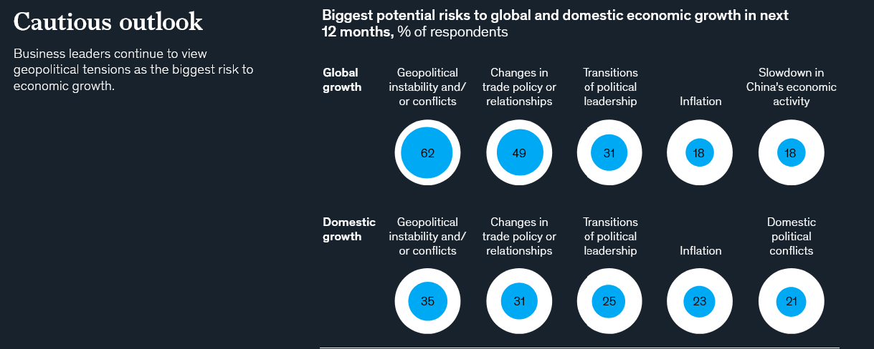
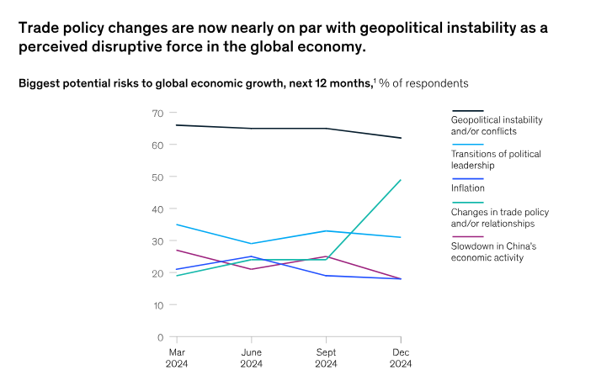

Slide 4
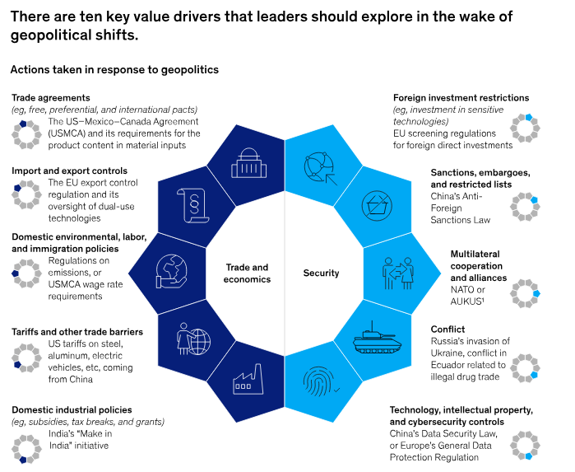

Slide 5
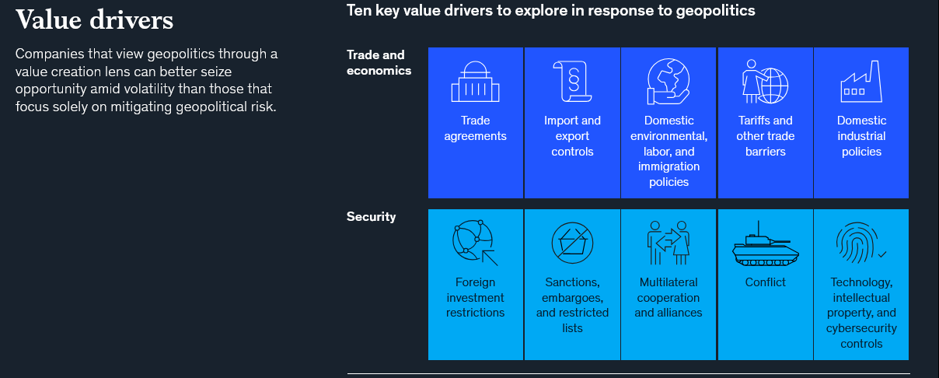

Slide 6
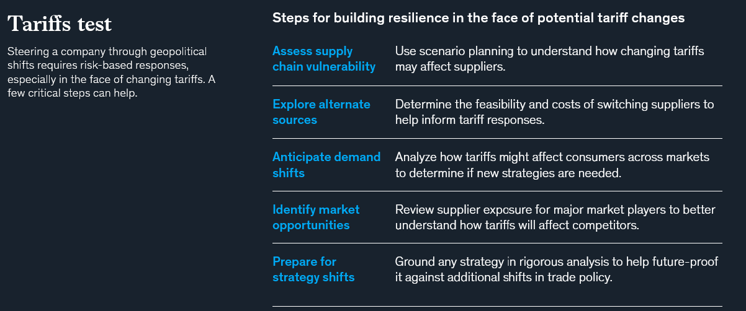

Slide 7
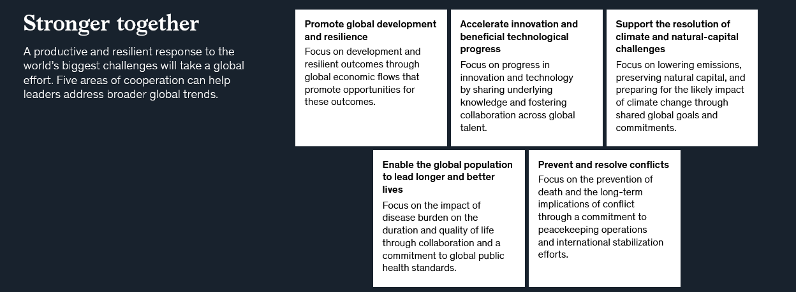

Slide 8
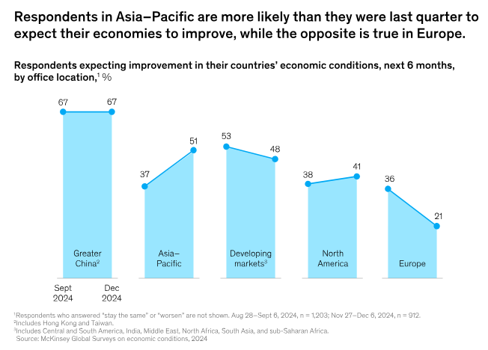

Slide 9
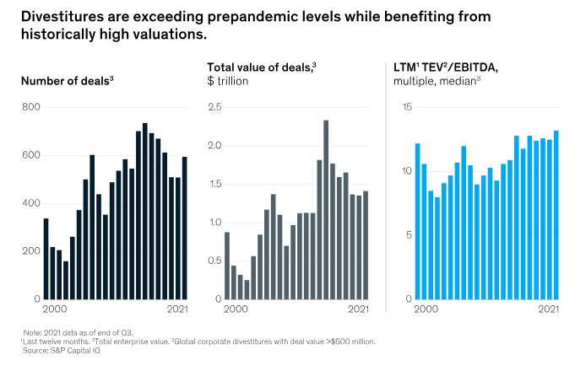
When bigger isn’t always better
As revenues increase, so do costs and complexity. Some operational and other synergies may materialize—but eventually executives and boards realize how difficult it is to add value to businesses that have little or no direct connection to the company’s core business.
The realization may come when a business unit’s performance is lagging behind that of its peers with no clear path to catch up. Or a review of the company’s portfolio may reveal that some business units’ cost structures are not comparable with peers. Or executives may recognize that the company lacks sufficient management capabilities to grow all the businesses in its portfolio.

Slide 10
When separating businesses, people are the key to unleashing value
Separations have become a widely adopted strategy for creating value, but their popularity does not mean these complex transactions are always effective. For instance, spin-offs—one of the main types of corporate separations, alongside divestitures and carveouts—have hit record numbers in recent years, but these deals are not guaranteed to create value for both the remaining and new businesses.
Set the foundation with talent and culture. Identify a list of key talent and roles. What are the unique roles or highly specialized skills that are critical to creating value for the business, and how do we identify them? Which new skills are needed to achieve the strategic goals of the separated organization? How can we match the best-fit employees with our most important roles to achieve the highest levels of productivity?
Culture. High-performing organizations are fueled by a strong culture—that is, the common set of behaviors, mindsets, and beliefs that shape how people work and interact. The jolt of a separation, while challenging, provides a great opportunity to reset the culture of the separated entity in service of what matters the most in the new company.
Inspire employees with a vision for change. Throughout the separation process, leaders will need to consistently communicate why the planned change will benefit all stakeholders, including investors and employees. Leaders should be clear about the strategic rationale for the separation and how it will serve the purpose of the new company. Companies should deliver a “true north” vision that will inspire employees to get behind the change and feel connected to the work required to meet the new objectives.

Slide 11
Why the Most Successful Companies Are Scalable
Existing belief/theory: a core assumption in economics is that the most successful companies achieve their dominance purely through superior productivity
New research (January 2025, Wharton University) tackle a central question in firm dynamics: “Are larger firms more productive, or do they just have more scalable technologies?”
“Our quantitative analysis shows that differences in (“returns to scale” RTS have important implications for the impact of financial frictions.”— Sergio Salgado
“In the traditional view, we think of large companies like Amazon as simply more productive than others. But that doesn’t quite capture it,” said Hubmer. “Amazon is unique because it’s scalable, and that’s something that seems built into their technology.”
Scalability, not just “total factor productivity” (TFP), explains why some companies grow significantly larger than others.While productivity grows with revenue, it plateaus for the largest firms, whereas scalability keeps climbing. In fact, the top 5% of firms enjoy RTS around 10 percentage points higher than their smaller peers, allowing them to expand efficiently even as they grow larger.

Slide 12
Step 1: Marketing and Customer Value - The Value Delivery Process
The traditional—but dated—view of marketing is that the firm makes something and then sells it, with marketing
taking place during the selling process. Companies that take this view succeed only in economies marked by
goods shortages where consumers are not fussy about quality, features, or style—for example, basic staple goods
in developing markets.
In economies with many different types of people, each with individual wants, perceptions, preferences, and
buying criteria, the smart competitor must design and deliver offerings for well-defined target markets. This
Realization inspired a new view of business processes that places marketing at the beginning of planning. Instead of
emphasizing making and selling, companies now see themselves as part of a value delivery process.
We can divide the value creation and delivery sequence into three phases:
First, choosing the value is the “homework” marketers must do before any product exists. They must segment the market, select the appropriate target, and develop the offering’s value positioning. The formula “segmentation, targeting, positioning (STP)” is the essence of strategic marketing.
The second phase is providing the value. Marketing must identify specific product features, prices, and distribution.
The task in the third phase is communicating the value by utilizing the Internet, advertising, sales force, and any other communication tools to announce and promote the product. The value delivery process begins before there is a product and continues through development and after launch. Each phase has cost implications.

Slide 13
The Value Chain
The firm’s success depends not only on how well each department performs its work, but also on how well the company coordinates departmental activities to conduct core business processes. These processes include:
• The market-sensing process—gathering and acting upon information about the market
• The new-offering realization process—researching, developing, and launching new high-quality offerings quickly and within budget
• The customer acquisition process—defining target markets and prospecting for new customers
• The customer relationship management process—building deeper understanding, relationships, and offerings to individual customers
• The fulfillment management process—receiving and approving orders, shipping goods on time, and collecting payment

Slide 14
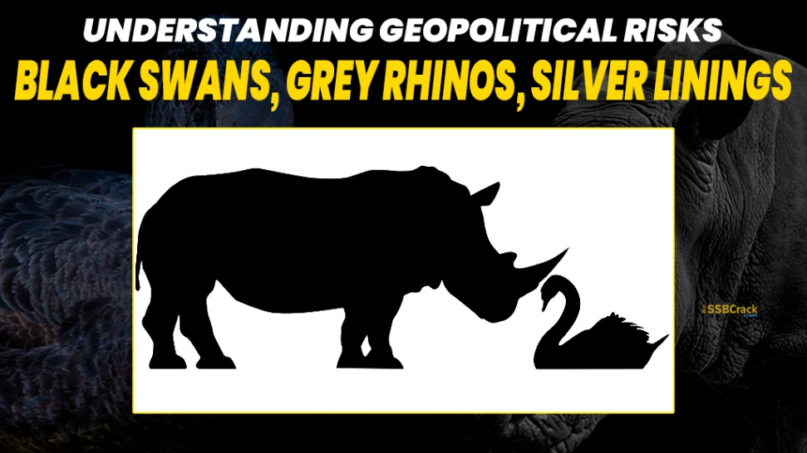
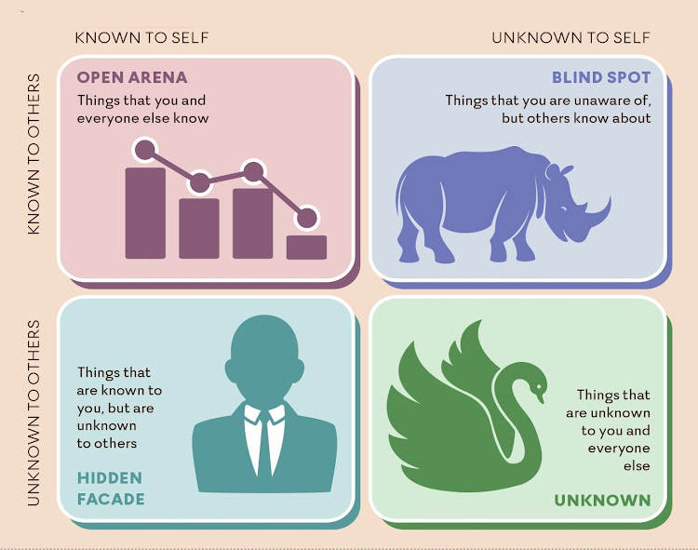
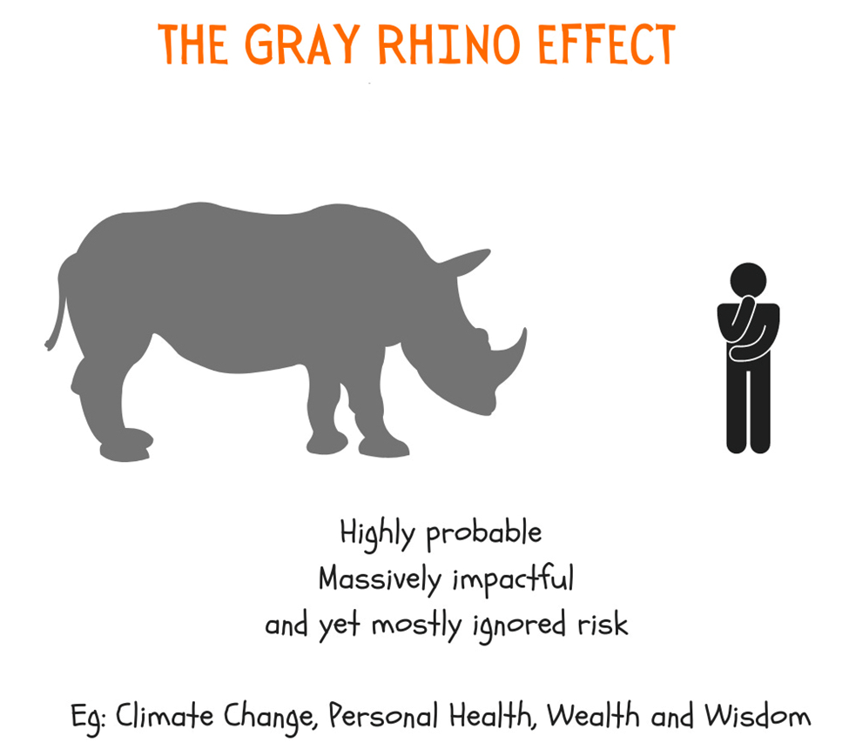
BLACK SWANS_GREY RHINOS AND SILVER LINING

Slide 15
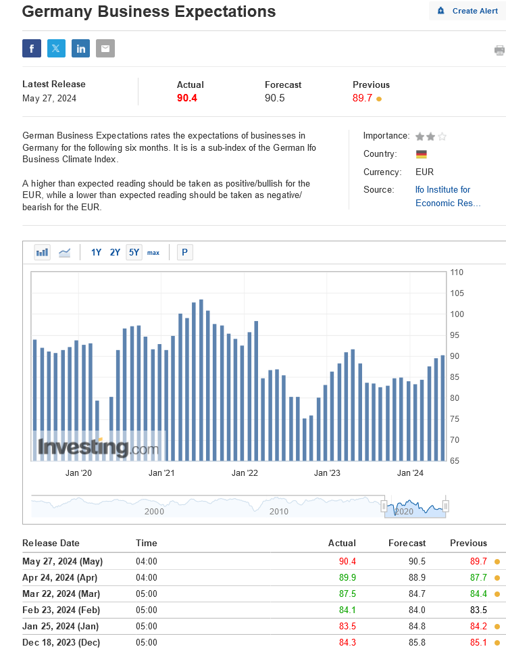
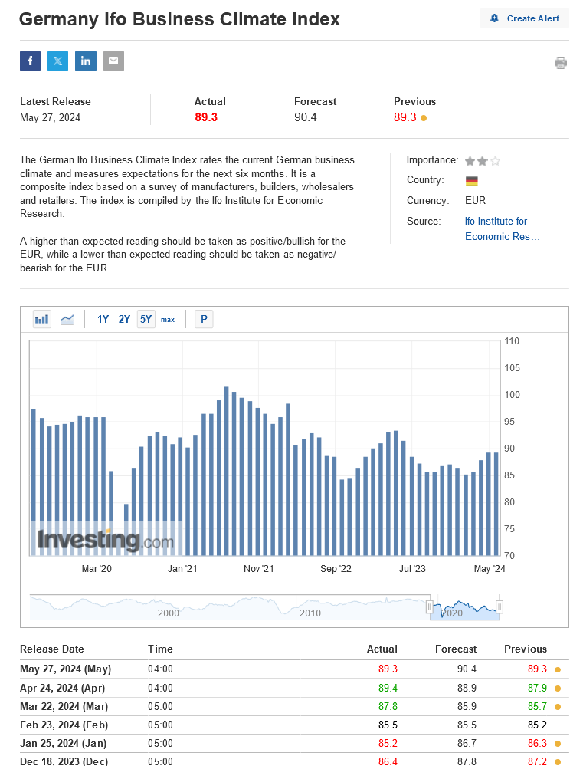
Τι διαμορφώνει την ψυχολογία της αγοράς σήμερα?

Slide 16
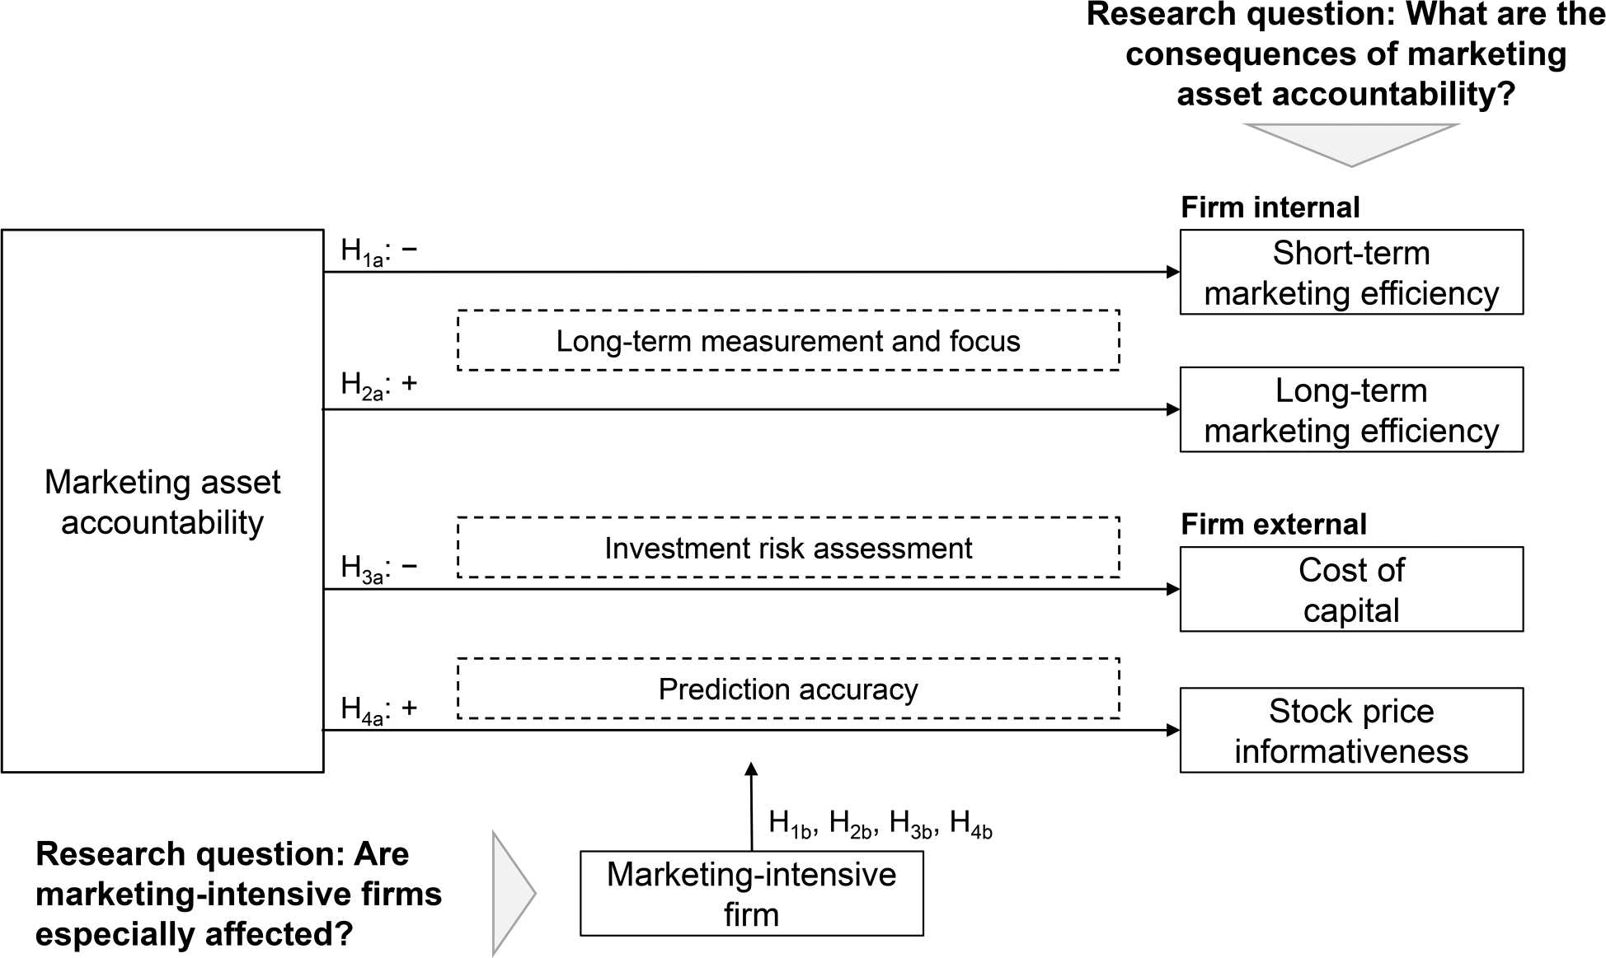
Financial accountability for marketing assets (MAs), such as brands and customer relationships, through regular and systematic financial reports (MA accountability) has been suggested as an especially effective way to demonstrate marketing accountability
(Bendle and Wang 2017). However, the actual consequences of MA accountability are unclear (Morgan et al.2022)
Η Στρατηγική ως Κατεύθυνση και ως Εργαλείο Λειτουργίας σήμερα

Slide 17
Που βρισκόμαστε σήμερα, που θέλουμε να πάμε και πως θα πάμε στο στόχο μας?
Η εξελιξη του Στρατηγικού Μάνατζμεντ
Η Στρατηγική ως Κατεύθυνση και ως Εργαλείο Λειτουργίας σήμερα

Slide 19
Η Αξιολόγηση της Στρατηγικής σημασίας των πόρων και των δυνατοτήτων της εταιρείας

Slide 21
Διαμορφώνοντας μια διεθνή στρατηγική

Slide 22
VISION FIRST – STRATEGIES FOLLOW
(Don’t put the carriage before the horse)

Slide 23
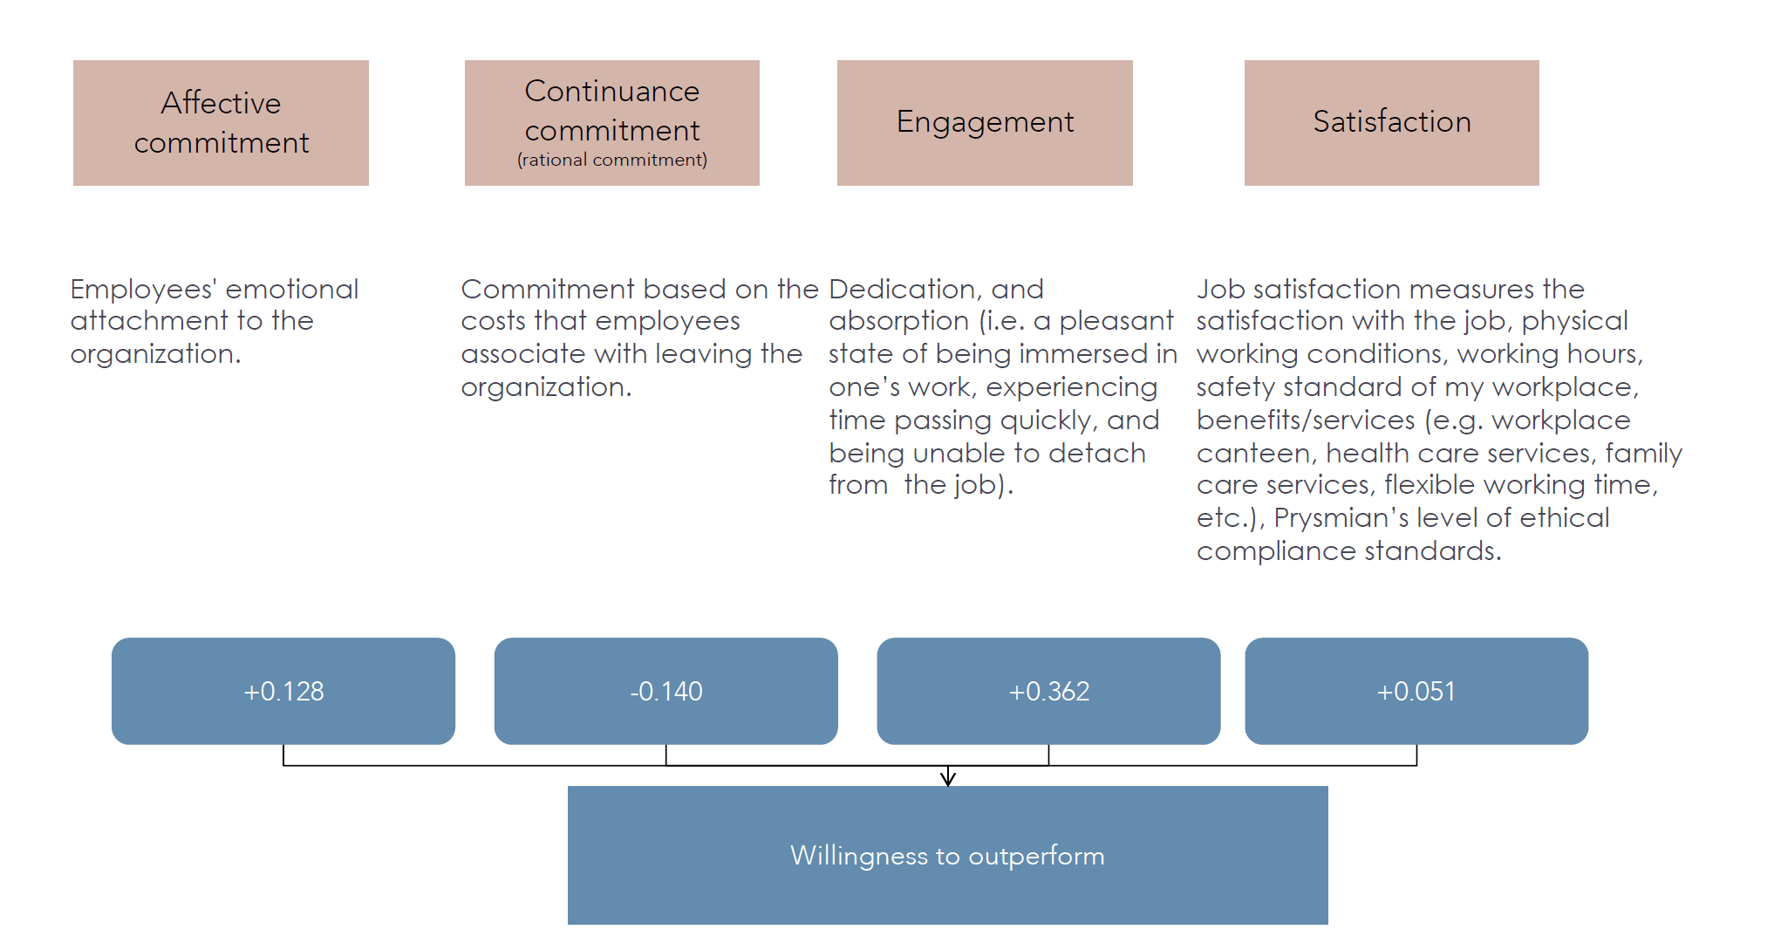
IT’S ALL ABOUT PEOPLE…
ΚΑΤΑΝΟΗΣΗ ΑΝΘΡΩΠΙΝΗΣ ΣΥΜΠΕΡΙΦΟΡΑΣ ΕΝΤΟΣ ΚΑΙ ΕΚΤΟΣ ΣΥΝΟΡΩΝ ΤΗΣ ΕΠΙΧΕΙΡΗΣΗΣ
ΠΑΡΑΜΕΤΡΟΙ ΠΟΥ ΔΙΑΜΟΡΦΩΝΟΥΝ ΤΗΝ ΕΠΙΤΥΧΙΑ ΜΙΑΣ ΕΠΙΧΕΙΡΗΣΗΣ ΜΕΣΩ ΤΗΣ ΕΠΙΤΥΧΙΑΣ ΤΩΝ ΑΝΘΡΩΠΩΝ ΤΟΥ

Slide 24


