Slide 1

CASE STUDY
“VIVA WALLET”
Οικονομική Επιχειρήσεων 14022025
A Case of Destructive Innovation.

Slide 2
Purpose of the presentation
The purpose of the analysis is to highlight the revolution that an innovative company can bring to the industry.
The transformation of the banking industry
Low cost operations vs conventional high break-even systemic banks
    comparison of Viva Wallet as a low - cost company compared to the corresponding services offered by banks
The disruptive case of Viva Wallet
Operates in the field of payment services
“VIVA PAYMENTS” operates as an electronic money issuer and as a payment service provider related to its issuance, use and redemption.
Viva Wallet operates as a Bank providing products such as loans and deposits.

Slide 3
The digital transformation of the banking industry
1

Slide 4
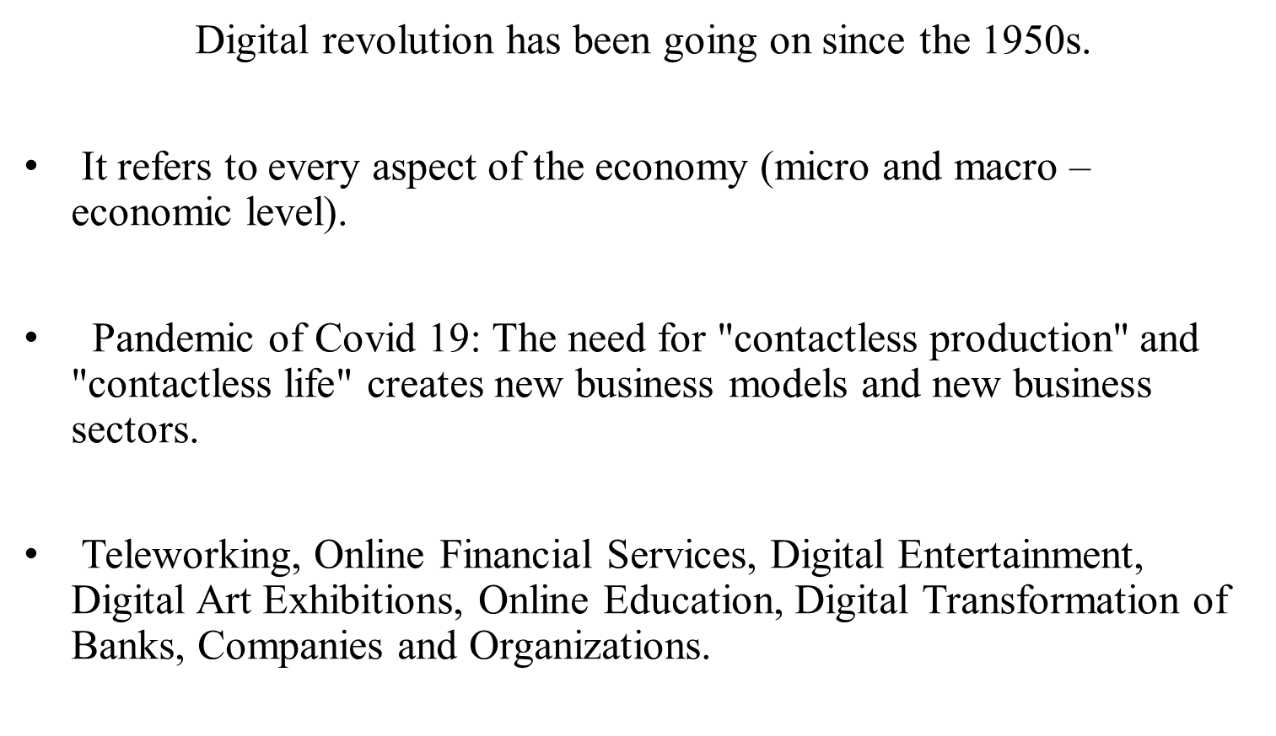
DIGITAL ECONOMY

Slide 5
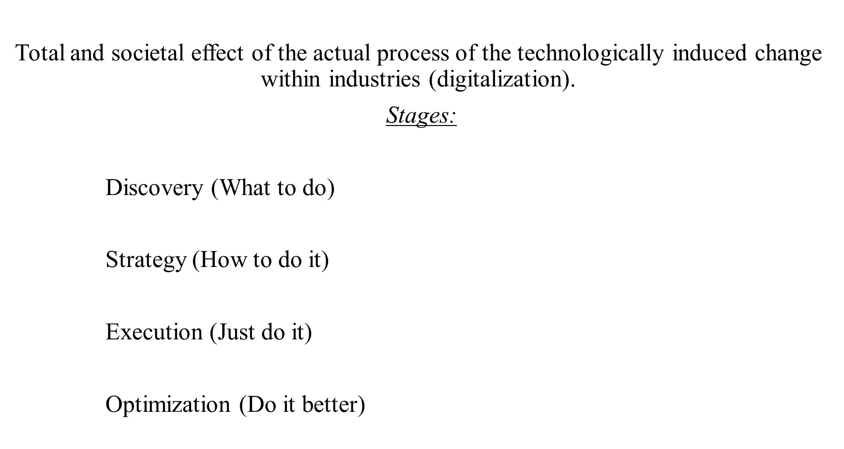

DIGITAL TRANSFORMATION OF BANKS

Slide 6

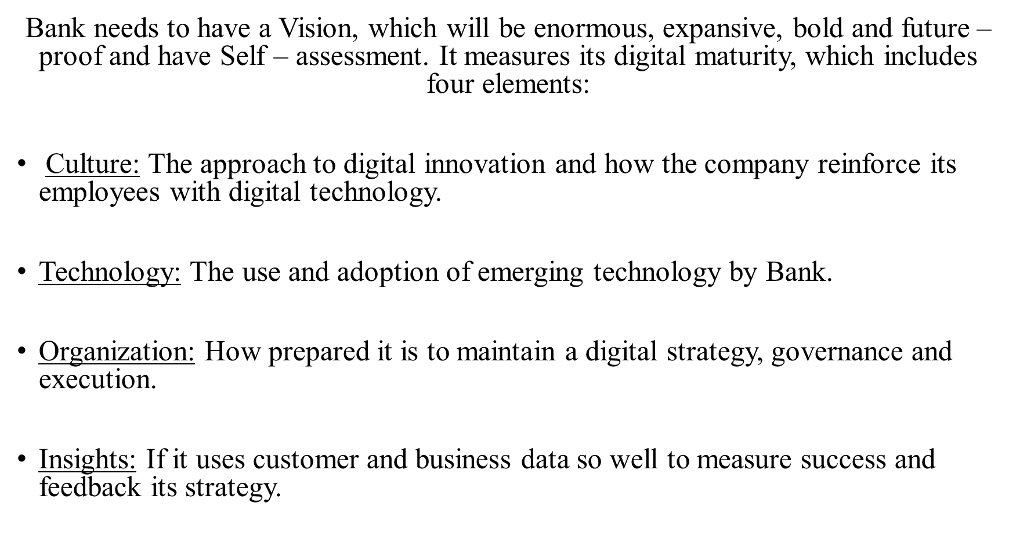


Slide 7

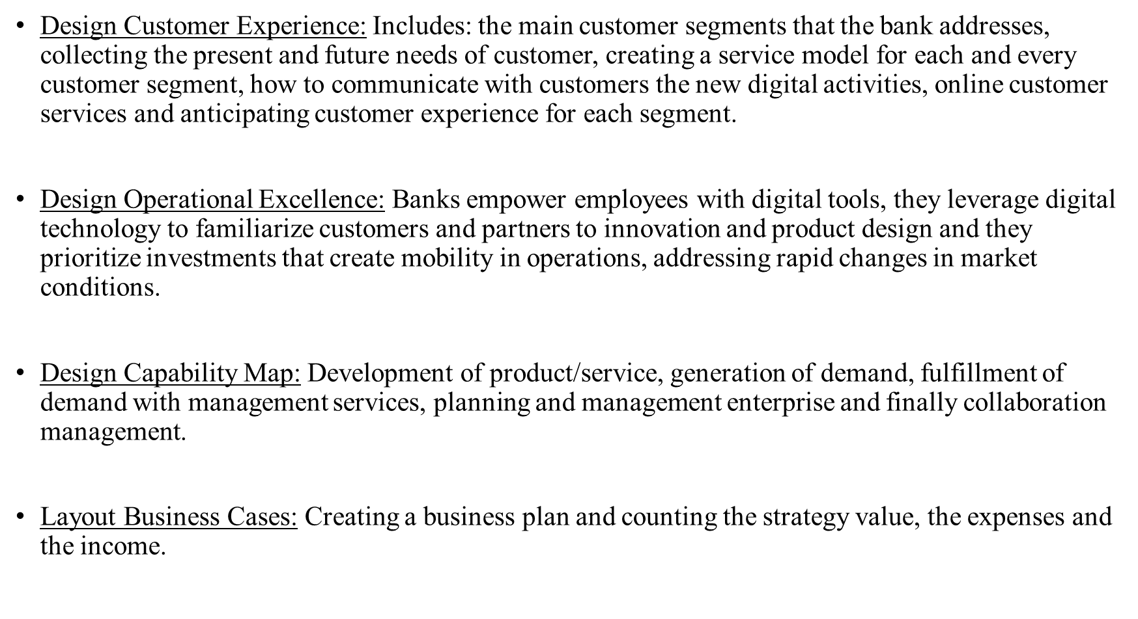

Slide 8

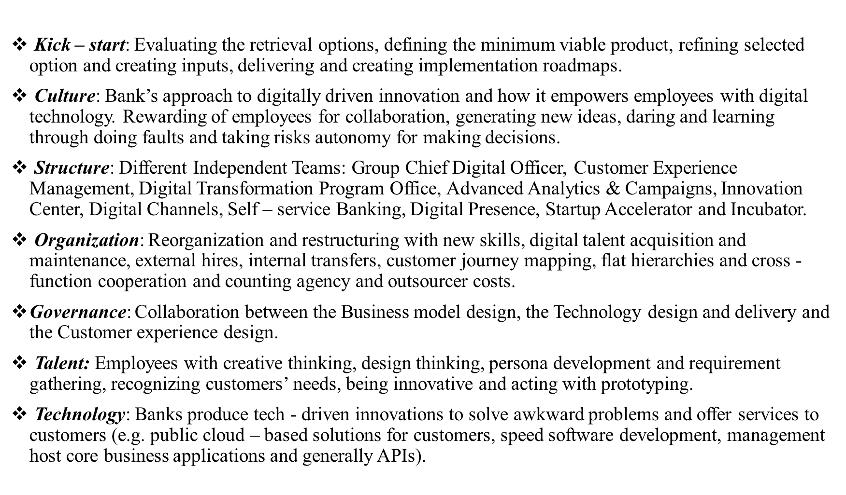

Slide 9

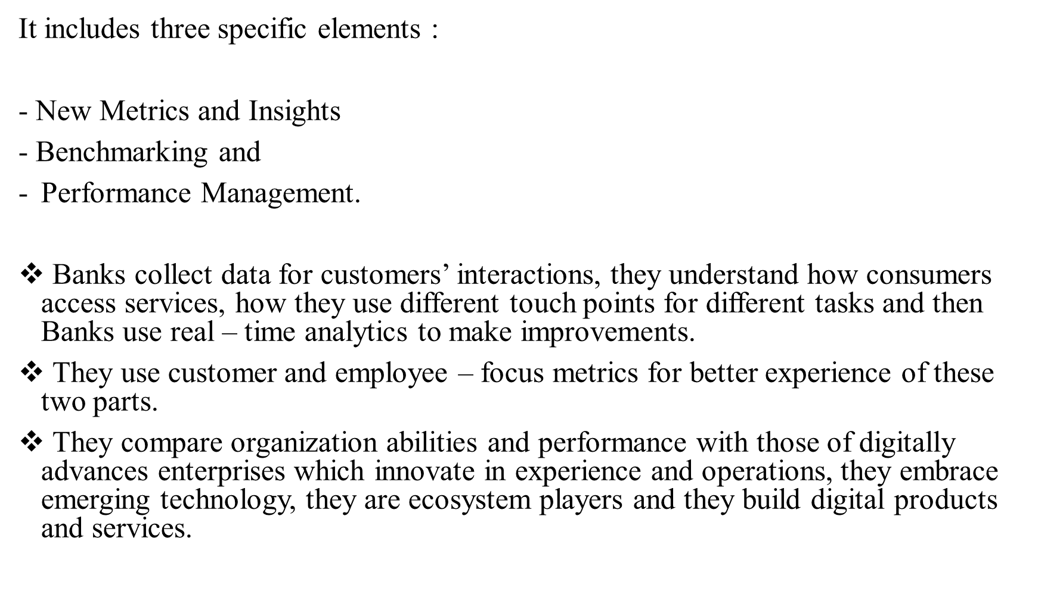

Slide 10




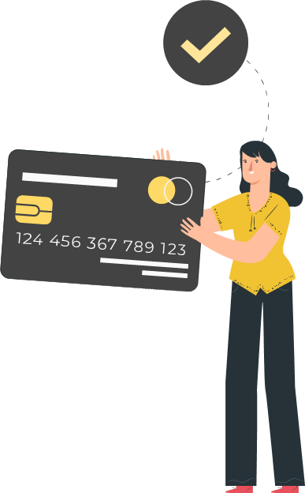



Comparison of Viva Wallet and Banks
2

Slide 11

Whenever we are told the word "banks", our mind automatically goes to one of the 4 institutions that more or less we all know.
In recent years, however, more and more new companies are beginning to offer banking services, exclusively from our computer or mobile phone, like PayPal, Viva and Revolut that are heard more and more often, and many have already begun to trust them. So what do these "digital" banks offer, and how do they fit our needs?
Purely digital banks, which serve their customers exclusively online without having a real store, are an important part of the "FinTech" phenomenon, which is spreading rapidly in the international financial landscape in recent years.
The term FinTech describes the trend of digitization and automation of financial services of any kind.

Slide 12
What’s the “key motivation” of this trend?
ease of use
increased efficiency
lower costs
Viva Wallet is a digital, trading service on a mission to change how businesses pay and get paid.
→ It’s the first provider of cloud-based electronic payments, providing 24/7 uninterrupted service throughout Europe through Microsoft Azure!
ADVANTAGES over banks
The most serious advantage of Viva Wallet is that it enables us to easily manage our money outside the Greek banking system.
Easy to use and attractive environment
The mobile app is the main way to access, and it’s very well designed and with many additional functions.
Commission less than 1% from Viva Wallet versus 4-5% from Banks.

Slide 13

The disruptive case of Viva Wallet
3

Slide 14
BIG CONCEPT
Viva Wallet is the first European payment services provider entirely cloud-based, over Microsoft Azure.

Slide 15

GENERAL INFORMATION
The story of Viva Wallet began in 2000 as a small but inspired group of technology, UX and payments experts. They started developing web platforms, electronic services and mobile applications for banks and other corporations.
Founders: Haris Karonis (CEO & Founder, Viva Wallet) and Makis Antypas (CEO, Vivabank and CIO & Co-Founder, Viva Wallet)
It’s a licensed e-money Institution, based on the provisions of European Commission’s PSD1 and PSD2 Directives with passporting rights and e-money license across the entire EEA-31 region.
Viva Wallet is “the first fully cloud-based digital payments institution in Europe”, which means, according to Makis Antypas:
“Being fully cloud-based means that nothing runs on premise. Instead, we use Microsoft Azure to run our operations. This allows us to be always available, always on, ensuring that there is no down time and no “maintenance windows” for our clients. “

Slide 16
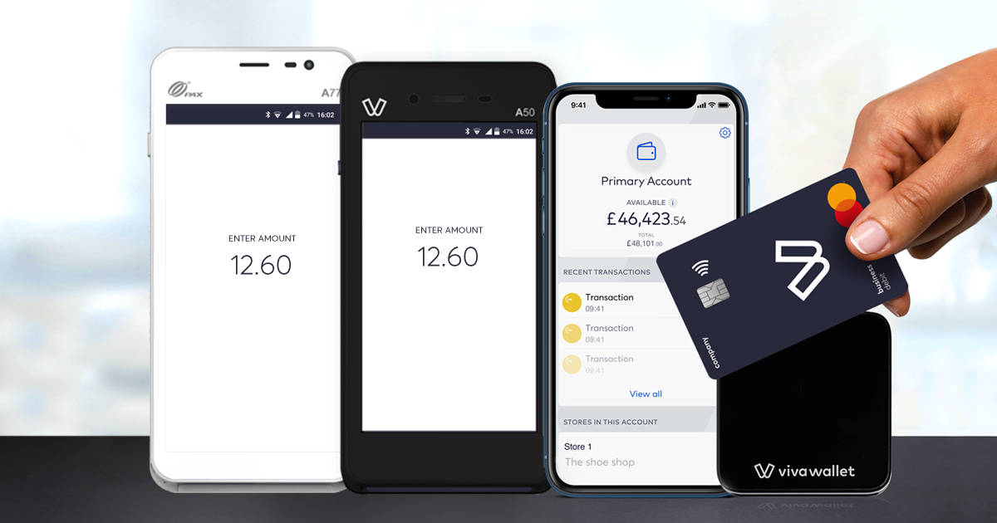
GENERAL INFORMATION
Target : large retail merchants as well as fintech companies and banks
Competitive advantage of Viva Wallet is:
As principal members of international card schemes Mastercard and Visa, Viva Wallet is directly connected with these payment networks via its in-house developed cloud platform, without relying on third-party legacy software.

Slide 17
What services Viva Wallet offers
Viva as ticketing platform (ferry, events, spectacles, etc.)
Acquisition of cards (acquiring) both with the latest technology POS terminals and through e-commerce
Issuing debit cards (Mastercard)
The possibility of issuing a professional IBAN account of the respective country in which the entrepreneur operates
Viva Wallet is a Principal Member of Visa and MasterCard for acquiring and issuing services with direct connectivity to the Card Schemes providing processing services through her platform.
Apple Pay is now available to its customers, offering a more secure and private payment method that helps customers avoid giving away their card, touching buttons or exchanging cash.

Slide 18

About 2020 and the effect of Covid-19
VIVA WALLET:
-successfully completed its €75 million Series C fundraising
-grew into a neobank with a major European footprint, establishing branches in 23 countries, by far the most than any other financial institution in Europe.
-has evolved into one of the very few technology-driven payment providers that also own a banking license after officially acquiring Praxia Bank in August 2020 while starting to offer credit products to its business clientele, at a record-time of under 3 months!

Slide 19

TIMELINE
2005- establishment of VIVA SERVICES S.A.
it provides both businesses and final consumers with a range of services including :
▪ Ticketing shows (theatre, concerts, cinema, sporting events etc)
▪ Travel services (reservation of seats and sale of ferry and air tickets)
▪ VoIP telephony services and a set of in Services (Intelligent Network Services)
▪ Disposal of POS card acceptance terminals
2000
2010
2018
2000- Establishment of Viva Wallet Holdings SA specializing in the design and development of systemic solutions (platforms) for the integration and service of business processes in the sectors:
2010- establishment VIVA PAYMENTS S.A
licensed by the Bank of Greece as a payment institution
2018- establishment VIVA WALLET.COM LTD
it operates as an electronic money institution offering a wide range of payment products such as POS terminals, redemption and issuance services, cards and online payment methods
2005
Banking applications (web-banking applications, real estate valuation applications, POS credit card management applications, systems for the online distribution of banking products, e-learning systems etc
Interactive Web-Based Applications
Electronic transactions-transaction based web applications and billing/payment systems
the interface of Information Systems (ERPs, Web-based applications, Billing systems, CRM, ERPs, Call center systems
in the provision of Online & Technology Marketing services

Slide 20
TIMELINE
BEFORE 3 August 2020 when Viva Wallet operated as Viva Payments (Viva Payment Services SA) founded in 2010 and has an e-money license, and operates with an official license from the Bank of Greece as an Electronic Money Issuing Institution for operation within EOX-31.
And separately as Viva Electronic Services (www.viva.gr) founded in 2005, and operates in the field of online transport services (air, ferry, taxi), e-ticketing services, insurance, hotels and telecommunications services .
AFTER 3 August 2020 when Viva Wallet formally acquired the Praxia Bank banking license on 3 August, following the successful completion of the shareholder transfer agreement from AMC Oak to Viva Wallet Holdings where the banking license will allow Viva Wallet to offer products such as loans and deposits to serve its customers, which will be officially announced by the end of the year.
2020

Slide 21


Porter's 5-Force Model is an analysis tool that focuses on 5 competing forces of an industry. It allows you to analyze the competitive position of your business in the field it belongs to.
INDUSTRY ANALYSIS OF PORTER
5.Competition between existing companies/ Internal Competition (Rivalry)
1.Threat of new entrants
3. Suppliers’ Bargaining Power
2. Customers’ Bargaining Power
4. Threat of Substitute Product or Service

Slide 22
“The collective strength of these forces determines the ultimate profit potential of an industry.”
- Michael E. Porter

Slide 23







1. Threat of new entrants
How serious a threat is depends on two factors:
A. from barriers to entry, which may be:
Inability to access specialized technology
Strong preferences for a specific brand and customer loyalty
Brand loyalty, which is higher, the more intense must be the marketing efforts of potential competitors
Existence of economies of scale, ie when potential competitors have to enter the market with corresponding dynamics of the existing ones
Legislative policies, trade restrictions
Capital requirements and other specialized resource requirements
Access to distribution channels
B. From the reactions of existing companies to potential entrants.

Slide 24

Regarding Viva Wallet and the threat of new entrants, we believe that due to the large and significant turn to online services and markets, especially in the last year, not only in Greece, but worldwide, due to the pandemic Covid-19, there is room for new companies to appear that will try to change the way payments are made.
At a time when more and more Europeans will adopt fintech services and products, according to estimates by EV and KPMG, and investment interest in European companies in the industry will increase even more dramatically in the near future, Viva Wallet's international expansion has continued. and during the pandemic crisis.

Slide 25


2. Costumers’ Bargaining Power
Audience interests
News and Media
Finance> Financial Planning and Management
Computers Electronics And Technology > Computers Electronics And Technology
Computers Electronics And Technology > Programming And Developer Software
Law And Government > Government

Slide 26

3. Suppliers’ Bargaining Power
→ the more suppliers there are in a market, the less dependent a business is on those suppliers.
However, if the number of suppliers is limited, the possible results are:
increase in production costs
reduction in product quality
reduction of quantity produced

Slide 27

Viva Wallet does not depend on third party companies and external partners, which allows Viva Wallet to launch a wide range of innovative services and specialized functions in a minimum of time.
According to Makis Antipas, CIO & Co-Founder of the company, “At Viva Wallet, we believe in the very high level of people in the Greek market in the field of software development. That is why we currently employ over 70 engineers in Greece, with specialization in the design and implementation of payment systems. We only invest in new and innovative technologies. We do not follow, but instead, shape trends and lead developments in a fairly wide range of electronic trading technologies.“
So, we understand that the power of suppliers isn’t so important due to the fact that Viva Wallet relies on its own strengths, which we will list below.

Slide 28

4. Threat of Substitute Product or Service
→how likely are costumers to switch to an alternative?
If there are a number of substitutes for a product or service on the market, buyers have more options to seek out similar products or services. It’s important for your client to ensure their product or service maintains demand among customers. That way, even if a substitute appears at some point, customers will trust the quality of their product or service regardless.
We have to take into consideration the following questions:
-Can the service of Viva Wallet be emulated in a cheaper way?
-How important is the quality of the service to buyers?

Slide 29

5. Internal Competition (Rivalry)
TOP COMPETITORS OF VIVA WALLET
Stripe
Websites
144,167
Market Share 18.51%
Braintree
Websites
17,749
Market Share
2.28%
Afterpay
Websites 10,916
Market Share 1.40%
Square Payments
Websites 14,690
Market Share 1.89%
PayPal
Websites 426,490
Market Share 54.75%
Amazon Pay
Websites
30,300
Market Share 3.89%
Stripe Checkout
Websites 15,766
Market Share 2.02%
Authorize.net
Websites 13,689
Market Share 1.76%

Slide 30



SWOT Analysis
Threats
Opportunities
Weaknesses
Strengths
Through SWOT analysis, we can identify the Strengths and the Weaknesses of a business, as well as the Opportunities and Threats. All data is collected through an analysis of the internal and external environment of the business. The analysis helps us to understand the actions that the company must take or what are the obstacles and difficulties that must be overcome in order to achieve the desired goal as efficiently as possible. Let’s try it for Viva Wallet!

Slide 31
Strengths
Business organization
Good financial position of the Company
Because it does not depend on third party companies and external partners, allows Viva Wallet to launch a wide range of innovative services and specialized functions in a minimum of time.
Research and development conducted "in-house" offers the possibility of immediate coverage of the needs and requests of its customers.
Receipts from electronic transactions
Receipts from transactions with Viva Wallet POS
Most Viva Wallet terminals have been technologically upgraded - A sense of security that gives both the customer and the trader.
Integrated services - without the physical presence in a bank
Supplier & partner payments
Unique payment features
It is licensed by the Bank of Greece
It is in continuous development and has made on major investment agreements
Variety of Viva Wallet charging modes available
Reliable and fast customer service in Greek
Instant SMS notifications for Viva Wallet moves
Real control account time via App

Slide 32

Weaknesses
Top-up charges have commission
There are e-shops that do not accept online transactions via Viva Wallet
Functions as a prepaid card and not as tied to a bank account
Does not work if the device does not have access on the internet
Distrust of consumers
There is a limit of € 2,500 in non-trading identified accounts
Moves made through Viva Wallet they pass through the Bank of Greece
No withdrawals can be made from automated teller machines via Viva Wallet Card

Slide 33

Opportunities
Expansion to twenty three countries based in the following cities: Dublin, London, Helsinki, Stockholm, Copenhagen, Amsterdam, Berlin, Warsaw, Brussels, Prague, Luxemburg, Paris, Vienna, Budapest, Milan, Zagreb, Bucharest, Sofia, Nicosia, Athens, Malta, Madrid and Lisbon.
To have a function so that they receive customers money from their receipts on the Viva Wallet Card
Covid-19: Viva Wallet was not affected but strengthened its presence.
Cooperation with banks of foreign
Exclusive offers for the Viva Wallet users
Merchants are expected to be able to use their mobile phone as a POS
Loyalty program (refund, points)
Have scheduled service transport and can organize easily all periodic obligations payment of your business
Make it simpler to trade with ability to log-in to a social account media
Investing in labor education potential
The application will also offer the possibility of payments via Google Pay
Ability to connect to existing ones bank account

Slide 34
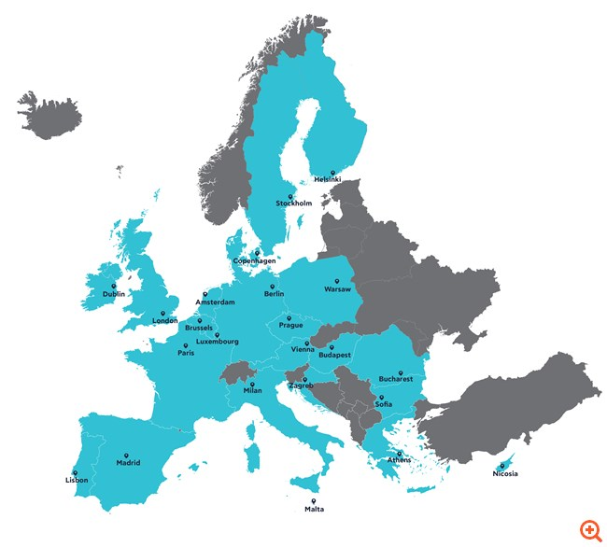
our office
Source: capital.gr

Slide 35
Threats
The importance of the safety of electronic transactions
Increased competition from corresponding actions of banks
Great international competition (Paypal, Revolut etc)
Consumer purchasing power
Now companies think a lot about costs to carry out the search for such services
The unstable political and economic situation of country

Slide 36


Conclusions
In conclusion, the company started as a small group of young and creative people and gradually managed to achieve its goals and set new ones. A typical example of readiness and hard work is the fact that in the midst of a pandemic, it managed to survive and support its customers.
The next goal of Viva Wallet is to unify the footprint of 23 countries by becoming the single payment provider that offers integrated payments and credit bundle for merchants across Europe.
Its strategic intent is to offer all available international and local payment products at each country, so that any business, merchant or any other business partner can plug into the cloud-based payments infrastructure and have seamless access to a truly single payments market.
It is important for the company to maintain its competitive advantage over its potential competitors and to increase it not by following the sure and tried path, but as they are already doing creating new payment methods.

Slide 37
Suggestions to the Company
By increasing the use of its product by existing customers. For example, it may try to increase the size of the market, or provide price incentives for buying more product units.
By attracting customers of competitors. this can be achieved by diversifying the product in the eyes of the customer, by strengthening the efforts to promote the product or by introducing a lower price
By attracting non-users of the product. for example, the company can introduce trial use through vouchers to attract new customers.
Free information of its new and old customers about the management of electronic transactions.
Serving people with disabilities with qualified staff.

