Slide 1
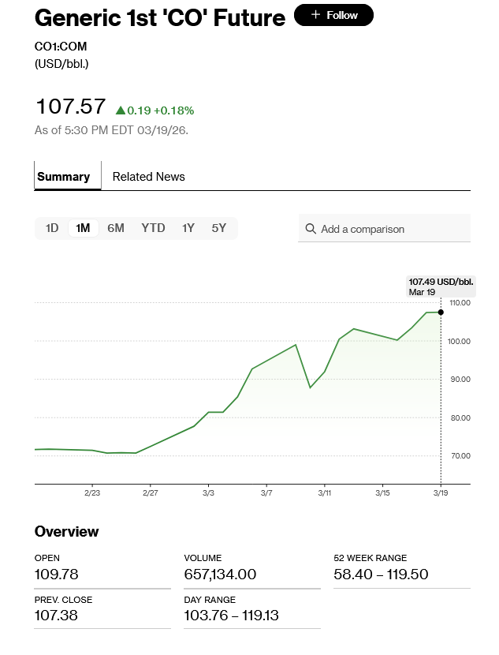
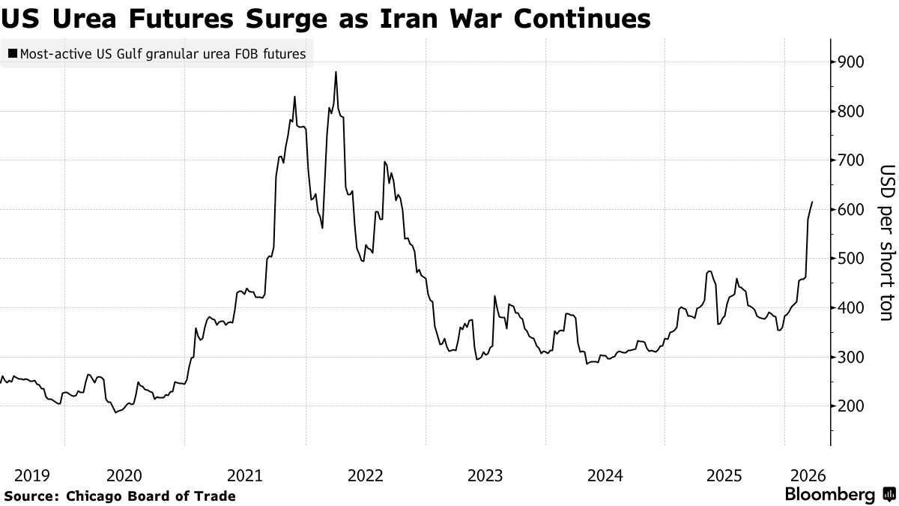
Global Oil Shock, Food Inputs, and Break-Even Economics
Tomato greenhouse case study
Lecture overview + live Excel model
20th March 2026 lecture Managerial Economics
The class begins with the market shock, then traces the effect into greenhouse costs, break-even, food inflation, and policy discussion.
Managerial Economics lecture
Notes:
[Sources] - Uploaded Bloomberg oil report for the oil chart asset. - Uploaded Bloomberg food-chain report for the urea futures chart asset.

Slide 2
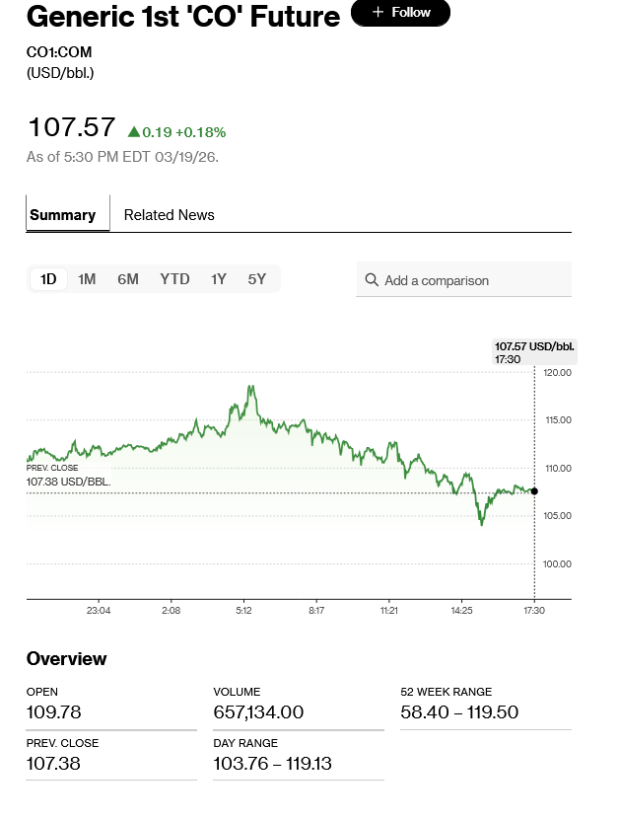
1. The shock begins in energy markets
Oil moved higher first; LNG disruption amplified the input-cost channel.
Energy Prices as per closing on 19/03/2026 NYSE and their impact
• The daily and monthly oil charts on your right show front-month crude near $107.5/bbl on 19 March after a war-period rise.
• The attached to the today’s lecture e-class folder refers to LNG report says the Qatar outage pushed more buyers toward US LNG and sent gas prices in Europe and Asia soaring.
• For a greenhouse, the first pass-through hits heating, transport, packaging, and fertilizer feedstock.
Oil + gas shock → energy VC rises → greenhouse total cost curve shifts upward
Managerial Economics lecture
Notes:
[Sources] - Uploaded Bloomberg oil report says buyers turned to US LNG after the Qatar plant outage and that gas prices in Europe and Asia soared. - The two crude screenshots on this slide come from the uploaded oil report.

Slide 3
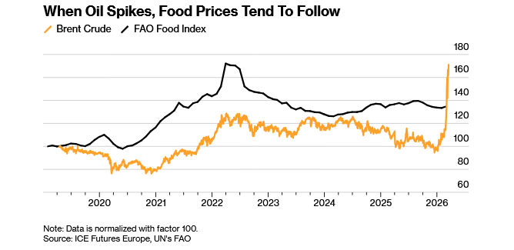
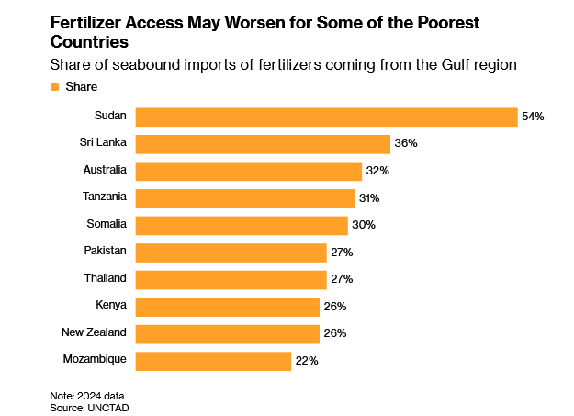
2. Why fertilizer matters for food inflation
The same geopolitical shock spreads from energy into fertilizer availability, yields, and retail food prices.
Teaching link to the case
• The uploaded food-chain report ties the war to disrupted fertilizer exports and gas feedstock for nitrogen production.
• It also links higher oil prices to freight, packaging, and grocery inflation with a lag.
• That is why the tomato case is both a break-even problem and a food-inflation problem.
Managerial Economics lecture
Notes:
[Sources] - Uploaded Bloomberg food-chain report says the war cut off important sources of energy and fertilizers, that nitrogen fertilizers underpin roughly half of global food production, and that higher oil prices lift freight and packaging costs. - All three charts on this slide come from the uploaded food-chain document.

Slide 4
3. Case study set-up: the tomato greenhouse
Baseline economics before the 2026 oil-shock scenario.
Shock in oil and fertilizer
Variable cost rises
Contribution margin falls
Break-even shifts up
Managerial response
Input costs start moving up
VC per kg shifts above the old benchmark
CM = P − VC can turn negative
BEQ grows sharply or disappears
Pricing, output, contracts, hedging
Baseline numbers used in the Excel model
Selling price €0.65 / kg
Immediate classroom insight
Fixed cost €420,000 / year
At 1.8 million kg, the greenhouse is already below its base break-even point. The starting annual result is a €60k loss even before the oil shock is imposed.
Capacity 3,000,000 kg
Current output 1,800,000 kg (60%)
Base VC €0.45 / kg
Base break-even 2,100,000 kg (70%)
Managerial Economics lecture
Notes:
[Sources] - Baseline numerical inputs come from the user’s tomato greenhouse case description. - Break-even logic and scenario values are derived from the attached Excel workbook built for this lecture.

Slide 5
Περίπτωση | VC €/kg | Τιμή €/kg | Contribution Margin €/kg | Break-even kg
Αρχική κατάσταση | 0,45 | 0,65 | 0,20 | 2.100.000
Νέο κόστος, τιμή 0,65, Σεν. Α | 0,66875 | 0,65 | -0,01875 | Δεν υπάρχει
Νέο κόστος, τιμή 0,65, Σεν. Β | 0,70875 | 0,65 | -0,05875 | Δεν υπάρχει
2.1 Πλήρης μετακύλιση, Σεν. Α | 0,66875 | 0,86875 | 0,20 | 2.100.000
2.1 Πλήρης μετακύλιση, Σεν. Β | 0,70875 | 0,90875 | 0,20 | 2.100.000
2.2 Break-even στα 1,8 εκ., Σεν. Α | 0,66875 | 0,90208 | 0,23333 | 1.800.000
2.2 Break-even στα 1,8 εκ., Σεν. Β | 0,70875 | 0,94208 | 0,23333 | 1.800.000
2.3 Contract farming + hedge, Σεν. Α | 0,45 | 0,59 (ελάχιστη) | 0,14 | 3.000.000
2.3 Contract farming + hedge, Σεν. Β | 0,49 | 0,63 (ελάχιστη) | 0,14 | 3.000.000

Slide 6
4. Break-even results from the live model
Students can vary oil, labour, misc, target output, and hedge assumptions in the attached workbook.
Base
P €0.65 | VC €0.45 | BEQ 2.10m kg | Profit (€60k)
Shock A / B if price stays unchanged
VC rises to €0.66875 / €0.70875. Contribution margin turns negative. Break-even disappears. Losses widen to about (€454k) / (€526k).
2.1 Full pass-through
Price must move to €0.86875 / €0.90875 to restore the original €0.20 unit margin. But at only 1.8m kg, the firm still loses (€60k).
2.2 Partial absorption with higher output
At a target of 2.4m kg, the break-even price becomes €0.84375 / €0.88375. This works only if output rises.
2.3 Contract farming + hedging
At full capacity and contract price €0.65, profit becomes €180k in A and €60k in B. This is the strongest risk-managed strategy.
Workbook attached: every scenario row is formula-driven
Notes:
[Sources] - Numerical results on this slide are taken from the attached Excel workbook prepared from the user’s case inputs. - Scenario logic: oil at $120/bbl, labour/misc stable in A, labour/misc +20% in B, contract farming with hedge options in 2.3.

Slide 7
5. Inflation and fiscal-policy discussion for Greece
Use the case to connect firm-level economics with the macro lecture thread.
Managerial conclusions
Macro / policy prompts
• If price stays unchanged, the greenhouse should not simply “produce more”; losses deepen because VC exceeds price.
• Food inflation persists with a lag because fertilizer, freight, packaging, and yields all respond after the original oil shock.
• That creates pressure for targeted producer support, temporary tax relief, fertilizer financing, or energy-cost mitigation.
• If management absorbs part of the shock, it must also raise output above a higher threshold to spread fixed cost.
• A supermarket contract plus hedging is the most resilient strategy because it stabilizes both revenue and key inputs.
• The classroom question for Greece: how far can the state cushion the shock without weakening fiscal discipline?
Bottom line
The main task of a manager is to build sustainable and resilient strategies through strategic alliances which include consumers, channels of distribution, producers and supply chains. The ultimate objective of the firm is to create consumer surplus and customer satisfaction in a dynamic mode of its needs. The bonding between all stakeholders is the ticket of company’s sustainability and resilience under all circumstances.
Managerial Economics lecture
Notes:
[Sources] - The transmission and inflation discussion is grounded in the uploaded Bloomberg food-chain report, which states that higher energy and fertilizer costs are likely to pass through to consumers and complicate inflation control. - The fiscal-policy items on this slide are discussion prompts, not claims about a specific enacted Greek policy change.

