Slide 1
IKEA B2B STRATEGY
CASE STUDY
07052025
​

Slide 2


Agenda
A
Introduction
B2B STRATEGY
B2C STRATEGY
GLOBALIZATION
Summary

Slide 3
Introduction
IKEA is named after the initials of founder Ingvar Kamprad, Elmtaryd, the farm on which he grew up, and Agunnaryd, the nearby village. At 14, he moved to attend boarding school nearby. Ever the entrepreneur, he kept a stock of pens, watches, wallets and belts under his bed. (His classmates needed these!)
Ingvar continued his business and his studies at college. His future took shape as he realized success depended on the simplest, most cost-efficient distribution from factory to customer.
For IKEA then, this meant direct import and mail order, mainly of watches and pens. But pens had issues, so Ingvar saw they didn’t have a future either. Like his match money, he saved to invest in something else.
When furniture debuted in the 1948 brochure, Ingvar wrote IKEA would offer more if customers showed “reasonable interest.”

Slide 4
IKEA INNOVATION PROCESS
IKEA INNOVATION PROCESS
1950s – Shut out in Sweden
Many Swedish furniture retailers feel threatened by the low prices of IKEA products. They put pressure on suppliers to boycott the IKEA brand. In the 1950s, they try to prevent Ingvar from exhibiting at or even visiting furniture fairs. But every challenge has a solution – this is one of the reasons we started to look for collaborations abroad.
1950 – The IKEA Catalogue makes its debut
A future icon, the first annual IKEA home furnishing catalogue is published in Sweden.
1953 – The first showroom opens
A permanent showroom opens in Älmhult. Here customers can see and experience the quality of the products before ordering them, and Ingvar can meet customers in person and learn from them.
1953 – Say Hi to the flat pack
High costs and damage rates when transporting furniture via mail order are a constant thorn in Ingvar’s side. Although flat-pack furniture already exists, it hasn’t really taken off in Sweden yet. It takes a demonstration by IKEA supplier Ovendals in Hultsfred of a very stable flat-pack table for this to change. Flat-pack, self-assembly products become the solution to the transportation struggle, and the rest is history.

Slide 5
IKEA MISSION AND LONG TERM OBJECTIVES
1976 – Ingvar puts pen to paper
30 years after his business is born, Ingvar Kamprad writes “The Testament of a Furniture Dealer” with its 9 points. This is where many of his ideas are first written down, including the IKEA vision: to create a better everyday life for the many people.
Early ‘80s – A new sustainable owner structure is created
Ingvar seeks an ownership structure to create the best possible conditions for total independence and a long-term business perspective. He describes this as trying to give the IKEA brand “eternal life”. His solution is to separate the ownership of the retail operation from the IKEA concept and the IKEA brand — to keep these separate roles in independent business groups, operating under a franchise system.

Slide 6
CUSTOMER IN THE DRIVER’S SEAT
1995 – ”Democratic Design” is launched
The term “Democratic Design” is used for the first time during the furniture fair in Milan in 1995. “I’ll never forget the feeling of seeing that statement on the billboards and trams of Milan during the fair. I sat outside drinking Campari and watching the trams go past bearing the words `Il design democratico – IKEA´”, explains Per Hahn, an archivist at the IKEA Museum in Älmhult.
2014 – The first Life at home report
We start using a new method of exploring life at home: a mix of our own research and interviews. The first report focuses on morning routines. We interview a total of 8,292 respondents aged between 18 and 60 in 8 cities. We find out all kinds of things – for example, we learn that 52% of Berliners interviewed press the snooze button at least once, and 36% snooze more than once. Read more about these sleepy Berlin night-owls and other fun facts in the report here.

Slide 7
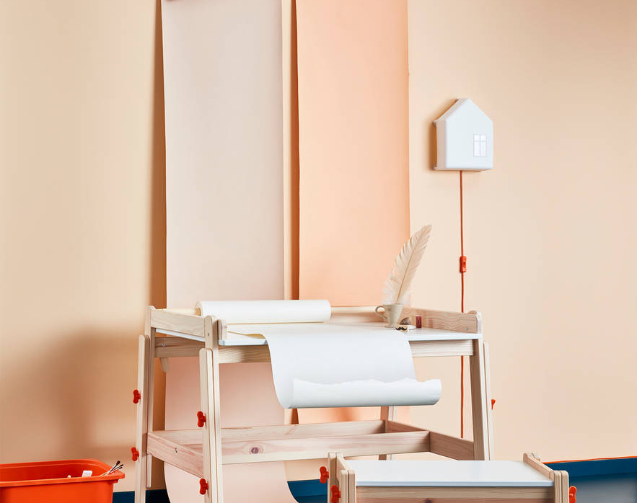
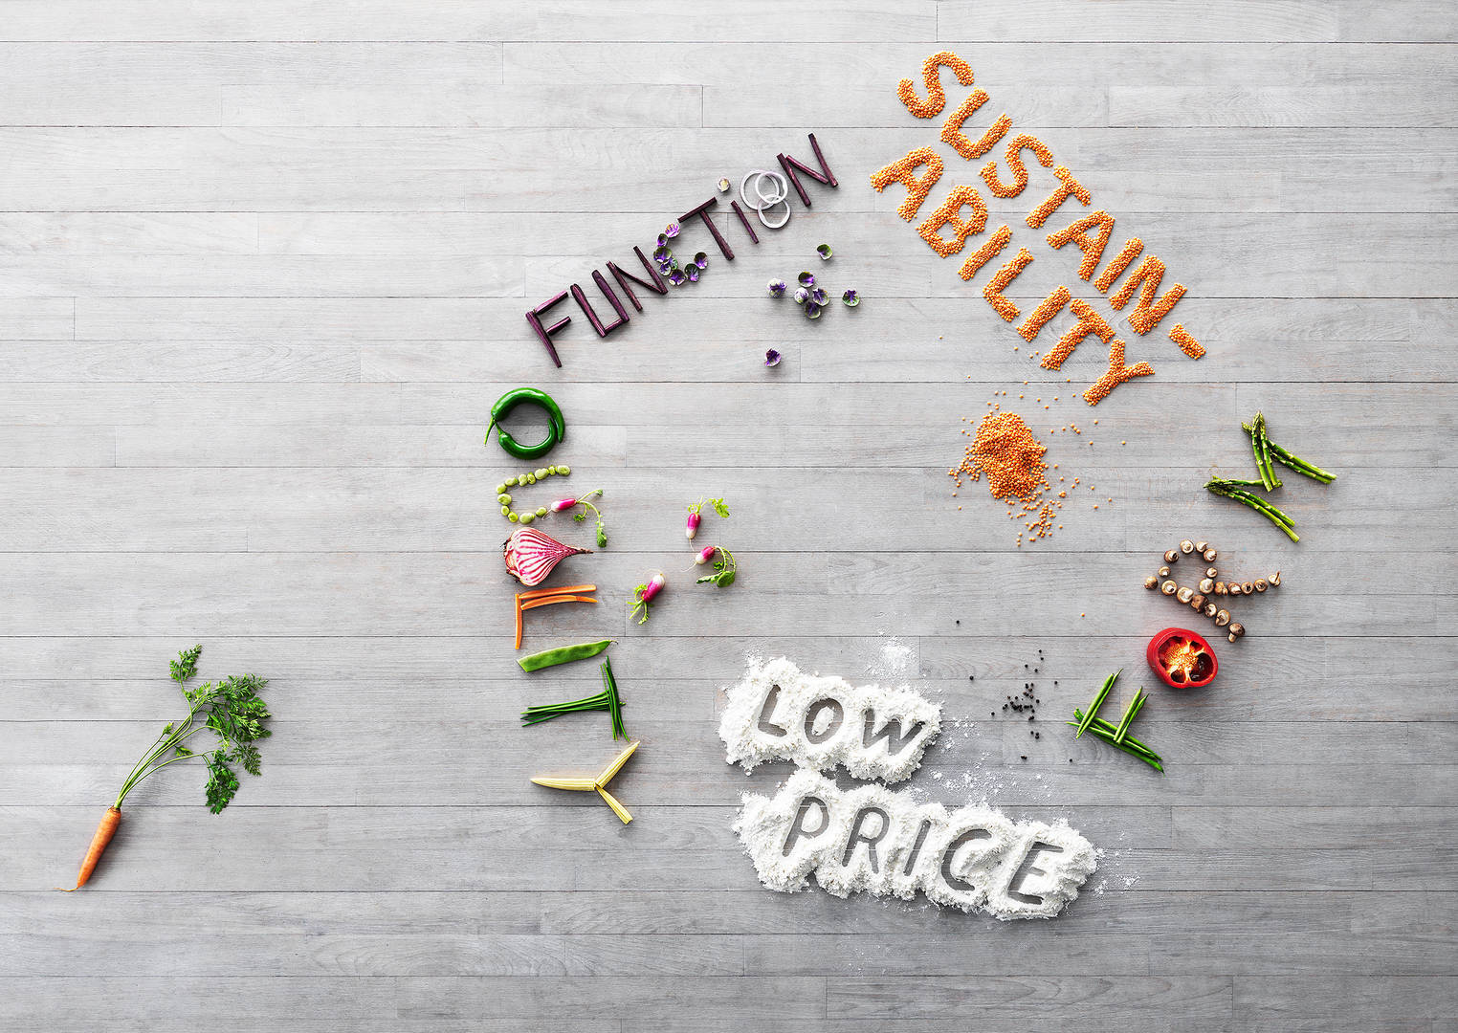
The FLISAT desk for kids. The price is fair, it can be height-adjusted so it grows with the child, and it has smart functions such as a tilted tabletop and paper holder. We hope these functions encourage children to be creative. It’s very high quality and has a classic form so that it can be loved and passed on to future generations. The material is sustainable and renewable – wood. It’s quite simply Democratic Design

Slide 8
CULTURE AND VALUES OF IKEA
“The form is for beauty, it’s what attracts the eye, and the object has to be functional, otherwise it won’t be used. When objects and materials last over time, that’s quality. Being mindful of resources is something that has been with us since the start. We don’t like complicated solutions and wastefulness, it’s bad for everyone. Part of sustainability is about using exactly the right materials for the function, and using them sparingly, but sustainability also means taking responsibility all the way through a product’s life. It starts with how we source materials, to the people who produce the product, all the way through to our clients.”
It’s basically our culture and values boiled down to five dimensions, together with simply using common sense in everything we do.
Sarah Fager, Senior Designer, IKEA of Sweden AB

Slide 9
THE B2B PRINCIPLES
We will design all of our products to be 100% circular from the beginning.
Malin Nordin, Head of Circular Development, Inter IKEA Group
“We investigated and followed waste streams around the world together with WWF. We wanted to find out which materials we could use and how we could introduce and set up processes to enable circularity in the future.
We also conducted the External Feedstock Project which led us to identify the 32 high priority materials in woods, plastics, papers, metals, and textiles, which have the fullest circular capabilities.”
“One aim of circular design is to develop products that can be useful throughout the changing lives of our customers. For example, we have baby cots that transform into toddler beds, or modular products such as PLATSA storage solution or VIMLE sofa, where pieces can be added or taken away as needed, to adapt to constantly evolving needs.”
“We believe that you shouldn’t have to compromise on quality of life or products to act responsibly. People should still be able to refresh their space as often as they want to and improve their life at home, with functional, beautiful and affordable furniture of good quality, without damaging the planet. When the products are no longer

Slide 10
What’s it like to be an IKEA franchisee?
The IKEA business is built on a franchise system and it is our franchisees that bring the IKEA Concept to all the IKEA markets. But what is it like to be an IKEA franchisee? IKEA Al-Homaizi Ltd operates three IKEA stores – in Kuwait, Jordan and Morocco. We asked their CEO, Marino Maganto, to share his thoughts on the franchisee’s role. Here, he explains how Al-Homaizi’s relationship with the IKEA business began, and highlights some of the challenges and surprises the group has experienced along the way.
How did IKEA Al-Homaizi Ltd first become an IKEA franchisee?
"Mr. Yousef Al-Homaizi had been running a successful home furnishing showroom in Kuwait for almost 25 years when his sons Yacoub and Jassim Youssef first came into contact with the IKEA brand. It was actually Jassim’s Danish wife who introduced the brothers to the Swedish home furnishing brand. Shortly afterwards, they set about acquiring one of the first IKEA franchises in the Gulf. 35 years later, their Kuwait store stretches across 21,500 m2 of the country’s largest mall and they are also operating stores in Jordan and Morocco."
What triggered the Al-Homaizi brothers’ interest in the IKEA brand?
“What the brothers immediately recognised was a brand that provides uncompromising value for money at the same time as offering inspiring, beautifully designed solutions for every home. They were struck by its freshness and simplicity. The IKEA business model and values also lined up perfectly with Al-Homaizi’s belief that home is the most important space in the world.”

Slide 11
What is your main task as an IKEA franchisee?
What is your main task as an IKEA franchisee?
“We implement the IKEA concept and develop the brand in the markets where we operate. In order to grow successfully in climates and cultures which are so far from Sweden, a certain amount of adaptation is needed. For example, before opening the store in Morocco, we did over 100 home visits to help us understand how the IKEA range could be made relevant to local consumers. We ended up building room sets with walls of muticoloured mosaic tiles and joining the sofas together in the style of a Moroccan salon. It looked great! Service expectations also vary from one market to another. People here are not so keen on DIY, so about 80% of our sales include home delivery and assembly. We have around 300 people dedicated to these tasks.”
How much freedom do you have as a franchisee?
"Inter IKEA Systems B.V. owns the IKEA Concept. As a franchisee, we can sell the IKEA Product Range, use the IKEA trademarks and operate according to proven working methods, following the IKEA values. Within this framework, we have the freedom to make certain decisions about what to sell and when. Of course, the majority of the products are part of the standard range, but we also select about 20% of them with local tastes in mind. For example, we stock more of the darker wooden furniture our customers prefer. We also adapt the timing of seasonal launches to match the local lifestyle and climate. That means we don’t put outdoor furniture on display until the winter months in Kuwait, when it’s cool enough to sit outside."
In the IKEA store in Kuwait, outdoor furniture is put on display in the winter months when it’s cool enough to sit outside.
What are the main challenges of being an IKEA franchisee?
"Being a franchisee is both a great privilege and a great responsibility. We represent a well-known brand that is very dear to many people around the world; one that lives by a great set of values and conducts its business in an ethical way. Our challenge is to protect the brand and develop the business in accordance with these values. That means, for example, continuously monitoring the online activities of organisations or individuals who want to use the IKEA trademark illegally. It happens about five times per week!"

Slide 12
What is your main task as an IKEA franchisee?
“We implement the IKEA concept and develop the brand in the markets where we operate. In order to grow successfully in climates and cultures which are so far from Sweden, a certain amount of adaptation is needed. For example, before opening the store in Morocco, we did over 100 home visits to help us understand how the IKEA range could be made relevant to local consumers. We ended up building room sets with walls of muticoloured mosaic tiles and joining the sofas together in the style of a Moroccan salon. It looked great! Service expectations also vary from one market to another. People here are not so keen on DIY, so about 80% of our sales include home delivery and assembly. We have around 300 people dedicated to these tasks.”
How much freedom do you have as a franchisee?
"Inter IKEA Systems B.V. owns the IKEA Concept. As a franchisee, we can sell the IKEA Product Range, use the IKEA trademarks and operate according to proven working methods, following the IKEA values. Within this framework, we have the freedom to make certain decisions about what to sell and when. Of course, the majority of the products are part of the standard range, but we also select about 20% of them with local tastes in mind. For example, we stock more of the darker wooden furniture our customers prefer. We also adapt the timing of seasonal launches to match the local lifestyle and climate. That means we don’t put outdoor furniture on display until the winter months in Kuwait, when it’s cool enough to sit outside."
In the IKEA store in Kuwait, outdoor furniture is put on display in the winter months when it’s cool enough to sit outside.
What are the main challenges of being an IKEA franchisee?
"Being a franchisee is both a great privilege and a great responsibility. We represent a well-known brand that is very dear to many people around the world; one that lives by a great set of values and conducts its business in an ethical way. Our challenge is to protect the brand and develop the business in accordance with these values. That means, for example, continuously monitoring the online activities of organisations or individuals who want to use the IKEA trademark illegally. It happens about five times per week!"

Slide 13
THE B2C PRINCIPLES - The IKEA way of retail
We are bringing IKEA closer to our customers through a diverse strategy of city-centre locations, traditional suburban stores, improved capabilities for online shopping, as well as home deliveries and services
In addition to IKEA.com and big blue stores filled with home furnishing and delicious food, we’re creating exciting new ways for people to shop – wherever they are.
Most IKEA customers have at least one thing in common; they like good design at affordable prices. Aside from that, they’re all different. Some live in a city, others in the countryside. Some have a car, others don’t. Some are too busy to go shopping, while others like to take their time. Because every customer is unique, we are creating more ways to get acquainted with our products.
In the classic IKEA stores on the outskirts of cities, customers can discover, touch and try out our entire range. “Our stores are the heart of the IKEA business and still stand for the majority of our sales,” says Jon Abrahamsson, Managing Director, Inter IKEA Systems B.V.
Online advantages
Shopping on ikea.com means you can compare colours and patterns with what you already have, and pick shelves and wardrobes that fit your rooms perfectly, by measuring while you’re shopping. Not to mention you can do it in your pyjamas and at the very moment inspiration strikes – regardless of how close you are to the nearest IKEA store. But again, to shop at ikea.com, you first need to know who we are.
Just like an IKEA store, only smaller
In cities like Hong Kong and Taipei, small stores have already been opened, and many more are under development in more markets

Slide 14
THE B2C PRINCIPLES - The IKEA way of retail
Popular pop-ups
IKEA Pop-ups are time-limited stores designed to really connect with consumers. Each one is like a circus of furniture fun, aimed to surprise, entertain, captivate and inspire.
IKEA shops – small, and with a focus
One of those formats is “IKEA shops”, meaning small stores that focus on a locally-adapted segment of the IKEA range. The very first IKEA bedroom shop opened in the centre of Madrid in the summer of 2017, and an IKEA shop with a small space living focus will be opening in Tokyo in 2022.
“IKEA shops” carry articles for immediate take-away.
IKEA Planning Studios offer expert help
Another format being tested is “IKEA Planning Studio” – a meeting point where customers can get support for more complex purchases, like kitchen and bathroom projects

Slide 15
Learning as we go – the challenges of entering a new market
Country Marketing Manager, Ulf Smedberg, was involved in setting up the IKEA business in South Korea and India. He discusses what’s important when entering a new market
How did you prepare to enter these new markets?
“Our first and arguably our most important step was to understand the culture of the country and the aspirations of its people. We researched what life at home is like for local consumers and tried to get a feel for their needs, expectations, hopes and dreams. Only then could we start to position the IKEA brand and create an offer that makes sense in that context.”
“One key thing is that to gain acceptance, we have to communicate our intentions clearly to all the relevant stakeholders; to prove that the IKEA brand is not after short term profit, but genuinely interested in investing in the country long term.

Slide 16
Visiting homes to create better homes
We have a vision – to create a better life for as many people as possible. And we firmly believe a better life starts at home. But how can we stay in touch with what people actually need when the world around us is constantly changing?
The answer lies in being constantly curious. We want to know how people live, and what their frustrations, needs and dreams are. Each year, IKEA co-workers do hundreds of home visits around the world.
The research we’re most proud of are the home visit interviews and Life at Home surveys. The two approaches complement each other. So far, we have collected insights from over 5,300 home visits across the globe.
The data and insights collected then work as input when new IKEA products and services are developed.
The life at home insights also give us knowledge about our different markets’ unique needs, so that we can tweak our offer to meet the community’s specific cultures and traditions. For example, when we opened our first store in India, we added more flexible seating options to our home furnishing solutions, as we found out that families often visit each other (unannounced) and need somewhere to sit.

Slide 17
Business opportunities are like buses. There's always another one coming.
“
”
Richard Branson

Slide 18
Areas of focus
F
B2B market scenarios
Develop winning strategies to keep ahead of the competition
Capitalize on low-hanging fruit to identify a ballpark value
Visualize customer directed convergence
Cloud-based opportunities
Iterative approaches to corporate strategy
Establish a management framework from the inside

Slide 19
How we get there
ROI
Niche markets
Supply chains
Envision multimedia-based expertise and cross-media growth strategies
Visualize quality intellectual capital
Engage worldwide methodologies with web-enabled technologies
Pursue scalable customer service through sustainable strategies
Engage top-line web services with cutting-edge deliverables
Cultivate one-to-one customer service with robust ideas
Maximize timely deliverables for real-time schemas

Slide 20
Summary- Everything is feasible
How do you create an LED bulb that has a recommended retail price of just one euro? To Paulina Pajak, the task seemed impossible. But since it was IKEA founder Ingvar Kamprad who was looking for the impossible, she just had to find a way. But before we meet the very troubled Paulina Pajak, let’s have a quick look at the environmental aspects of using LED bulbs.
Paulina Pajak enjoying the creative process.
We are always looking for ways to decrease energy consumption so, in 2011, we decided to phase out sales of all light sources other than LED. We wanted to give as many people as possible the opportunity to make more sustainable choices. And how would we do that? By offering high quality LED at really low prices, that’s how. Producing expensive bulbs that only some people can afford wouldn’t make any sense at all. If we were to truly make a difference, high sales volume was key. And the key to volume was the low price.
A LED bulb uses about 85 % less energy than a traditional bulb.

