Slide 1
The Chartered Institute of Marketing
&
University of Piraeus
Helping you to become more employable
In a global market
Notes:
I will talk about different ways you can become more employable when you engage with CIM

Slide 2
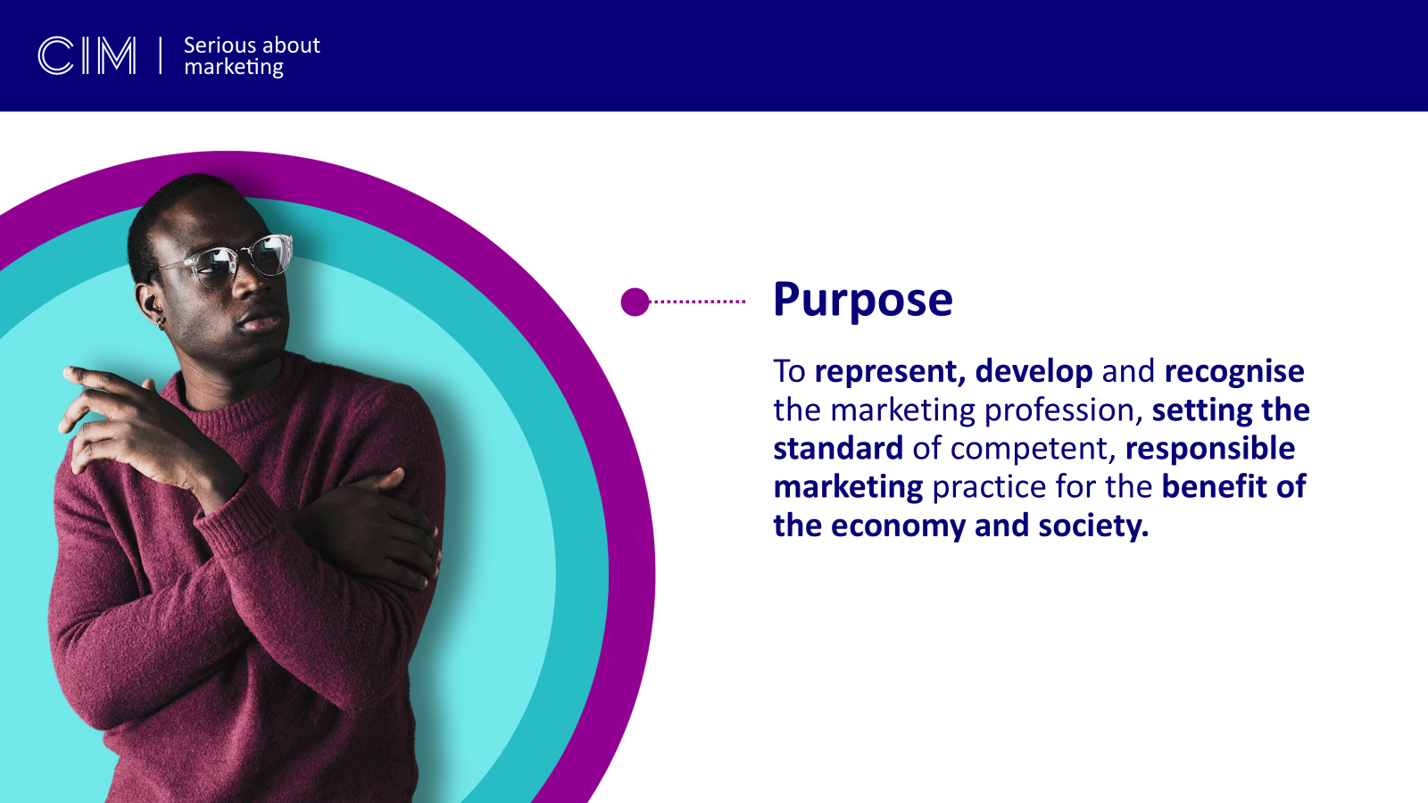

Slide 3
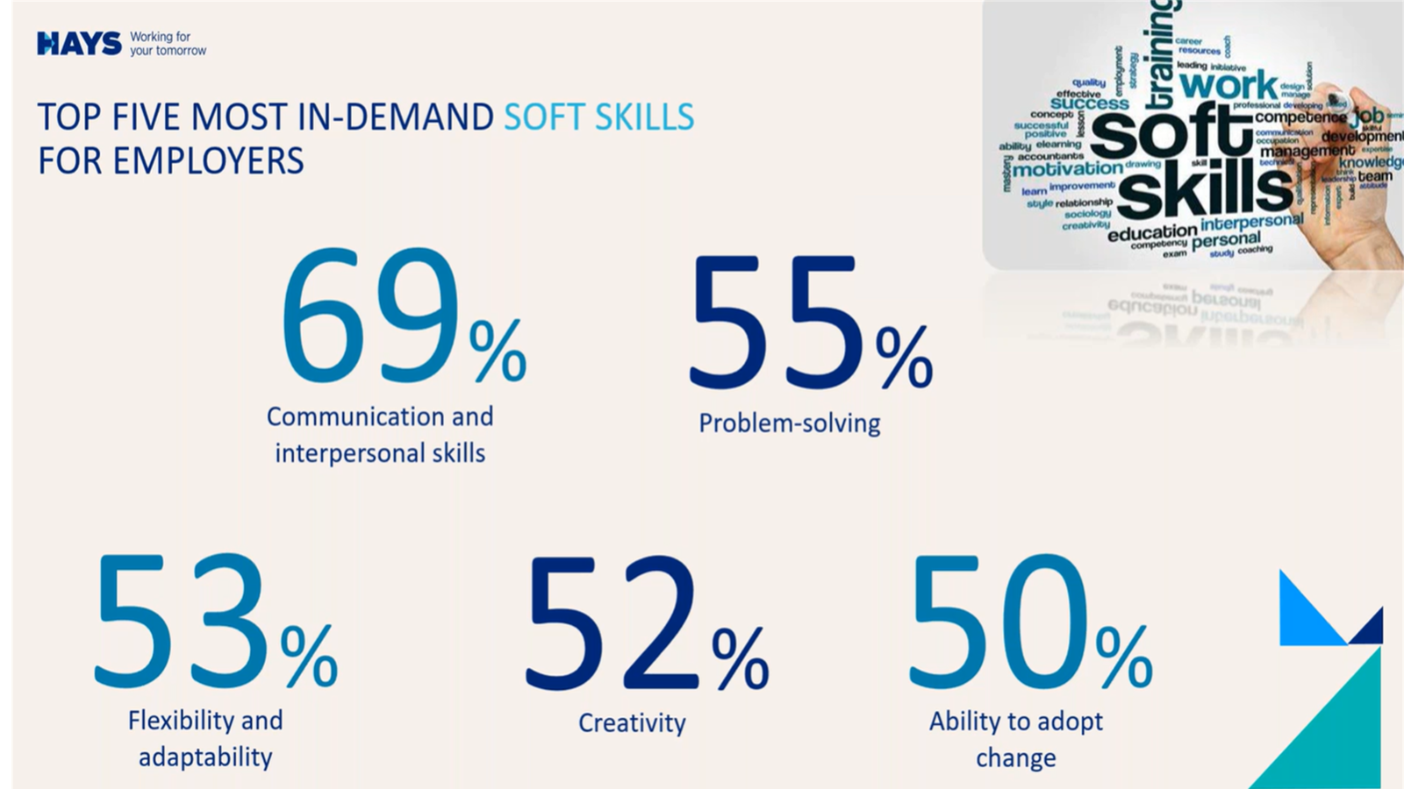

Slide 4
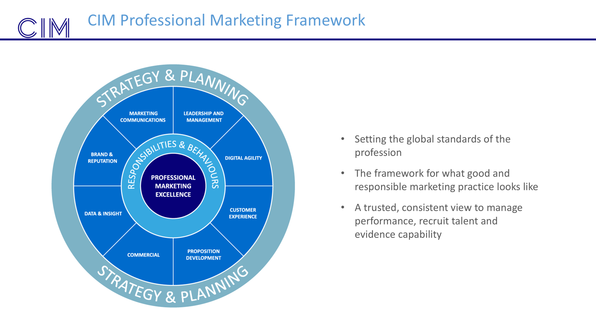

Slide 5
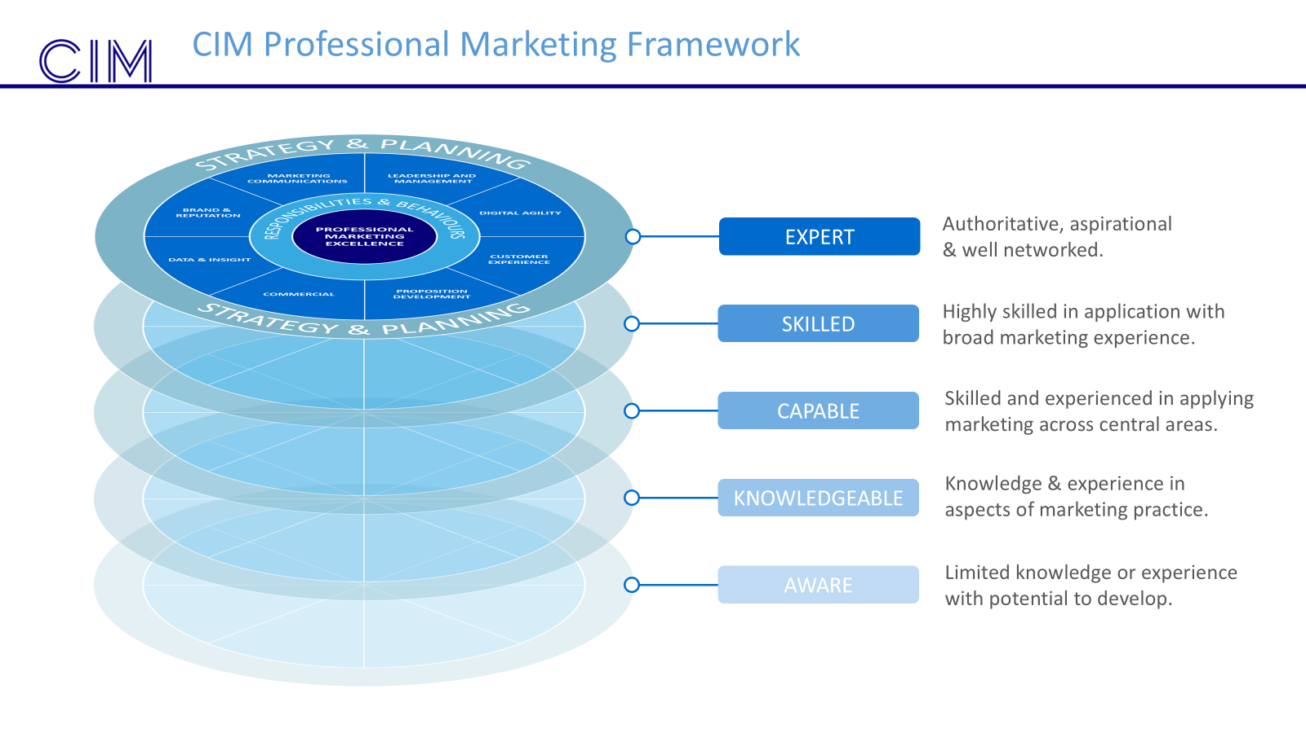

Slide 6
Nearly half (47%) of CIM graduates get promoted or receive a pay rise within 12 months of graduating with CIM
After university degrees, CIM qualifications are the most sought after by employers
6 good reasons to gain a CIM qualification
Adds practitioner experience, improving your employability
60% of CIM graduates are more respected at work or given more responsibility
50% of employers look at applicants that have a CIM qualification when recruiting
Internationally recognised qualifications that lead to Chartered Marketer status
Notes:
demonstrate ability to use theory learnt at university with practitioner expertise, & it shows a passion for marketing & a desire to impress employers.

Slide 7
CIM Qualifications
Notes:
Differentiate yourself from the other 90K marketing students in UK
Add to your university degree by gaining a CIM Qualification
CIM has mapped the academic programme you are studying at YSJ = fast track to a CIM Qualification.

Slide 8
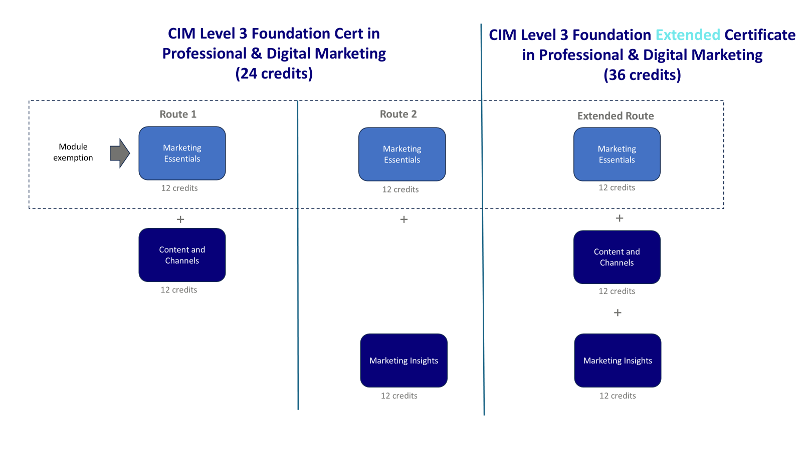

Slide 9
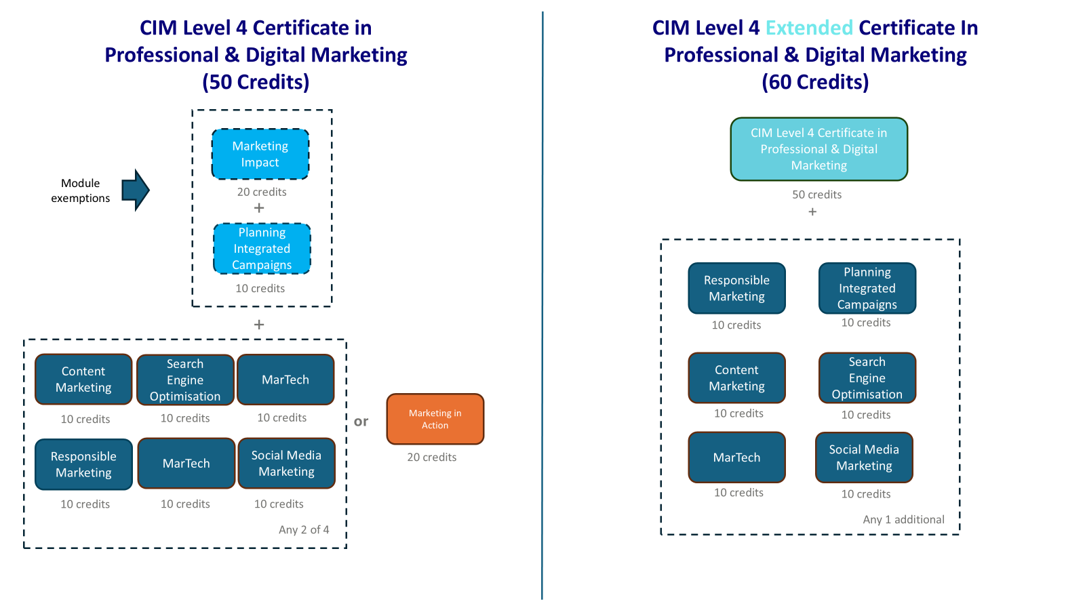











Slide 10
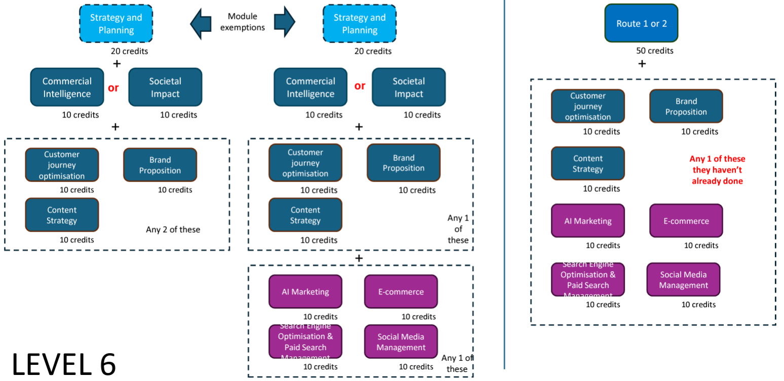
Level 6 Diploma in Professional & Digital Marketing (50 credits)
Extended Diploma in Professional & Digital Marketing (60 credits)

Slide 11
Practical marketing experience
Notes:
Differentiate yourself from the other 90K marketing students in UK
Add to your university degree by gaining a CIM Qualification
CIM has mapped the academic programme you are studying at YSJ = fast track to a CIM Qualification.

Slide 12
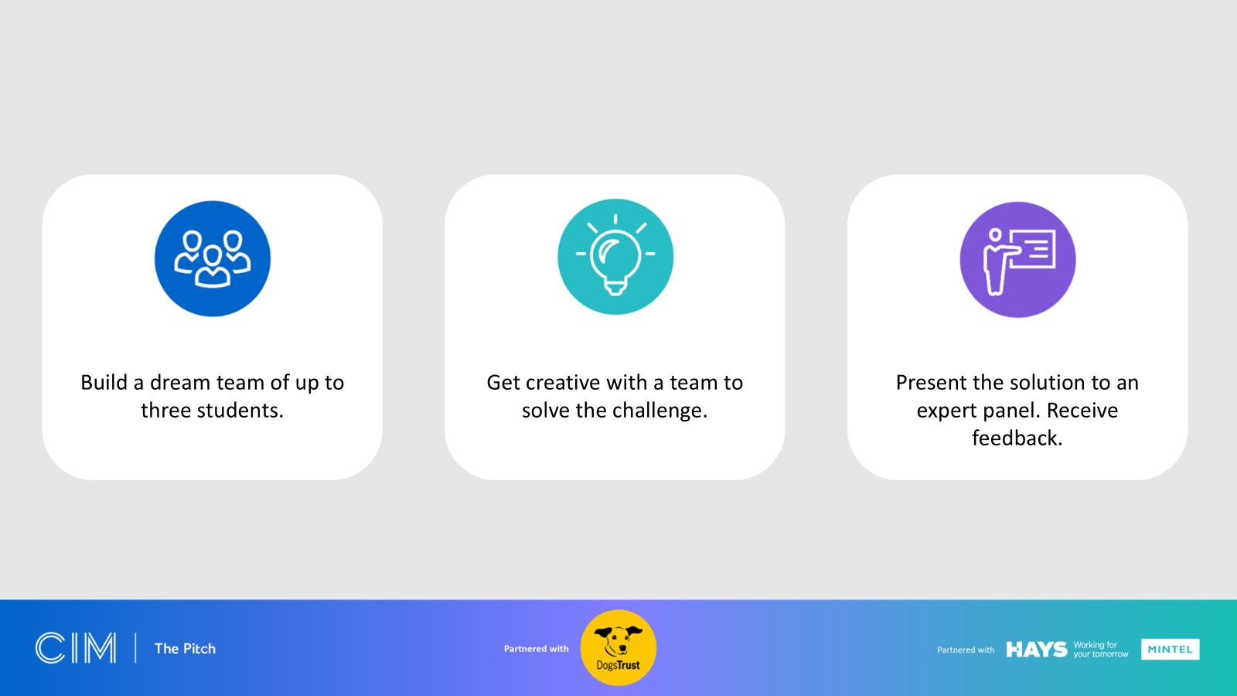

Slide 13


Slide 14
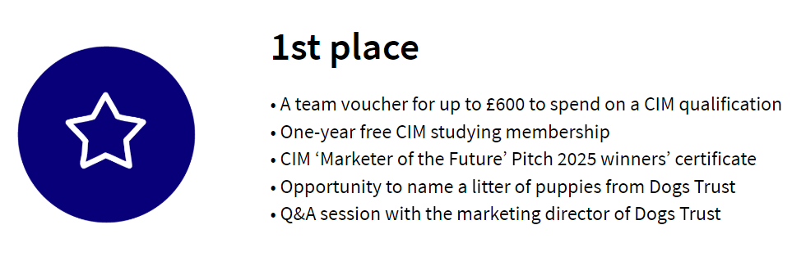
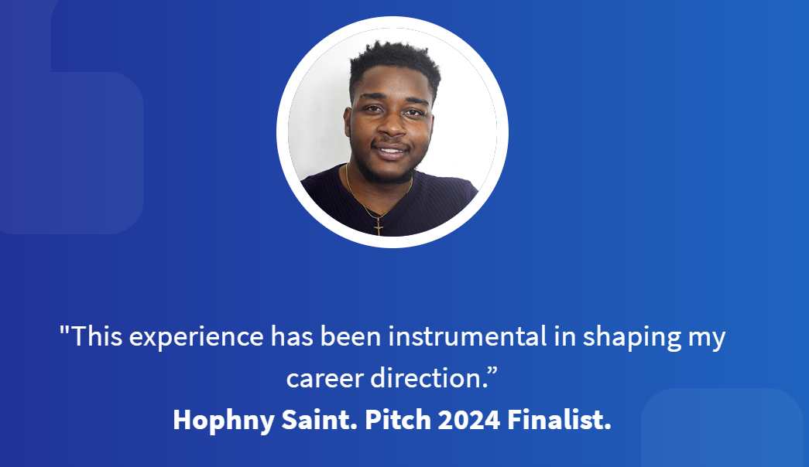
In the competitive world of marketing, CIM’s annual student marketing competition, The Pitch, stands as a beacon of opportunity for students eager to prove themselves. The Pitch challenges participants to apply their academic knowledge and creative skills to real-world marketing problems set by a charity, presenting their solutions to a panel of seasoned industry experts.
Jack Hardy, Head of Marketing – Jam 7
Reflecting on the experience, Triputra shared, "The most important lesson I learned from participating in The Pitch was how to develop a complete and feasible marketing plan within the constraints of a real-world business framework.”
Sakri Triputra – The Pitch Winner 2023
Notes:
Differentiate yourself from the other 90K marketing students in UK
Add to your university degree by gaining a CIM Qualification
CIM has mapped the academic programme you are studying at YSJ = fast track to a CIM Qualification.

Slide 15
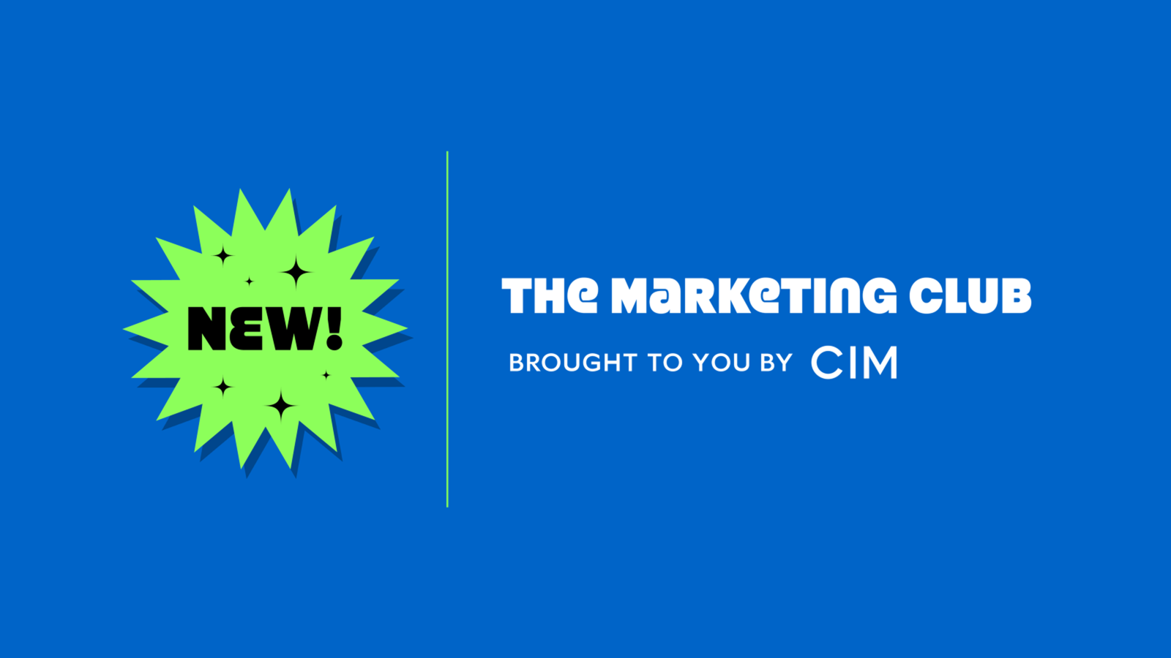

Slide 16
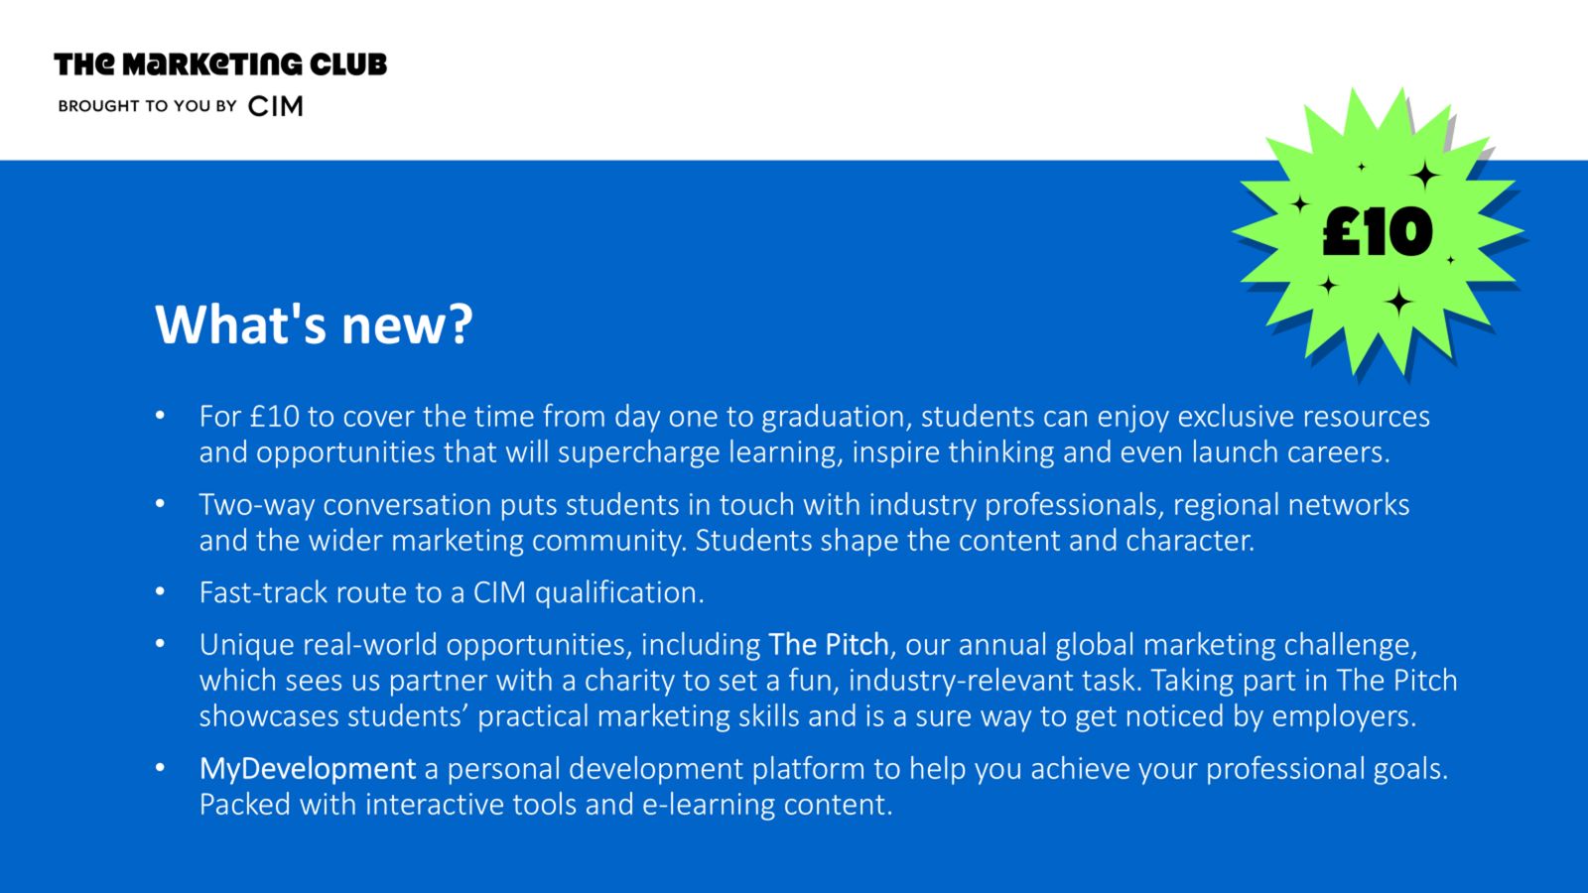

Slide 17
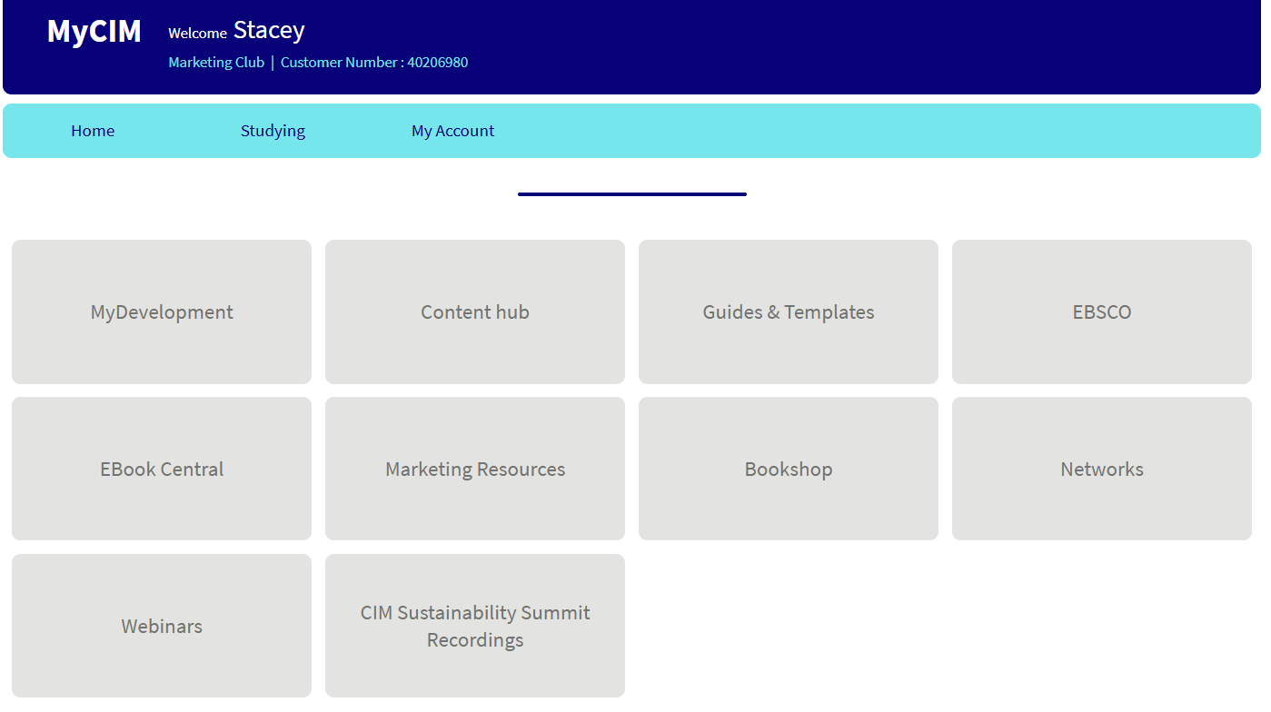


Slide 18
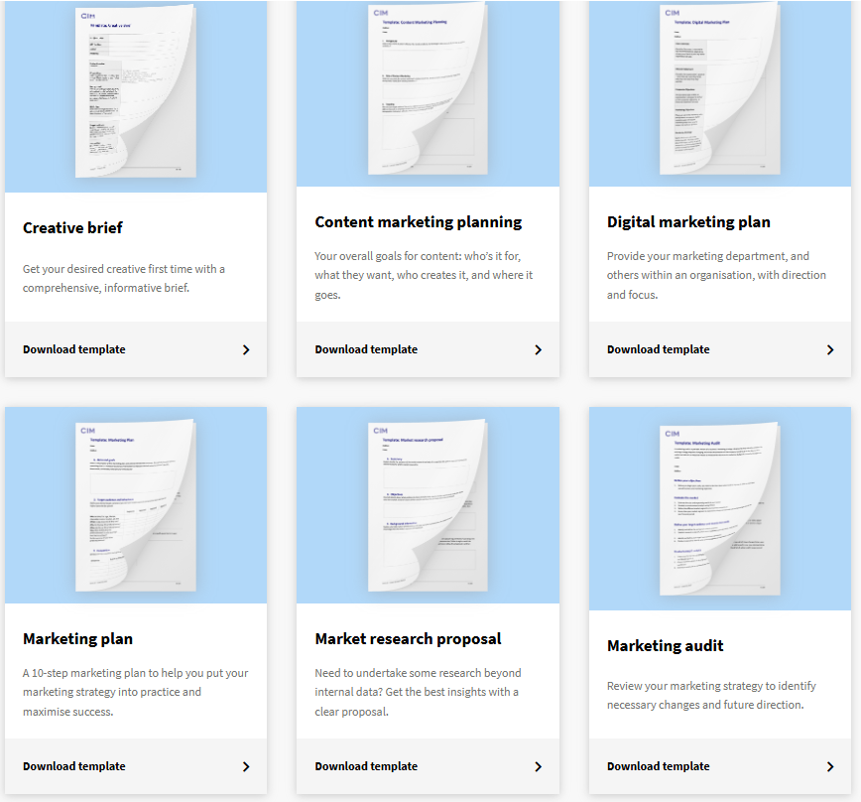
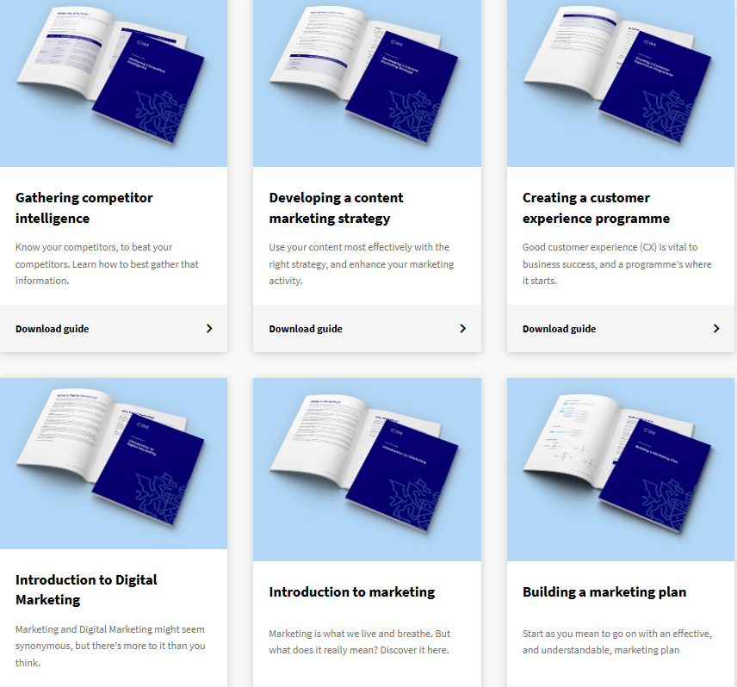
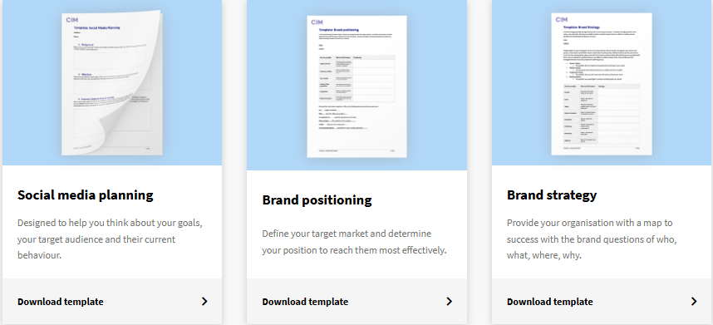
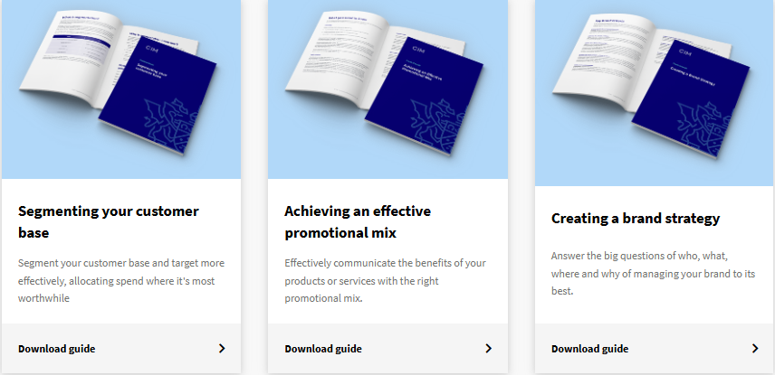

Slide 19
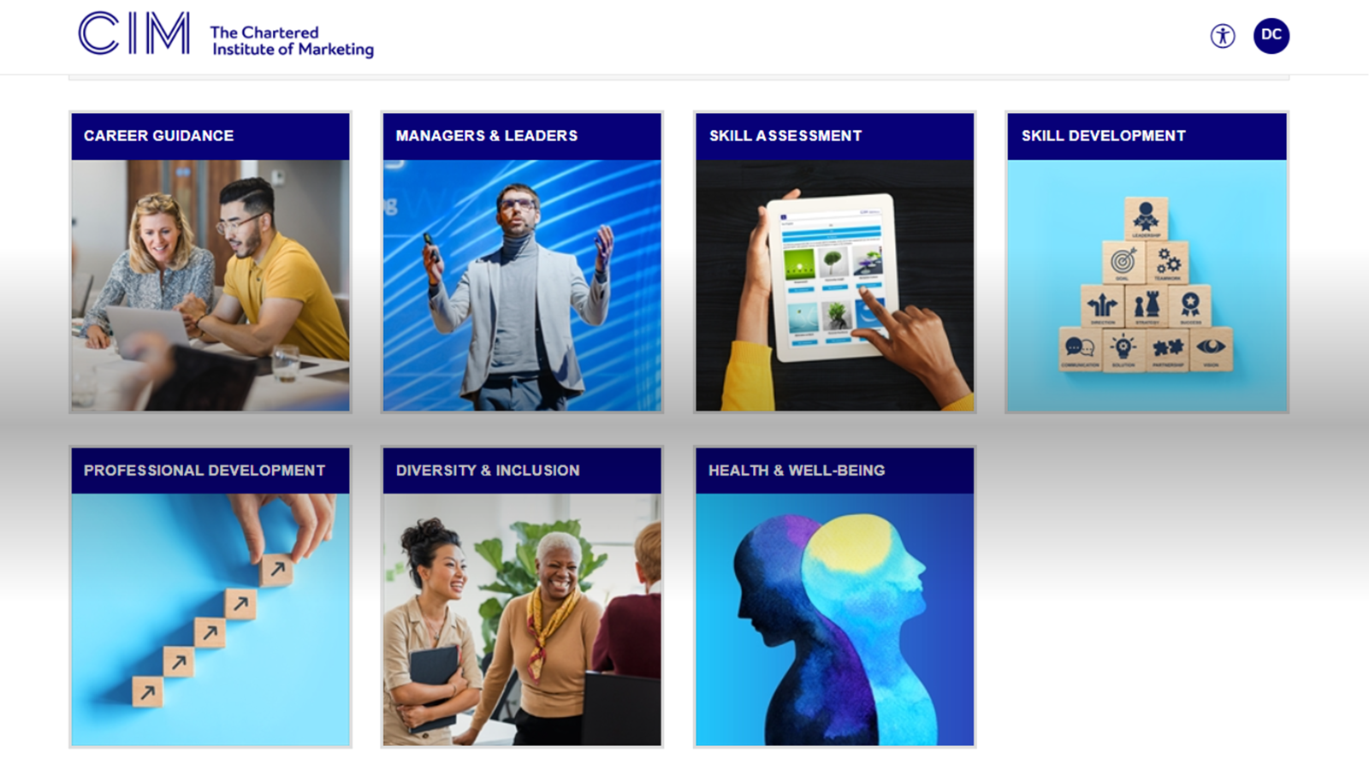

Slide 20
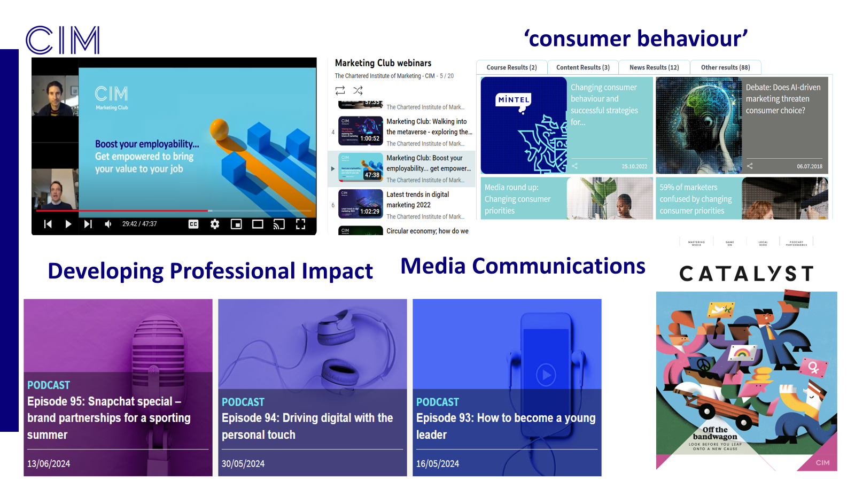

Slide 21
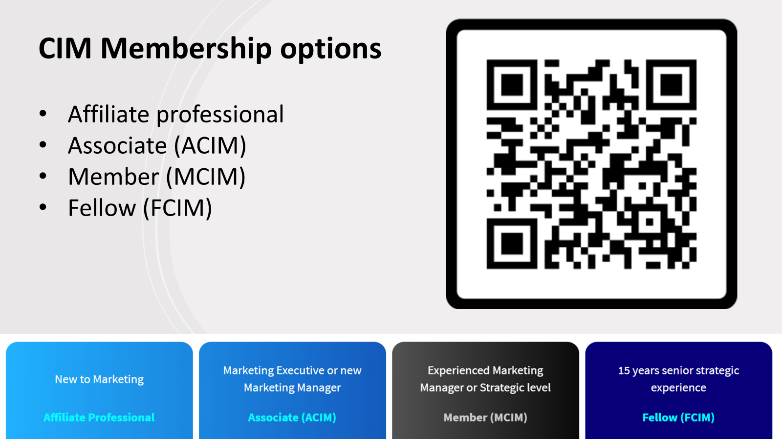

Slide 22
Tutor Benefits
Free access to CIM Tutorzone:
CIM Module specifications
CIM Module Assessment briefs
CIM Study Resources
Marketing Materials
Additional free Access for tutors for The Marketing Club or can upgrade to a higher membership depending on experience and qualifications
Can be a purchased via the university for a significantly discounted fee of £65 for Affiliate Membership
Access to online and offline content
Professional Webinar content
Guidance Documents and Professional templates
Access to CIM professional qualifications including Leadership and Management.
Notes:
Differentiate yourself from the other 90K marketing students in UK
Add to your university degree by gaining a CIM Qualification
CIM has mapped the academic programme you are studying at YSJ = fast track to a CIM Qualification.

Slide 23
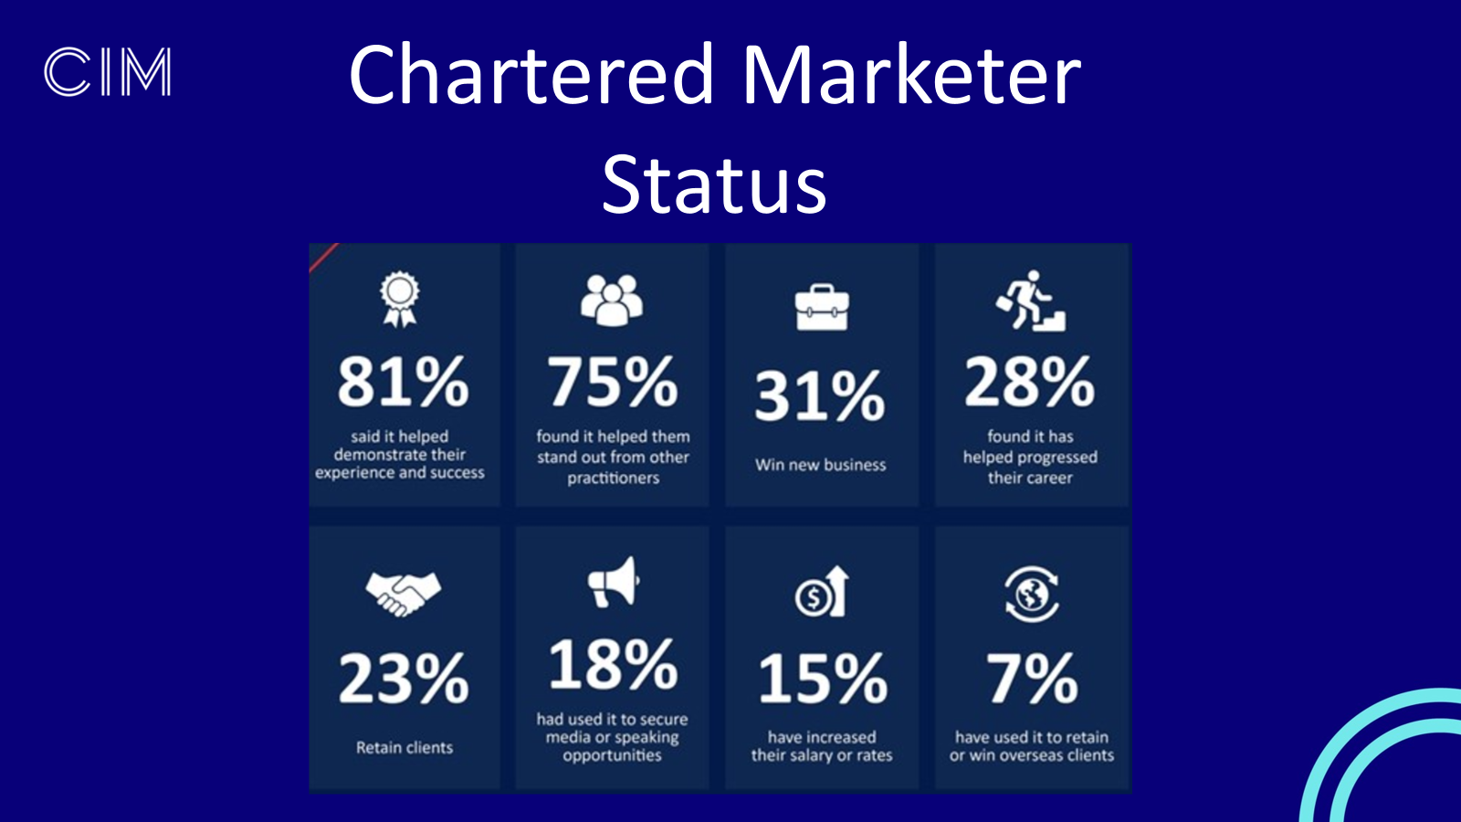

Slide 24
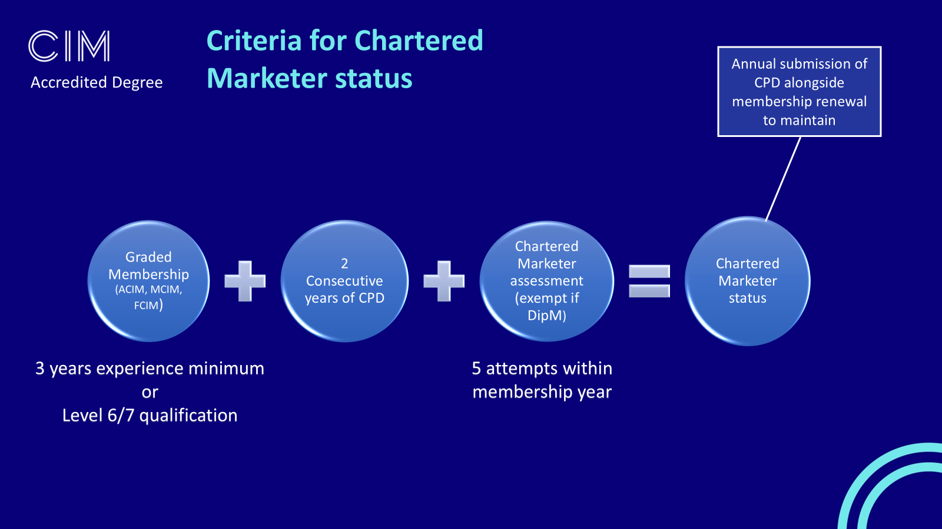

Slide 25
