Slide 1
ΧΡΗΜΑΤΟΟΚΟΙΝΟΜΙΚΗ ΛΟΓΙΣΤΙΚΗ
(ΜΑΘΗΜΑ ΚΟΡΜΟΥ)
ΔιδΑσκοντες: Επικ. ΚαθηγητΗς κος. ΤοΥντας ΚανΕλλος
Dr. ΔιαμαντοποΥλου ΛυδΙα

Slide 2
Objectives of FSA
Financial statement analysis is an information system that provides information:
  with the study, assessment and interpretation of the relationships and trends that exist between the different financial items.
  which is refers to the current financial position of the company and forecasts related to the future position and performance of the firm to the external decision-makers.
  that can be used for the valuation of a company.

Slide 3
Key steps
Macroeconomic Environment
Business Strategic Analysis
Accounting Analysis
  Examination of annual accounting statements.
  Examination of external auditor's report.
  Analysis of the accounting principles used to prepare the financial statements.
  Examination of notes in the financial statements and existing complementary accounting statements.
Common-size analysis (Vertical analysis)
  Convey items in the balance sheet as a percentage of total asset and items in the income statement as a percentage of sales
Trend analysis (Horizontal analysis) and/or Comparative Financial Statement Analysis
  Percentage change of a financial item over time relative to a base year
Financial Ratio Analysis

Slide 4
Macroeconomic Environment
The macro-environment refers to how the macroeconomic conditions in which a company or sector operates influences its performance. Macroeconomics deals with aggregate production, spending, and the price level in an economy as opposed to individual industries and markets.
The Macro Environment consists of 6 different forces. These are: Demographic, Economic, Political, Ecological, Socio-Cultural, and Technological forces.
The factors that make up the macro-environment are economic factors, demographic forces, technological factors, natural and physical forces, political and legal forces, and social and cultural forces.
What is macro environment in business environment?
  the major uncontrollable, external forces (economic, demographic, technological, natural, social and cultural, legal and political) which influence a firm's decision making and have an impact upon its performance.

Slide 5
Business Strategic Analysis
Business analysis is the evaluation of a company’s prospects and risks for the purpose of making business decisions.
Business analysis aids in making informed decisions by helping structure the decision task through an evaluation of a company’s business environment, its strategies, and its financial position and performance.
The goal of business analysis is to improve business decisions by evaluating available information about a company’s financial situation, its management, its plans and strategies, and its business environment.

Slide 6
Business Strategic Analysis
Types of Business Analysis
  Credit Analysis: Credit analysis is the evaluation of the creditworthiness of a company. Creditworthiness is the ability of a company to honor its credit obligations.
    Credit analysis focuses on downside risk instead of upside potential. This includes analysis of both liquidity and solvency. Liquidity is a company’s ability to raise cash in the short term to meet its obligations. Liquidity depends on a company’s cash flows and the makeup of its current assets and current liabilities. Solvency is a company’s long run viability and ability to pay long-term obligations. It depends on both a company’s long-term profitability and its capital (financing) structure.
    Credit Analysis: Credit analysis is the evaluation of the creditworthiness of a company. Creditworthiness is the ability of a company to honor its credit obligations.

Slide 7
Business Strategic Analysis
Types of Business Analysis
  Equity Analysis: Individuals who apply active investment strategies primarily use technical analysis, fundamental analysis, or a combination.
    Technical analysis, or charting, searches for patterns in the price or volume history of a stock to predict future price movements.
    Fundamental analysis, which is more widely accepted and applied, is the process of determining the value of a company by analyzing and interpreting key factors for the economy, the industry, and the company. A main part of fundamental analysis is evaluation of a company’s financial position and performance.

Slide 8
Business Strategic Analysis
A major goal of fundamental analysis is to determine intrinsic value, also called fundamental value. Intrinsic value is the value of a company (or its stock) determined through fundamental analysis without reference to its market value (or stock price).
While a company’s market value can equal or approximate its intrinsic value, this is not necessary.
An investment strategy with fundamental analysis is straightforward: buy when a stock’s intrinsic value exceeds its market value, sell when a stock’s market value exceeds its intrinsic value, and hold when a stock’s market value approximates its intrinsic value.

Slide 9
Business Strategic Analysis

Slide 10
Business Strategic Analysis
Strategy analysis is the evaluation of both a company’s business decisions and its success at establishing a competitive advantage.
Strategy analysis requires scrutiny of a company’s competitive strategy for its product mix and cost structure.

Slide 11
Comparative Financial Statement Analysis (Horizontal analysis)
Individuals conduct comparative financial statement analysis by reviewing consecutive balance sheets, income statements, or statements of cash flows from period to period. The most important information often revealed from comparative financial statement analysis is trend.
Year to year change analysis: Comparing financial statements over relatively short time periods—two to three years—is usually performed with analysis of year-to-year changes in individual accounts.
When a negative amount appears in the base and a positive amount in the next period (or vice versa), we cannot compute a meaningful percentage change.
When there is no amount for the base period, no percentage change is computable. Similarly, when the base period amount is small, a percentage change can be computed but the number must be interpreted with caution.

Slide 12
Trend Analysis
Διαχρονική Ανάλυση Ενεργητικού
 | 20Χ9 | 20Χ8 | 20Χ7 | 20Χ6 | 20Χ5
Ενσώματα Πάγια | 45.291 | 46.429 | 41.096 | 111.104 | 130.445
Λοιπά Μακροπρόθεσμα | 78.410 | 77.672 | 75.944 | 106.673 | 160.378
Σύνολο Παγίων | 123.701 | 124.101 | 117.040 | 217.777 | 290.823
Αποθέματα | 1.136.318 | 748.151 | 561.849 | 508.068 | 710.470
Εμπορικές Απαιτήσεις | 13.890.526 | 10.536.207 | 8.233.678 | 11.274.204 | 22.132.732
Λοιπές Απαιτήσεις | 535.133 | 293.777 | 594.662 | 900.641 | 130.934
Απαιτήσεις | 14.425.659 | 10.829.984 | 8.828.340 | 12.174.845 | 22.263.666
Διαθέσιμα | 3.886.889 | 4.245.891 | 7.971.448 | 3.937.966 | 4.219.267
Κυκλοφορούν Ενεργητικό | 19.448.866 | 15.824.026 | 17.361.637 | 16.620.879 | 27.193.403
Συνολικό Ενεργητικό | 19.572.567 | 15.948.127 | 17.478.677 | 16.838.656 | 27.484.226

Slide 13
Trend Analysis
Διαχρονική Ανάλυση Ενεργητικού
 | 20Χ9 | 20Χ8 | Μεταβολή | Μεταβολή σε %
Ενσώματα Πάγια | 45.291 | 46.429 | -1.138 | -2,51%
Λοιπά Μακροπρόθεσμα | 78.410 | 77.672 | 738 | 0,94%
Σύνολο Παγίων | 123.701 | 124.101 | -400 | -0,32%
Αποθέματα | 1.136.318 | 748.151 | 388.167 | 34,16%
Εμπορικές Απαιτήσεις | 13.890.526 | 10.536.207 | 3.354.319 | 24,15%
Λοιπές Απαιτήσεις | 535.133 | 293.777 | 241.356 | 45,10%
Απαιτήσεις | 14.425.659 | 10.829.984 | 3.595.675 | 24,93%
Διαθέσιμα | 3.886.889 | 4.245.891 | -359.002 | -9,24%
Κυκλοφορούν Ενεργητικό | 19.448.866 | 15.824.026 | 3.624.840 | 18,64%
Συνολικό Ενεργητικό | 19.572.567 | 15.948.127 | 3.624.440 | 18,52%

Slide 14
Trend Analysis
Διαχρονική Ανάλυση Ενεργητικού
 | 20Χ9 | 20Χ8 | 20Χ7 | 20Χ6 | 20Χ5
Ενσώματα Πάγια | 34,72% | 35,59% | 31,50% | 85,17% | 130.445
Λοιπά Μακροπρόθεσμα | 48,89% | 48,43% | 47,35% | 66,51% | 160.378
Σύνολο Παγίων | 42,53% | 42,67% | 40,24% | 74,88% | 290.823
Αποθέματα | 159,94% | 105,30% | 79,08% | 71,51% | 710.470
Εμπορικές Απαιτήσεις | 62,76% | 47,60% | 37,20% | 50,94% | 22.132.732
Λοιπές Απαιτήσεις | 408,70% | 224,37% | 454,17% | 687,86% | 130.934
Απαιτήσεις | 64,79% | 48,64% | 39,65% | 54,68% | 22.263.666
Διαθέσιμα | 92,12% | 100,63% | 188,93% | 93,33% | 4.219.267
Κυκλοφορούν Ενεργητικό | 71,52% | 58,19% | 63,85% | 61,12% | 27.193.403
Συνολικό Ενεργητικό | 71,21% | 58,03% | 63,60% | 61,27% | 27.484.226

Slide 15
Trend Analysis
Διαχρονική Ανάλυση Παθητικού
 | 20Χ9 | 20Χ8 | 20Χ7 | 20Χ6 | 20Χ5
Μετοχικό Κεφάλαιο | 6.300.000 | 6.300.000 | 6.300.000 | 7.800.000 | 7.800.000
Αδιανέμητα Κέρδη | 5.512.139 | 4.018.596 | 5.404.165 | 3.884.125 | 907.054
Σύνολο Ιδίων Κεφαλαίων | 11.812.139 | 10.318.596 | 11.704.165 | 11.684.125 | 8.707.054
Προβλέψεις | 764.614 | 682.658 | 681.542 | 674.182 | 542.942
Μακροπρόθεσμες Υποχρεώσεις
Εμπορικές υποχρεώσεις | 3.396.547 | 2.407.037 | 1.913.508 | 1.972.208 | 7.500.479
Λοιπές Βραχυπρόθεσμες Υποχρεώσεις | 3.599.267 | 2.539.835 | 3.179.462 | 2.508.141 | 10.733.751
Βραχυπρόθεσμες Υποχρεώσεις | 6.995.814 | 4.946.872 | 5.092.970 | 4.480.349 | 18.234.230
Σύνολο Παθητικού | 19.572.567 | 15.948.126 | 17.478.677 | 16.838.656 | 27.484.226

Slide 16
Trend Analysis
Διαχρονική Ανάλυση Παθητικού
 | 20Χ9 | 20Χ8 | Μεταβολή | Μεταβολή σε %
Μετοχικό Κεφάλαιο | 6.300.000 | 6.300.000 |  | 0,00%
Αδιανέμητα Κέρδη | 5.512.139 | 4.018.596 | 1.493.543 | 27,10%
Σύνολο Ιδίων Κεφαλαίων | 11.812.139 | 10.318.596 | 1.493.543 | 12,64%
Προβλέψεις | 764.614 | 682.658 | 81.956 | 10,72%
Μακροπρόθεσμες Υποχρεώσεις
Εμπορικές υποχρεώσεις | 3.396.547 | 2.407.037 | 989.510 | 29,13%
Λοιπές Βραχυπρόθεσμες Υποχρεώσεις | 3.599.267 | 2.539.835 | 1.059.432 | 29,43%
Βραχυπρόθεσμες Υποχρεώσεις | 6.995.814 | 4.946.872 | 2.048.942 | 29,29%
Σύνολο Παθητικού | 19.572.567 | 15.948.126 | 3.624.441 | 18,52%

Slide 17
Trend Analysis
Διαχρονική Ανάλυση Παθητικού
 | 20Χ9 | 20Χ8 | 20Χ7 | 20Χ6 | 20Χ5
Μετοχικό Κεφάλαιο | 80,77% | 80,77% | 80,77% | 100,00% | 7.800.000
Αδιανέμητα Κέρδη | 607,70% | 443,04% | 595,79% | 428,21% | 907.054
Σύνολο Ιδίων Κεφαλαίων | 135,66% | 118,51% | 134,42% | 134,19% | 8.707.054
Προβλέψεις | 140,83% | 125,73% | 125,53% | 124,17% | 542.942
Μακροπρόθεσμες Υποχρεώσεις | 0,00% | 0,00% | 0,00% | 0,00%
Εμπορικές υποχρεώσεις | 45,28% | 32,09% | 25,51% | 26,29% | 7.500.479
Λοιπές Βραχυπρόθεσμες Υποχρεώσεις | 33,53% | 23,66% | 29,62% | 23,37% | 10.733.751
Βραχυπρόθεσμες Υποχρεώσεις | 38,37% | 27,13% | 27,93% | 24,57% | 18.234.230
Σύνολο Παθητικού | 71,21% | 58,03% | 63,60% | 61,27% | 27.484.226

Slide 18
Trend Analysis
Διαχρονική Ανάλυση ΚΑΧ
 | 20Χ8 | 20Χ7 | 20Χ6 | 20Χ5 | 20Χ4
Πωλήσεις | 42.085.923 | 31.467.085 | 31.048.439 | 29.238.932 | 47.360.615
Κόστος Πωληθέντων | -27.109.123 | -20.116.844 | -20.391.524 | -18.038.745 | -34.224.215
Μικτό Κέρδος | 14.976.800 | 11.350.241 | 10.656.915 | 11.200.187 | 13.136.400
Λοιπά Συνήθη Έσοδα | 1.353.741 | 1.171.767 | 1.217.904 | 1.176.291 | 1.237.186
Έξοδα Διοίκησης & Διάθεσης | -10.087.708 | -7.663.901 | -9.106.882 | -8.044.908 | -9.761.679
Αποτελέσματα προ τόκων & φόρων | 6.242.833 | 4.858.107 | 2.767.937 | 4.331.570 | 4.611.907
Χρηματοοικονομικά αποτελέσματα | -71.924 | -90.787 | -90.832 | -146.728 | -168.392
Έκτακτα & Ανόργανα | 0 | 0 | 0 | 0 | 0
Αποτελέσματα προ φόρων | 6.170.909 | 4.767.320 | 2.677.105 | 4.184.842 | 4.443.515
Φόροι | -1.677.366 | -1.252.890 | -1.151.298 | -1.207.771 | -1.777.826
Αποτελέσματα μετά από φόρους | 4.493.543 | 3.514.430 | 1.525.807 | 2.977.071 | 2.665.689

Slide 19
Trend Analysis
Διαχρονική Ανάλυση ΚΑΧ
 | 20Χ8 | 20Χ7 | Μεταβολή | Μεταβολή σε %
Πωλήσεις | 42.085.923 | 31.467.085 | 10.618.838 | 25,23%
Κόστος Πωληθέντων | -27.109.123 | -20.116.844 | 6.992.279 | 25,79%
Μικτό Κέρδος | 14.976.800 | 11.350.241 | 3.626.559 | 24,21%
Λοιπά Συνήθη Έσοδα | 1.353.741 | 1.171.767 | 181.974 | 13,44%
Έξοδα Διοίκησης & Διάθεσης | -10.087.708 | -7.663.901 | 2.423.807 | 24,03%
Αποτελέσματα προ τόκων & φόρων | 6.242.833 | 4.858.107 | 1.384.726 | 22,18%
Χρηματοοικονομικά αποτελέσματα | -71.924 | -90.787 | -18.863 | -26,23%
Έκτακτα & Ανόργανα | 0 | 0
Αποτελέσματα προ φόρων | 6.170.909 | 4.767.320 | 1.403.589 | 22,75%
Φόροι | -1.677.366 | 1.252.890 | -2.930.256 | 174,69%
Αποτελέσματα μετά από φόρους | 4.493.543 | 6.020.210 | -1.526.667 | -33,97%

Slide 20
Common Size Analysis
Common-size financial statements show the euro amount of each item as a percentage of a reference value
  Common-size balance sheet may use total assets as the reference value; each item is expressed as a percentage of total assets
  Common-size income statement may use net sales as the reference value; each item is expressed as a percentage of net sales

Slide 21
Common Size Analysis
Ενεργητικού
 | 20Χ9 | 20Χ8 | 20Χ7 | 20Χ6 | 20Χ5
Ενσώματα Πάγια | 0,23% | 0,29% | 0,24% | 0,66% | 0,47%
Λοιπά Μακροπρόθεσμα | 0,40% | 0,49% | 0,43% | 0,63% | 0,58%
Σύνολο Παγίων | 0,63% | 0,78% | 0,67% | 1,29% | 1,06%
Αποθέματα | 5,81% | 4,69% | 3,21% | 3,02% | 2,59%
Εμπορικές Απαιτήσεις | 70,97% | 66,07% | 47,11% | 66,95% | 80,53%
Λοιπές Απαιτήσεις | 2,73% | 1,84% | 3,40% | 5,35% | 0,48%
Απαιτήσεις | 73,70% | 67,91% | 50,51% | 72,30% | 81,01%
Διαθέσιμα | 19,86% | 26,62% | 45,61% | 23,39% | 15,35%
Κυκλοφορούν Ενεργητικό | 99,37% | 99,22% | 99,33% | 98,71% | 98,94%
Συνολικό Ενεργητικό | 100,00% | 100,00% | 100,00% | 100,00% | 100,00%

Slide 22
Common Size Analysis
Παθητικού
 | 20Χ9 | 20Χ8 | 20Χ7 | 20Χ6 | 20Χ5
Μετοχικό Κεφάλαιο | 32,19% | 39,50% | 36,04% | 46,32% | 28,38%
Αδιανέμητα Κέρδη | 28,16% | 25,20% | 30,92% | 23,07% | 3,30%
Σύνολο Ιδίων Κεφαλαίων | 60,35% | 64,70% | 66,96% | 69,39% | 31,68%
Προβλέψεις | 3,91% | 4,28% | 3,90% | 4,00% | 1,98%
Μακροπρόθεσμες Υποχρεώσεις | 0,00% | 0,00% | 0,00% | 0,00% | 0,00%
Εμπορικές υποχρεώσεις | 17,35% | 15,09% | 10,95% | 11,71% | 27,29%
Λοιπές Βραχυπρόθεσμες Υποχρ. | 18,39% | 15,93% | 18,19% | 14,90% | 39,05%
Βραχυπρόθεσμες Υποχρεώσεις | 35,74% | 31,02% | 29,14% | 26,61% | 66,34%
Σύνολο Παθητικού | 100,00% | 100,00% | 100,00% | 100,00% | 100,00%

Slide 23
Common Size Analysis
ΚΑΧ
 | 20Χ8 | 20Χ7 | 20Χ6 | 20Χ5 | 20Χ4
Πωλήσεις | 100,00% | 100,00% | 100,00% | 100,00% | 100,00%
Κόστος Πωληθέντων | -64,41% | -63,93% | -65,68% | -61,69% | -72,26%
Μικτό Κέρδος | 35,59% | 36,07% | 34,32% | 38,31% | 27,74%
Λοιπά Συνήθη Έσοδα | 3,22% | 3,72% | 3,92% | 4,02% | 2,61%
 | 0,00% | 0,00% | 0,00% | 0,00% | 0,00%
Έξοδα Διοίκησης & Διάθεσης | -23,97% | -24,36% | -29,33% | -27,51% | -20,61%
Αποτελέσματα προ τόκων & Φόρων | 14,83% | 15,44% | 8,91% | 14,81% | 9,74%
Χρηματοοικονομικά αποτελέσματα | -0,17% | -0,29% | -0,29% | -0,50% | -0,36%
Έκτακτα & Ανόργανα | 0,00% | 0,00% | 0,00% | 0,00% | 0,00%
Αποτελέσματα προ φόρων | 14,66% | 15,15% | 8,62% | 14,31% | 9,38%
Φόροι | -3,99% | -3,98% | -3,71% | -4,13% | -3,75%
Αποτελέσματα μετά από φόρους | 10,68% | 11,17% | 4,91% | 10,18% | 5,63%

Slide 24
Just Remember
Το να βγάζουμε απλά νούμερα δεν έχει κανένα απολύτως νόημα από μόνο του. Στην οποιαδήποτε ανάλυση ισχύει ο κανόνας «Garbage in, garbage out»
Η trend analysis από μόνη της δεν έχει νόημα. Πρέπει να κρίνουμε μοτίβα, να δούμε για major events τόσο σε επίπεδο εταιρείας (ειδήσεις – εκθέσεις – άρθρα, σημειώσεις επί των οικονομικών καταστάσεων) όσο και σε επίπεδο κλάδου – γενικότερης οικονομίας (λ.χ covid)
Στην ανάλυση κοινών μεγεθών πρέπει να προσέξουμε τα εξής:
  If consistency in the accounting principle, concepts, conventions is not maintained then Common Size Statement becomes useless.
  Common-Size Statement fails to convey proper records during seasonal fluctuations in various components of sales, assets liabilities etc. e.g. sales and closing stock significantly vary. Thus, the statement fails to supply the real information to the users of financial statements.

Slide 25
Just Remember
Στην ανάλυση κοινών μεγεθών πρέπει να προσέξουμε τα εξής:
  Effect of window dressing in financial statements cannot be ignored and Common-Size Statements fail to supply the real positions of sales, assets, liabilities etc. due to the evil effects of window dressing appearing in the financial statements.
Ότι και αν κάνουμε θέλει κριτική σκέψη, γνώση της εταιρείας – των ομοειδών επιχειρήσεων – του κλάδου καθώς και των περιορισμών της κάθε μεθόδου ανάλυσης

Slide 26
Αξιολόγηση με βάση σημεία αναφοράς (benchmarking)
  Συγκρίνει μια εταιρεία με πρότυπα που έχουν τεθεί από τρίτους
  Διευκολύνεται από καταστάσεις κοινού μεγέθους
  Σκοπός είναι η βελτίωση
Πίνακας 13-6
Copyright ©2015 Pearson Education Inc. All rights reserved.
LO 3

Slide 27
Χρήση των αριθμοδεικτών για τη λήψη επιχειρηματικών αποφάσεων
Μέτρηση της ικανότητας να πληρωθούν οι βραχυπρόθεσμες υποχρεώσεις
Μέτρηση κυκλοφοριακής ταχύτητας και του κύκλου ταμειακής μετατροπής
Μέτρηση της μόχλευσης
Μέτρηση της κερδοφορίας
Ανάλυση της επένδυσης σε μετοχές
LO 5
Copyright ©2015 Pearson Education Inc. All rights reserved.

Slide 28
Risk Analysis
The analysis of risk is central to any decision to commit economic resources to a project or an investment.

Slide 29
Risk Analysis
FINANCIAL STATEMENT ANALYSIS OF RISK
In addition to using information about risk disclosed in the notes to the financial statements, we can also assess many dimensions of risk using ratios of various items in the financial statements.
The statement of cash flows also is an important source of information for studying risk.
types of risk:
  Financial flexibility
  Short-term liquidity risk
  Long-term solvency risk
  Credit risk
  Bankruptcy risk
  Financial reporting manipulation risk

Slide 30
Short-term liquidity risk & Long-term solvency risk
In addition to using information about risk disclosed in the notes to the financial statements, we can also assess many dimensions of risk using ratios of various items in the financial statements.
Short-term liquidity risk, relates to the near-term ability to generate cash to meet working capital needs and debt service requirements.
Long-term solvency risk, relates to the longer-term ability to generate cash internally or externally to satisfy plant capacity and debt repayment needs.

Slide 31
Short-term liquidity risk
Liquidity is the ability to convert assets into cash or to obtain cash to meet short-term obligations.
Easily converted assets into cash = Current Assets - Cash and other assets reasonably expected to be (1) realized in cash, or (2) sold or consumed, during the longer of one-year or the operating cycle.
Short-term obligations = Current liabilities - Obligations to be satisfied within a relatively short period, usually a year.
Working Capital = Current Assets – Current Liabilities
Thus,
Short term liquidity risk is linked to working capital

Slide 32
Short-term liquidity risk
Are all current obligations reported in current liabilities? The answer is no.
  1. Contingent liabilities associated with loan guarantees. We need to assess the likelihood of this contingency materializing when we compute working capital.
  2. Future minimum rental payments under noncancelable operating lease agreements.
  3. Contracts for construction or acquisition of long-term assets often call for substantial progress payments.
These obligations for payments are reported in the footnotes as “commitments” and not as liabilities in the balance sheet. When computing working capital, our analysis should often include these commitments.
We also should recognize that current deferred tax assets (debits) are no more current assets than current deferred tax liabilities (credits) are current liabilities. Current deferred tax assets (liabilities) do not always represent expected cash inflows (outflows) in the form of tax refunds.
These assets usually serve to reduce future income tax expense.

Slide 33
Short-term liquidity risk
Financial statement ratios for assessing short-term liquidity risk:
current ratio,
quick ratio,
operating cash flow to current liabilities ratio,
accounts receivable turnover,
inventory turnover,
accounts payable turnover

Slide 34
Current Ratio
It indicates the amount of cash available at the balance sheet date plus the amount of other current assets the firm expects to turn into cash within one year of the balance sheet date (from collection of receivables and sale of inventory) relative to obligations coming due during that period.
Large current ratios indicate the substantial amounts of cash and near-cash assets available to repay obligations coming due within the next year. Small ratios, on the other hand, indicate that current levels of cash and near-cash assets may not be sufficient to repay short term obligations.

Slide 35
Current Ratio
Current ratio is a widespread measure of liquidity because:
It measures Current liability coverage. The higher the amount (multiple) of current assets to current liabilities, the greater assurance we have that current liabilities will be paid.
It serves as a buffer against losses. The larger the buffer, the lower the risk. The current ratio shows the margin of safety available to cover shrinkage in noncash current asset values when ultimately disposing of or liquidating them.
Reserve of liquid funds. The current ratio is relevant as a measure of the margin of safety against uncertainties and random shocks to a company’s cash flows.
Current ratio’s limitation
The current ratio is a static measure of resources available at a point in time to meet current obligations.
We cannot
  Measure and predict the pattern of future cash inflows and outflows
  Measure the adequacy of future cash inflows to outflows

Slide 36

Quick Ratio
A variation of the current ratio is the quick ratio, also called the acid test ratio.
Acid-Test (Quick) Ratio - A more stringent test of liquidity
Inventories are removed from the calculation of the quick ratio since they represent the most illiquid current assets.
Prepaid expenses are removed from the calculation of the quick ratio since they represent a receivable that will not incur a cash inflow in the near future.

Slide 37
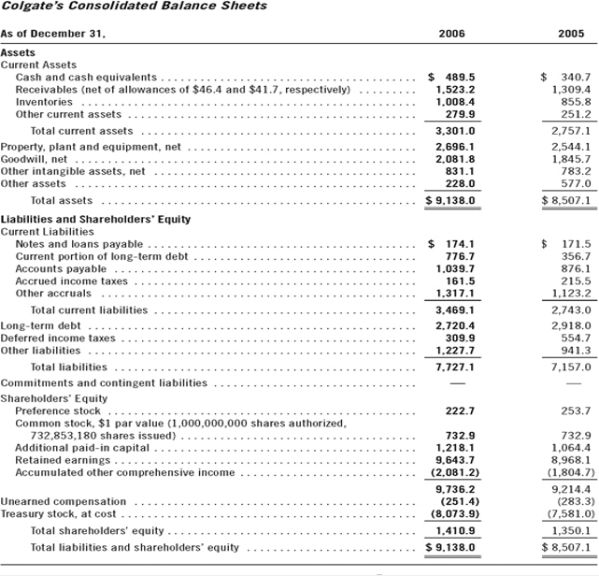
Current Ratio & Quick Ratio (Example)

Slide 38
Current Ratio & Quick Ratio (Example)

Slide 39
Current Ratio & Quick Ratio
Proper use and caution:
  Comparative Analysis when used. Analyzing the trend in the current ratio is often enlightening.
  Caution: Changes in this ratio do not necessarily imply changes in liquidity or operating performance.
  Caution for “management” of the current ratio, also known as window dressing. Toward the close of a period, management will occasionally press the collection of receivables, reduce inventory below normal levels, and delay normal purchases. Proceeds from these activities are then used to pay off current liabilities.

Slide 40
Operating Cash Flow To Current Liabilities Ratio
Cash flow from operations, reported on the statement of cash flows, indicates the amount of cash the firm derived from (or used in) operations after funding working capital needs.
Because the numerator of this ratio uses amounts for a period of time, the denominator typically uses an average of current liabilities for the same period.
Overcomes the static nature of the current ratio since its numerator reflects a flow variable.

Slide 41
Operating Activity Analysis of Liquidity
It involves:
accounts receivable turnover,
inventory turnover,
accounts payable turnover, and

Slide 42
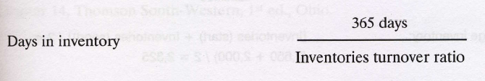
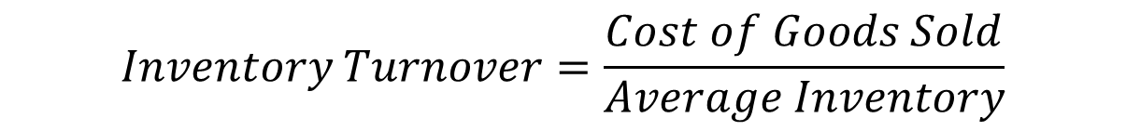
Inventory Turnover
Ο Δείκτης Κυκλοφοριακής Ταχύτητας Αποθεμάτων, μετρά το ρυθμό με τον οποίο ανακυκλώνεται το απόθεμα κατά τη διάρκεια μιας χρονικής περιόδου.
Μπορεί να χρησιμοποιηθεί για να διαπιστωθεί εάν μια επιχείρηση έχει υπερβολική επένδυση σε αποθέματα σε σύγκριση με τις πωλήσεις της, κάτι που μπορεί να υποδηλώνει είτε απροσδόκητα χαμηλές πωλήσεις είτε κακή διαχείριση του αποθέματος.
$$Inventory Turnover=\frac{Cost of Goods Sold}{Average Inventory}$$

Slide 43
Inventory Turnover
Τα ακόλουθα ζητήματα μπορούν να επηρεάσουν το Δείκτη Κυκλοφοριακής Ταχύτητας Αποθεμάτων:
  Εποχικότητα. Το απόθεμα μπορεί να αυξηθεί πριν από μια εποχική περίοδο πώλησης.
  Απαξίωση. Κάποιο τμήμα του αποθέματος μπορεί να είναι τεχνολογικά ή ποιοτικά ξεπερασμένο και επομένως δεν μπορεί να πωληθεί.
  Λογιστική κόστους. Η χρησιμοποιούμενη λογιστική μέθοδος αποτίμησης του αποθέματος, σε συνδυασμό με αλλαγές στα κόστη παραγωγής (πρώτες ύλες, κόστος εργασίας κλ.), μπορεί να οδηγήσουν σε σημαντικές μεταβολές στην αναφερόμενη αξία του αποθέματος.
  Χρησιμοποίηση της μεθόδου just in time. Ένα σύστημα παραγωγής μόνο των παραγγελιών που ζητήθηκαν το οποίο απαιτεί πολύ λιγότερα αποθέματα από ένα σύστημα "προώθησης" που κατασκευάζει με βάση την εκτιμώμενη ζήτηση.
  Πρακτικές αγορών. Ο υπεύθυνος προμηθειών μπορεί να υποστηρίξει μεγάλες ποσότητες αγορών για να λάβει εκπτώσεις αγοράς όγκου. Κάτι τέτοιο μπορεί να αυξήσει σημαντικά την επένδυση στο απόθεμα.

Slide 44
Inventory Turnover
Όταν υπάρχει χαμηλή κυκλοφοριακή ταχύτητα αποθέματος, υπάρχει μεγάλος κίνδυνος γήρανσης των αποθεμάτων, οπότε καθίσταται παρωχημένο και έχει μικρή υπολειμματική αξία.
Όταν υπάρχει υψηλή κυκλοφοριακή ταχύτητα αποθέματος, αυτό μπορεί να σημαίνει ότι η επιχείρηση διαχειρίζεται αποτελεσματικά τα αποθέματα της. Ωστόσο, μπορεί επίσης να σημαίνει ότι μια επιχείρηση δεν διαθέτει ταμειακά αποθέματα για να διατηρήσει τα κανονικά επίπεδα αποθέματος, και έτσι αποκλείει τις πιθανές πωλήσεις. Το τελευταίο σενάριο υπάρχει πιθανότατα να υφίσταται όταν το ποσό του χρέους είναι ασυνήθιστα υψηλό και υπάρχουν λίγα αποθέματα διαθεσίμων.

Slide 45
Inventory Turnover (example)

Slide 46
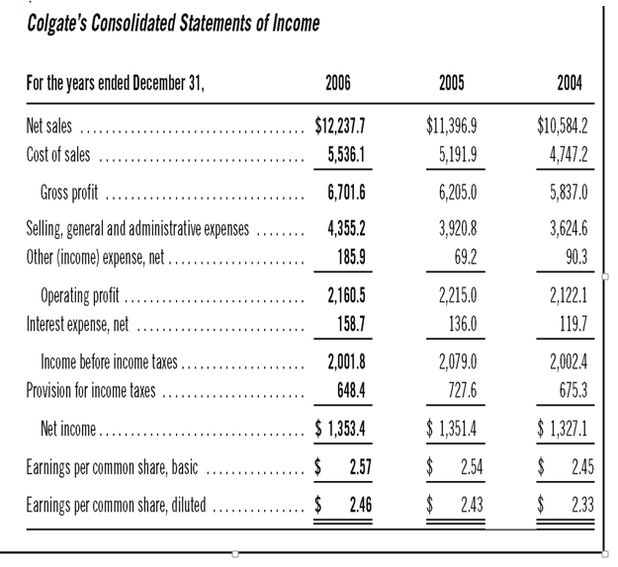
Inventory Turnover (example)

Slide 47
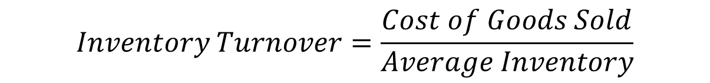

Inventory Turnover (example)
$$Inventory Turnover=\frac{Cost of Goods Sold}{Average Inventory}$$
$$Days in Inventory=\frac{365}{5.94}=61,44 days$$

Slide 48
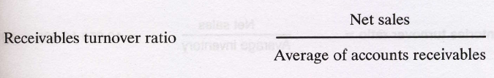

Accounts Receivable Turnover
Ο Δείκτης Κυκλοφοριακής Ταχύτητας Εμπορικών Απαιτήσεων (λογαριασμών εισπρακτέων από εμπορικές απαιτήσεις – Πελάτες), προσδιορίζει το πόσες φορές ανά έτος μια επιχείρηση συλλέγει τους μέσους εισπρακτέους λογαριασμούς της.

Slide 49
Accounts Receivable Turnover
Ο δείκτης χρησιμοποιείται για την αξιολόγηση της ικανότητας μιας εταιρείας να εκχωρεί αποτελεσματικά πίστωση στους πελάτες της και να συλλέγει τα χρήματα από αυτούς εγκαίρως.
Ένας υψηλός δείκτης υποδηλώνει έναν συνδυασμό συντηρητικής πιστωτικής πολιτικής και επιθετικού τμήματος είσπραξης, καθώς και ορισμένων πελατών υψηλής πιστότητας.
Ένας χαμηλός δείκτης δείχνει ανείσπρακτα κεφάλαια που “υπονομεύουν” άσκοπα το κεφάλαιο κίνησης.
Ο χαμηλός δείκτης μπορεί να οφείλεται σε χαλαρή ή ανύπαρκτη πιστωτική πολιτική, σε ανεπαρκή λειτουργία συλλογής ή / και σε μεγάλο ποσοστό πελατών που έχουν οικονομικές δυσκολίες. Είναι επίσης πολύ πιθανό ότι ένα χαμηλό επίπεδο κύκλου εργασιών δείχνει υπερβολικό ποσό επισφαλών απαιτήσεων.
Είναι χρήσιμο να παρακολουθείται ο κύκλος εργασιών του τμήματος διαχείρισης των εισπρακτέων λογαριασμών σε μια γραμμή τάσης για να δείτε εάν ο κύκλος εργασιών επιβραδύνεται. Εάν ναι, μπορεί να απαιτείται αύξηση της χρηματοδότησης για το προσωπικό των συλλογών ή τουλάχιστον επανεξέταση του λόγου για τον οποίο επιδεινώνεται ο κύκλος εργασιών.

Slide 50
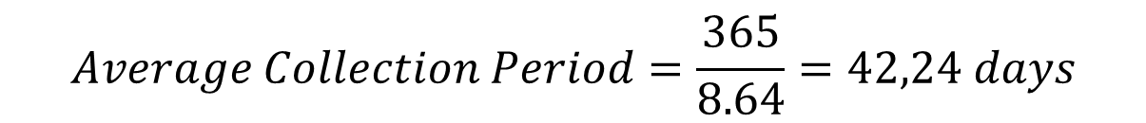
Accounts Receivable Turnover
$$Average Collection Period=\frac{365}{8.64}=42,24 days$$

Slide 51
Accounts Payable Turnover
Ο Δείκτης Κυκλοφοριακής Ταχύτητας Εμπορικών Υποχρεώσεων είναι ένας δείκτης που μετρά την ταχύτητα με την οποία μια εταιρεία πληρώνει τους προμηθευτές της.
Εάν ο δείκτης μειωθεί από τη μία περίοδο στην άλλη, αυτό δείχνει ότι η εταιρεία πληρώνει πιο αργά τους προμηθευτές της και μπορεί να αποτελεί ένδειξη επιδείνωσης της οικονομικής κατάστασης.
Μια αλλαγή στην αναλογία του δείκτη μπορεί επίσης να υποδηλώνει τροποποιημένους όρους πληρωμής με τους προμηθευτές, αν και αυτό σπάνια έχει περισσότερο από μια μικρή επίδραση στο δείκτη.
Εάν μια εταιρεία πληρώνει τους προμηθευτές της πολύ γρήγορα, αυτό μπορεί να σημαίνει ότι οι προμηθευτές απαιτούν όρους γρήγορης πληρωμής ή ότι η εταιρεία εκμεταλλεύεται τις εκπτώσεις πρόωρης πληρωμής.

Slide 52
Accounts Payable Turnover

Slide 53
Long-term solvency risk
Basics of Solvency:
  Solvency — long-run financial viability and its ability to cover interest expenses and long-term obligations
  Capital structure — financing sources and their attributes
  Earning power — recurring ability to generate cash from operations to cover interest payments
  Loan covenants — protection against insolvency and financial distress; they define default and the legal remedies available when it occurs.
  Financial leverage enhances the return to common shareholders when firms borrow funds and invest those funds in assets that generate a higher return than the after-tax cost of borrowing.
  Common shareholders benefit with increasing proportions of debt in the capital structure as long as the firm maintains an excess rate of return on assets over the after-tax cost of the debt.
  However, increasing the proportion of debt in the capital structure increases the risk that the firm cannot pay interest and repay the principal on the amount borrowed.
  Analysts use measures of long-term solvency risk to examine a firm’s ability to make interest and principal payments on long-term debt and similar obligations as they come due.

Slide 54
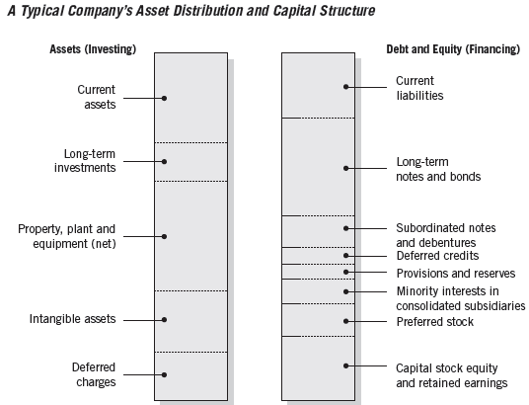
Long-term solvency risk
Capital Structure
Equity financing
  Risk capital of a company
  Uncertain and unspecified return
  Lack of any repayment pattern
  Contributes to a company’s stability and solvency
Debt financing
  Must be repaid with interest
  Specified repayment pattern
When the proportion of debt financing is higher, the higher are the resulting fixed charges and repayment commitments

Slide 55
C A P I T A L S T R U C T U R E C O M P O S I T I O N
A N D S O LV E N C Y
  A common measure of financial risk for a company is its capital structure composition.
  Composition analysis is performed by constructing a common-size statement of the liabilities and equity section of the balance sheet.
  Reveals relative magnitude of financing sources.

Slide 56
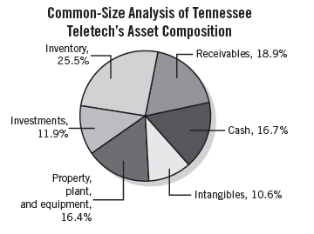
C A P I T A L S T R U C T U R E C O M P O S I T I O N
A N D S O LV E N C Y
  Asset composition in solvency analysis
  Important tool in assessing capital structure risk exposure.
  Typically evaluated using common-size statements of asset balances.

Slide 57
DEBT RATIOS
  Analysts use debt ratios to measure the amount of liabilities, particularly long-term debt, in a firm’s capital structure.
  The higher this proportion, the greater the long-term solvency risk.

Slide 58

Interest Coverage Ratios
  Interest coverage ratios indicate the number of times a firm’s income or cash flows could cover interest charges
  Standard debt ratios such as the Liabilities to Assets Ratio give no recognition to the ability of a firm to generate cash flow from operations to service debt. The ratio of cash flow from operations to average total liabilities overcomes this deficiency.

Slide 59
DEBT RATIOS (example)

Slide 60
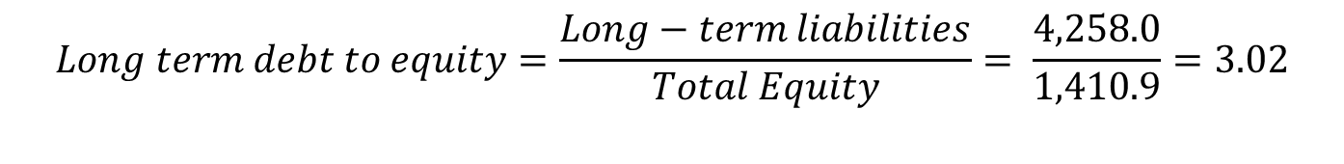
Leverage Ratios
$$Long term debt to equity=\frac{Long−term liabilities}{Total Equity}= \frac{4,258.0}{1,410.9}=3.02$$

Slide 61
Leverage Ratios

Slide 62
Credit Risk
  The Prelude:
  Know the business
  Appreciate the “moral hazard” problem of debt
  Understand the financing strategy
  Understand the current financing arrangements
  Understand the quality of the firm’s accounting
  Understand the auditor’s opinion, particularly any qualification to the opinion
  Forecasting Default with Credit Scoring
  Credit scores combine a number of indicators into one score that estimates the probability of default.
  Credit Scoring Methods:
  Multiple Discriminate Analysis (MDA)
  Logit Analysis

Slide 63
Financial Flexibility
  Ability to take steps to counter unexpected interruptions in the flow of funds.
  Ability to borrow from various sources.
  Ability to raise equity capital; to sell and redeploy assets.
  Ability to adjust the level and direction of operations in order to meet changing circumstances.
  Levels of prearranged financing and open lines of credit.

Slide 64
Just Remember
Στην κινδύνου δεν εξετάζουμε στατικά τους δείκτες μιας εταιρείας αλλά πάντα σε συνάρτηση με:
  Τους δείκτες της εταιρείας διαχρονικά
  Τους δείκτες της εταιρείας συναρτήσει ομοειδών/ ομομεγεθών επιχειρήσεων ή/και κύριων ανταγωνιστών
  Τους δείκτες της εταιρείας συναρτήσει του κλάδου/γενικότερης οικονομίας
  Συναρτήσει των εκτιμήσεων αναλυτών και των σημειώσεων των ελεγκτών

Slide 65
Δείκτες Αποδοτικότητας
Αποδοτικότητα είναι η σχέση που υπάρχει μεταξύ του κέρδους που πραγματοποιείται από την επιχείρηση και του κεφαλαίου που χρησιμοποιείται από αυτή.
Οι αριθμοδείκτες αποδοτικότητας (profitability ratios) αξιολογούν την ικανότητα της διοίκησης μίας επιχείρησης να επιτυγχάνει κέρδη με τη χρήση των κεφαλαίων που έχει στη διάθεσή της.
Οι χρηματοοικονομικοί αναλυτές μπορούν να εξετάσουν μια ποικιλία δεικτών απόδοσης για να κάνουν μια συνολική αξιολόγηση της συνολικής επιχειρησιακής αποδοτικότητας μιας εταιρείας, καθώς οι διαφορετικοί δείκτες απόδοσης επικεντρώνονται σε διαφορετικούς τομείς λειτουργίας, όπως το πόσο καλά διαχειρίζεται μια εταιρεία τα περιουσιακά στοιχεία, τις ταμειακές ροές και το απόθεμά της.

Slide 66
Δείκτες Αποδοτικότητας
Although firms must report comprehensive income, net income, or earnings, remains the key measure of profitability.
With the exception of firms in the financial industry, net income is more strongly associated with stock returns than comprehensive income.
Other comprehensive income amounts exhibit a very low level of persistence.
Thus, we focus on net income as our primary measure of profitability, with the caveat that components of other comprehensive income for certain firms should not be automatically dismissed.

Slide 67
Δείκτες Αποδοτικότητας

Slide 68
Profitability
Return on Assets
Η Απόδοση Περιουσιακών Στοιχείων (ROA) είναι ένας τύπος μέτρησης απόδοσης επένδυσης (ROI) που μετρά την κερδοφορία μιας επιχείρησης σε σχέση με το σύνολο του ενεργητικού της.
Αυτός ο λόγος δείχνει πόσο καλά αποδίδει μια εταιρεία συγκρίνοντας το κέρδος (καθαρό εισόδημα) που δημιουργεί με το κεφάλαιο που επενδύει σε περιουσιακά στοιχεία. Όσο υψηλότερη είναι η απόδοση, τόσο πιο παραγωγική και αποτελεσματική η διαχείριση των οικονομικών πόρων.

Slide 69
Profitability
Return on Assets

Slide 70
Profitability
Return on Assets

Slide 71
Profitability
Return on Assets

Slide 72
Balance Sheet

Slide 73
Income Statement

Slide 74
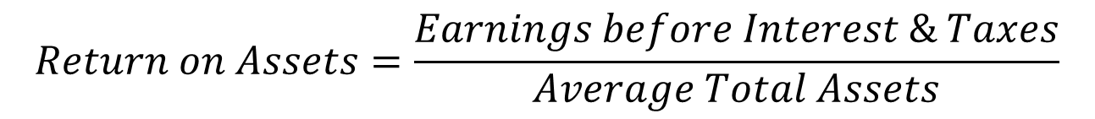
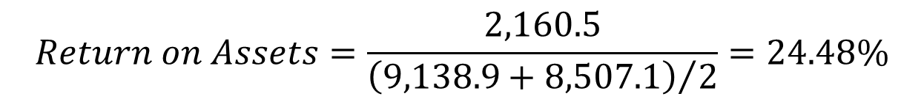
Profitability
Return on Assets
$$Return on Assets=\frac{Earnings before Interest \& Taxes}{Average Total Assets}$$
$$Return on Assets=\frac{2,160.5}{{\left(9,138.9+8,507.1\right)}/2}=24.48\%$$

Slide 75
Profitability
Return on Assets
Ο τύπος ROA είναι ένας σημαντικός δείκτης στην ανάλυση της κερδοφορίας μιας εταιρείας.
Ο δείκτης χρησιμοποιείται συνήθως κατά τη σύγκριση της απόδοσης μιας εταιρείας μεταξύ περιόδων ή κατά τη σύγκριση δύο διαφορετικών εταιρειών παρόμοιου μεγέθους στον ίδιο κλάδο σε σχέση με τον έλεγχο της πορείας της εταιρείας στον κλάδο.
Σημειώστε ότι είναι πολύ σημαντικό να λάβετε υπόψη την κλίμακα των εταιρειών και τις δραστηριότητές τους, κατά τη σύγκριση δύο διαφορετικών εταιρειών στην βάση του χρησιμοποιούν ROA.

Slide 76
Profitability
Return on Assets
Συνήθως, διαφορετικοί κλάδοι έχουν διαφορετικούς ROA.
Οι βιομηχανίες που είναι υψηλής έντασης κεφαλαίου και απαιτούν υψηλή αξία πάγιων περιουσιακών στοιχείων για λειτουργίες, θα έχουν γενικά χαμηλότερο ROA, καθώς η μεγάλη βάση περιουσιακών στοιχείων τους θα αυξήσει τον παρονομαστή του τύπου.
Φυσικά, μια εταιρεία με μεγάλη βάση περιουσιακών στοιχείων μπορεί να έχει μεγάλο ROA, εάν το εισόδημά τους είναι αρκετά υψηλό.

Slide 77
Profitability
Return on Assets
Η αύξηση του ROA ενδέχεται να οφείλεται στους εξής παράγοντες:
  Αύξηση των καθαρών κερδών μετά φόρων και σταθερό ενεργητικό.
  Μείωση του ενεργητικού και σταθερά καθαρά κέρδη μετά φόρων.
  Αύξηση των καθαρών κερδών μετά φόρων με παράλληλη μείωση του ενεργητικού.
  Αύξηση των καθαρών κερδών μετά φόρων, αναλογικά μεγαλύτερη, από την αύξηση του ενεργητικού.
  Μείωση των καθαρών κερδών μετά φόρων, αναλογικά μικρότερη, από τη μείωση του ενεργητικού.

Slide 78
Profitability
Return on Capital Employed

Slide 79
Profitability
Return on Capital Employed

Slide 80
Profitability
Return on Equity
Απόδοση ιδίων κεφαλαίων (Return on Equity - ROE) - εκφράζει το ποσοστό του καθαρού κέρδους σε σχέση με τα ίδια κεφάλαια ή το ποσοστό απόδοσης των χρημάτων που έχουν επενδύσει οι επενδυτές μετοχών στην επιχείρηση.
Ο δείκτης ROE είναι αυτός που παρακολουθείται ιδιαίτερα από αναλυτές μετοχών και επενδυτές. Ένας ευνοϊκά υψηλός δείκτης ROE αναφέρεται συχνά ως λόγος για την αγορά μετοχών μιας εταιρείας.
Οι εταιρείες με υψηλή απόδοση ιδίων κεφαλαίων είναι συνήθως πιο ικανές να παράγουν μετρητά εξ ιδίων και επομένως εξαρτώνται λιγότερο από τη χρηματοδότηση χρέους αφού τα καθαρά κέρδη έχουν προκύψει μετά την πληρωμή του κόστους του ξένου χρήματος (των υποχρεώσεων).

Slide 81
Profitability
Return on Equity

Slide 82
Balance Sheet

Slide 83
Income Statement

Slide 84
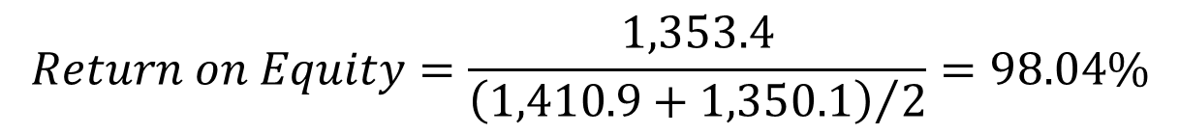
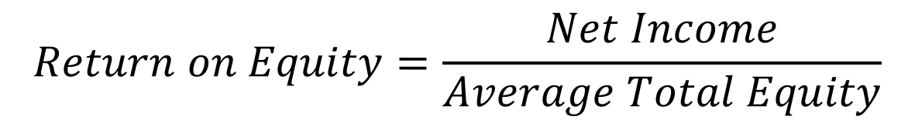
Profitability
Return on Equity
$$Return on Equity=\frac{Net Income}{Average Total Equity}$$
$$Return on Equity=\frac{1,353.4}{{\left(1,410.9+1,350.1\right)}/2}=98.04\%$$

Slide 85
Profitability
Return on Equity
Η αύξηση του ROE ενδέχεται να οφείλεται στους εξής παράγοντες:
  Αύξηση των καθαρών κερδών μετά φόρων και σταθερά ίδια κεφάλαια
  Μείωση των ιδίων κεφαλαίων και σταθερά καθαρά κέρδη μετά φόρων.
  Αύξηση των καθαρών κερδών μετά φόρων με παράλληλη μείωση των ιδίων κεφαλαίων.
  Αύξηση των καθαρών κερδών μετά φόρων, αναλογικά μεγαλύτερη, από την αύξηση των ιδίων κεφαλαίων.
  Μείωση των καθαρών κερδών μετά φόρων, αναλογικά μικρότερη, από την μείωση των ιδίων κεφαλαίων.

Slide 86
Profitability
Gross Profit Margin
Περιθώριο μικτού κέρδους - συγκρίνει το μικτό κέρδος με τα έσοδα από πωλήσεις.
Αυτό δείχνει πόσο κερδίζει μια επιχείρηση από τη βασική λειτουργία της δηλαδή την πώληση του εμπορεύματος, του προϊόντος ή της υπηρεσίας πριν από τα άλλα λειτουργικά έξοδα, λαμβάνοντας υπόψη τα απαραίτητα κόστη για την παραγωγή ή προμήθεια των αγαθών και των υπηρεσιών της.

Slide 87
Profitability
Gross Profit Margin
Ένας υψηλός μικτός δείκτης περιθωρίου κέρδους αντικατοπτρίζει την υψηλότερη αποτελεσματικότητα της βασικής λειτουργίας, που σημαίνει ότι μπορεί ακόμα να καλύψει λειτουργικά έξοδα, πάγια έξοδα, αποσβέσεις και να αποδώσει μερίσματα, ενώ παράλληλα παρέχει και καθαρά κέρδη στην επιχείρηση.
Από την άλλη πλευρά, ένα χαμηλό περιθώριο κέρδους δείχνει ένα υψηλό κόστος πωληθέντων αγαθών, το οποίο μπορεί να αποδοθεί σε αντίξοες πολιτικές αγορών, χαμηλές τιμές πώλησης, χαμηλές πωλήσεις, σκληρό ανταγωνισμό στην αγορά ή λανθασμένες πολιτικές προώθησης πωλήσεων.

Slide 88
Profitability
Gross Profit Margin
Μια υψηλή τιμή του GPM, παρέχει ενδείξεις:
  Αγοράς εμπορευμάτων με χαμηλές τιμές και πώλησης τους σε υψηλές τιμές.
  Παραγωγής έτοιμων προϊόντων με χαμηλό κόστος και πώλησης τους σε υψηλές τιμές.
  Παροχής υπηρεσιών χαμηλού κόστους σε υψηλές τιμές.
  Επενδύσεων σε περιουσιακά στοιχεία που επιτρέπουν χαμηλό κόστος πωληθέντων σε σχέση με τις πωλήσεις.
  Ικανοποιητικού περιθωρίου ασφαλείας σχετικά με την αντιμετώπιση ανεπιθύμητων εξελίξεων στο κόστος πωληθέντων και στις πωλήσεις.

Slide 89
Profitability
Gross Profit Margin
Η αύξηση του GPM ενδέχεται να οφείλεται στους εξής παράγοντες:
  Αύξηση των πωλήσεων και σταθερό κόστος πωληθέντων.
  Μείωση του κόστους πωληθέντων και σταθερές πωλήσεις.
  Αύξηση των πωλήσεων με παράλληλη μείωση του κόστους πωληθέντων.
  Αύξηση των πωλήσεων, αναλογικά μεγαλύτερη, από την αύξηση του κόστους πωληθέντων.
  Μείωση των πωλήσεων, αναλογικά μικρότερη, από την μείωση του κόστους πωληθέντων.

Slide 90
Profitability
Operating Profit Margin
Περιθώριο λειτουργικού κέρδους - εξετάζει τα κέρδη ως ποσοστό των πωλήσεων πριν αφαιρεθούν τα έξοδα τόκων και οι φόροι εισοδήματος.
Οι εταιρείες με υψηλά περιθώρια λειτουργικού κέρδους είναι γενικά σε καλύτερη θέση για πληρωμή των τόκων, έχουν καλύτερες πιθανότητες να επιβιώσουν από οικονομική ύφεση και είναι πιο ικανές να προσφέρουν χαμηλότερες τιμές από τους ανταγωνιστές τους που έχουν χαμηλότερο περιθώριο λειτουργικού κέρδους.

Slide 91
Profitability
Operating Profit Margin
Το περιθώριο λειτουργικού κέρδους χρησιμοποιείται συχνά για την εκτίμηση της δύναμης της διοίκησης μιας εταιρείας, καθώς η καλή διαχείριση μπορεί να βελτιώσει ουσιαστικά την κερδοφορία μιας εταιρείας με τη διαχείριση του λειτουργικού κόστους.

Slide 92
Profitability
Net Profit Margin
Το καθαρό περιθώριο κέρδους (επίσης γνωστό ως «περιθώριο κέρδους» ή «καθαρό ποσοστό κέρδους») είναι ένας χρηματοοικονομικός λόγος που χρησιμοποιείται για τον υπολογισμό του ποσοστού κέρδους που μια εταιρεία παράγει από τα συνολικά της έσοδα.
Μετρά το ποσό του καθαρού κέρδους που λαμβάνει μια εταιρεία ανά δολάριο των εσόδων που αποκτήθηκαν. Το καθαρό περιθώριο κέρδους ισούται με το καθαρό κέρδος (επίσης αναφερόμενο ως καθαρό εισόδημα) διαιρεμένο με τα συνολικά έσοδα, εκφραζόμενα ως ποσοστό.

Slide 93
Profitability
Net Profit Margin
Η αύξηση του NPM ενδέχεται να οφείλεται στους εξής παράγοντες:
  Αύξηση των καθαρών κερδών μετά φόρων και σταθερές πωλήσεις
  Μείωση των πωλήσεων και σταθερά καθαρά κέρδη μετά φόρων.
  Αύξηση των καθαρών κερδών μετά φόρων και μείωση των πωλήσεων.
  Αύξηση των καθαρών κερδών μετά φόρων, αναλογικά μεγαλύτερη, από την αύξηση των πωλήσεων.
  Μείωση των καθαρών κερδών μετά φόρων, αναλογικά μικρότερη, από την μείωση των πωλήσεων.

Slide 94
Income Statement

Slide 95
Profitability
Profit Margins

Slide 96
Profitability

Slide 97
Activity Ratios
Δείκτες Αποτελεσματικότητας
Οι δείκτες αποτελεσματικότητας (κυκλοφοριακής ταχύτητας) μετρούν την ικανότητα μιας επιχείρησης να χρησιμοποιεί αποδοτικά τα περιουσιακά στοιχεία και τις υποχρεώσεις της για τη δημιουργία πωλήσεων.
Ένας άκρως αποτελεσματικός οργανισμός έχει ελαχιστοποιήσει τις καθαρές επενδύσεις του σε περιουσιακά στοιχεία, και έτσι απαιτεί λιγότερα κεφάλαια και δάνεια για να παραμείνει σε λειτουργία.
Στους λογαριασμούς του Ενεργητικού, οι δείκτες αποδοτικότητας συγκρίνουν στοιχεία του κυκλοφορούντος ενεργητικού με τις πωλήσεις ή το κόστος των πωληθέντων αγαθών.
Στους λογαριασμούς των υποχρεώσεων, ο κύριος δείκτης αποδοτικότητας συγκρίνει τις πληρωμές με τις συνολικές αγορές από προμηθευτές.

Slide 98
Activity
Asset Turnover Ratio
Ο Δείκτης Κυκλοφοριακής Ταχύτητας Ενεργητικού συγκρίνει τις καθαρές πωλήσεις με τα καθαρά περιουσιακά στοιχεία ενεργητικού.
Χρησιμοποιείται για την αξιολόγηση της ικανότητας της διοίκησης να δημιουργεί πωλήσεις από την επένδυσή της στα περιουσιακά στοιχεία. Η υψηλή αναλογία δείχνει ότι μια επιχείρηση είναι ιδιαιτέρως αποτελεσματική διότι αποδίδει υψηλά έσοδα για κάθε ευρώ που έχει επενδύσει.

Slide 99
Activity
Fixed Asset Turnover Ratio
Αναλόγως του κλάδου δραστηριοποίησης των επιχειρήσεων κρίνεται ότι είναι πιο αποτελεσματικοί δείκτες σύγκρισης των πωλήσεων με τμήματα του Ενεργητικού.
Για παράδειγμα για εταιρείες υψηλής παγιοποίησης όπως είναι οι βιομηχανίες ή εταιρείες παροχής υπηρεσιών όπως ξενοδοχεία, νοσοκομεία, εκπαιδευτικά ιδρύματα, πολιτιστικά κέντρα κλ. Ιδιαίτερα χρήσιμος είναι ο δείκτης κυκλοφοριακής ταχύτητας Παγίου Ενεργητικού, όπου ως αριθμητή χρησιμοποιούμε μόνο τα πάγια (ενσώματες ακινητοποιήσεις).

Slide 100
Activity
Fixed Asset Turnover Ratios
Σε αυτή την περίπτωση ένας καλό δείκτης θα σηματοδοτούσε ενδεικτικά μία ή περισσότερες από τις πιο κάτω περιπτώσεις:
  Πραγματοποιείται αποτελεσματική δουλειά στην επίτευξη πωλήσεων με χρήση σχετικά μικρής αξίας παγίων στοιχείων.
  Ανατίθενται εργασίες σε εξωτερικούς συνεργάτες (ανάθεση φασόν) για αποφυγή επενδύσεων σε πάγια περιουσιακά στοιχεία
  Υπάρχει πώληση πλεονάζουσας παραγωγικής ικανότητας.

Slide 101
Activity
Fixed Asset Turnover Ratio
Ο χαμηλός δείκτης δείχνει ότι μια επιχείρηση:
  Επενδύει υπερβολικά σε πάγια περιουσιακά στοιχεία και παρουσιάζει αδράνεια.
  Πρέπει να παράγει νέα προϊόντα για να αυξήσει τις πωλήσεις του.
  Έχει πραγματοποιήσει μεγάλη επένδυση σε πάγια περιουσιακά στοιχεία, πολύ πριν ξεκινήσουν οι πωλήσεις από τα νέα περιουσιακά στοιχεία.
  Έχει επενδύσει σε τομείς που δεν αυξάνουν την παραγωγική ικανότητα, με αποτέλεσμα να μην υπάρχει επιπλέον απόδοση.
Η ανάλυση ενός τέτοιου δείκτη θα μπορούσε να γίνει εξειδικευμένα ανά τομείς, μηχανήματα ή προϊόντα αλλά κάτι τέτοιο απαιτεί εσωτερική πληροφόρηση.

Slide 102
Activity
Fixed Asset Turnover Ratio
Η αύξηση του δείκτη ενδέχεται να οφείλεται στους εξής παράγοντες:
  Αύξηση των πωλήσεων και σταθερό πάγιο ενεργητικό.
  Μείωση του πάγιου ενεργητικού και σταθερές πωλήσεις.
  Αύξηση των πωλήσεων με παράλληλη μείωση του πάγιου ενεργητικού.
  Αύξηση των πωλήσεων, αναλογικά μεγαλύτερη, από την αύξηση του πάγιου ενεργητικού.
  Μείωση των πωλήσεων, αναλογικά μικρότερη, από την μείωση του πάγιου ενεργητικού.

Slide 103
Activity
Current Asset Turnover Ratio
Ο δείκτης ταχύτητας κυκλοφορίας κυκλοφορούντος ενεργητικού είναι ίσος με το λόγο των πωλήσεων προς το σύνολο του κυκλοφορούντος ενεργητικού:
Δείχνει πόσες φορές κατά μέσο όρο χρησιμοποιήθηκαν τα κυκλοφοριακά στοιχεία μιας επιχείρησης κατά την διάρκεια μιας λογιστικής χρήσεως προκειμένου να πραγματοποιηθούν έσοδα από πωλήσεις.

Slide 104
Activity
Current Asset Turnover Ratio
Μια υψηλή τιμή του δείκτη παρέχει ενδείξεις:
  Εντατικής χρησιμοποίησης του κεφαλαίου κινήσεως για πραγματοποίηση εσόδων από πωλήσεις.
  Ορθής επένδυσης σε κεφάλαιο κινήσεως.
  Υψηλής ταχύτητας εισπράξεως των απαιτήσεων και ανανέωσης των αποθεμάτων.
Είναι προφανές, ότι όσο μεγαλύτερος είναι ο δείκτης τόσο καλύτερη μπορεί να χαρακτηριστεί η θέση της επιχείρησης από πλευράς διαχειρίσεως του κεφαλαίου κινήσεως.
Όμως, μια υπερβολικά υψηλή τιμή του δείκτη σημαίνει χαμηλές επενδύσεις σε κεφάλαιο κινήσεως, με άμεση συνέπεια την αδυναμία απορρόφησης ζημιών από ενδεχόμενη μείωση των πωλήσεων.

Slide 105
Activity
Current Asset Turnover Ratios
Η αύξηση του δείκτη ενδέχεται να οφείλεται στους εξής παράγοντες:
  Αύξηση των πωλήσεων και σταθερό κεφάλαιο κινήσεως.
  Μείωση του κεφαλαίου κινήσεως και σταθερές πωλήσεις.
  Αύξηση των πωλήσεων με παράλληλη μείωση του κεφαλαίου κινήσεως.
  Αύξηση των πωλήσεων, αναλογικά μεγαλύτερη, από την αύξηση του κεφαλαίου κινήσεως.
  Μείωση των πωλήσεων, αναλογικά μικρότερη, από την μείωση του κεφαλαίου κινήσεως.

Slide 106
Balance Sheet

Slide 107
Income Statement

Slide 108
Activity
Asset Turnover Ratios
$$Current Asset Turnover=\frac{12,737.7}{{\left(3,301.0+2,757.1\right)}/2}=4.2$$

Slide 109
Activity
Asset Turnover Ratios
Η ταχύτητα κυκλοφορίας του ενεργητικού μιας επιχείρησης μπορεί να αναλυθεί στις επιμέρους συνιστώσες της, σύμφωνα με την παρακάτω σχέση:
$$\frac{1}{ Asset Turnover}=\frac{1}{Fixed Asset Turnover}+\frac{1}{Current Asset Turnover}$$

Slide 110
Activity
Asset Turnover Ratios

Slide 111
Activity
Asset Turnover Ratios

Slide 112
Activity
Asset Turnover Ratios

Slide 113
Activity
Asset Turnover Ratios

Slide 114
Activity
Asset Turnover Ratios

Slide 115
Activity
Asset Turnover Ratios

Slide 116
DuPont Analysis

Slide 117
DuPont Analysis
Χωρίζοντας το ROE σε τρία μέρη, οι εταιρείες μπορούν να κατανοήσουν ευκολότερα τις αλλαγές στις αποδόσεις τους επί των ιδίων κεφαλαίων με την πάροδο του χρόνου.
Καθώς αυξάνεται το περιθώριο κέρδους, κάθε πώληση θα αποφέρει περισσότερα κέρδη, με αποτέλεσμα υψηλότερη συνολική απόδοση των ιδίων κεφαλαίων.
Καθώς ο κύκλος εργασιών αυξάνεται, μια εταιρεία θα παράγει περισσότερες πωλήσεις ανά περιουσιακό στοιχείο, με αποτέλεσμα υψηλότερη συνολική απόδοση ιδίων κεφαλαίων.
Η αυξημένη χρηματοοικονομική μόχλευση θα οδηγήσει επίσης σε αύξηση της απόδοσης των ιδίων κεφαλαίων, καθώς η χρήση αυξημένης χρηματοδότησης από τρίτους συνεπάγεται μικρότερο κόστος κεφαλαίων λόγω αποφορολόγησης των τόκων.

Slide 118
DuPont Analysis

Slide 119
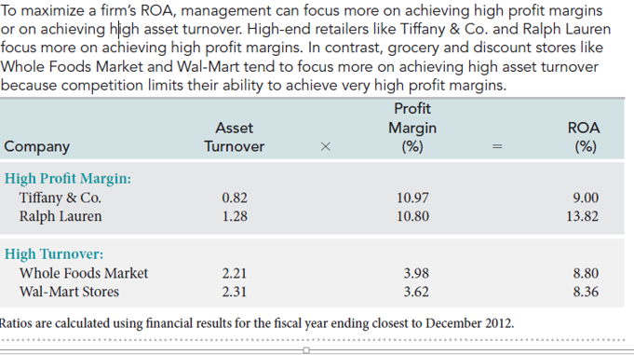
DuPont Analysis

Slide 120
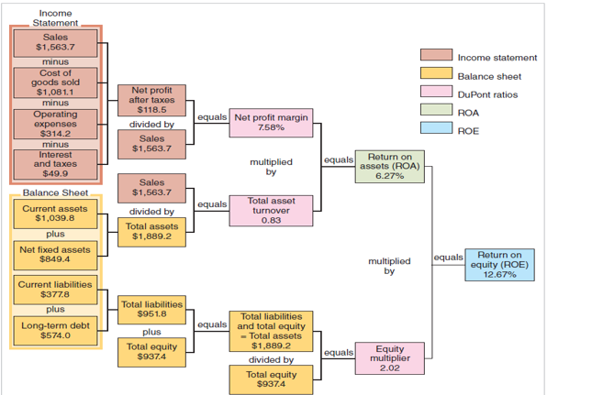
DuPont Analysis

Slide 121
Investment Ratios

Slide 122
Investment Ratios

Slide 123
Break Even Point
Νεκρό Σημείο
Η Ανάλυση Νεκρού Σημείου στα οικονομικά, στις επιχειρήσεις και στη λογιστική του κόστους αναφέρεται στο σημείο στο οποίο το συνολικό κόστος και τα συνολικά έσοδα είναι ίσα.
Χρησιμοποιείται ανάλυση νεκρού σημείου για τον προσδιορισμό του αριθμού μονάδων ή αξίας εσόδων που απαιτούνται για την κάλυψη του συνολικού κόστους (σταθερό και μεταβλητό κόστος).

Slide 124
Break Even Point
Νεκρό Σημείο

Slide 125
Break Even Point
Νεκρό Σημείο
Το σταθερό κόστος είναι κόστος που δεν αλλάζει όταν αλλάζει ο όγκος παραγωγής (π.χ. αποσβέσεις, μισθώσεις, τακτική συντήρηση μηχανημάτων, ασφάλιστρα κ.λ.π.).
Η τιμή πώλησης ανά μονάδα είναι η μεσοσταθμική τιμή πώλησης ανά μονάδα.
Μεταβλητό κόστος ανά μονάδα είναι το άμεσο κόστος που προκύπτει για τη δημιουργία μιας μονάδας (υλικό, εργασία και μεταβλητά κόστη όπως ηλεκτρική ενέργεια) με βάση τον προϋπολογισμό του όγκου παραγωγής και θεωρείται ότι είναι σταθερό ανά μονάδα.
Είναι επίσης χρήσιμο να σημειωθεί ότι η τιμή πώλησης ανά μονάδα μείον το μεταβλητό κόστος ανά μονάδα είναι το περιθώριο συνεισφοράς ανά μονάδα που καλύπτει τα σταθερά έξοδα και δημιουργεί το κέρδος. Για παράδειγμα, εάν η τιμή πώλησης ενός βιβλίου είναι 100 $ και το μεταβλητό κόστος του είναι 5 $ για την παραγωγή του βιβλίου, 95 $ είναι το περιθώριο συνεισφοράς ανά μονάδα και συμβάλλει στην αντιστάθμιση του σταθερού κόστους.

Slide 126
Break Even Point
Νεκρό Σημείο
Ο Διευθυντής Λογιστηρίου της εταιρείας A, η οποία πωλεί ποδήλατα, έχει καθορίσει ότι το σταθερό κόστος της Εταιρείας Α είναι 80.000 $.
Το μεταβλητό κόστος που σχετίζεται με την παραγωγή ενός ποδήλατου είναι 300 $ ανά μονάδα.
Το προϊόν Π πωλείται σε τιμή 500 $.

Slide 127
Break Even Point
Νεκρό Σημείο

Slide 128
ΜΕΡΟΣ ΤΩΝ ΔΙΑΦΑΝΕΙΩΝ ΠΡΟΕΡΧΕΤΑΙ ΑΠΟ

Slide 129

Copyright ©2015 Pearson Education Inc. All rights reserved.
Prepared by
Coby Harmon
University of California, Santa Barbara
Westmont College

